Slide 1
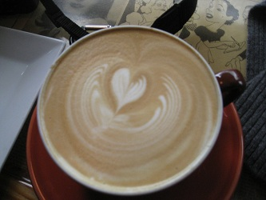
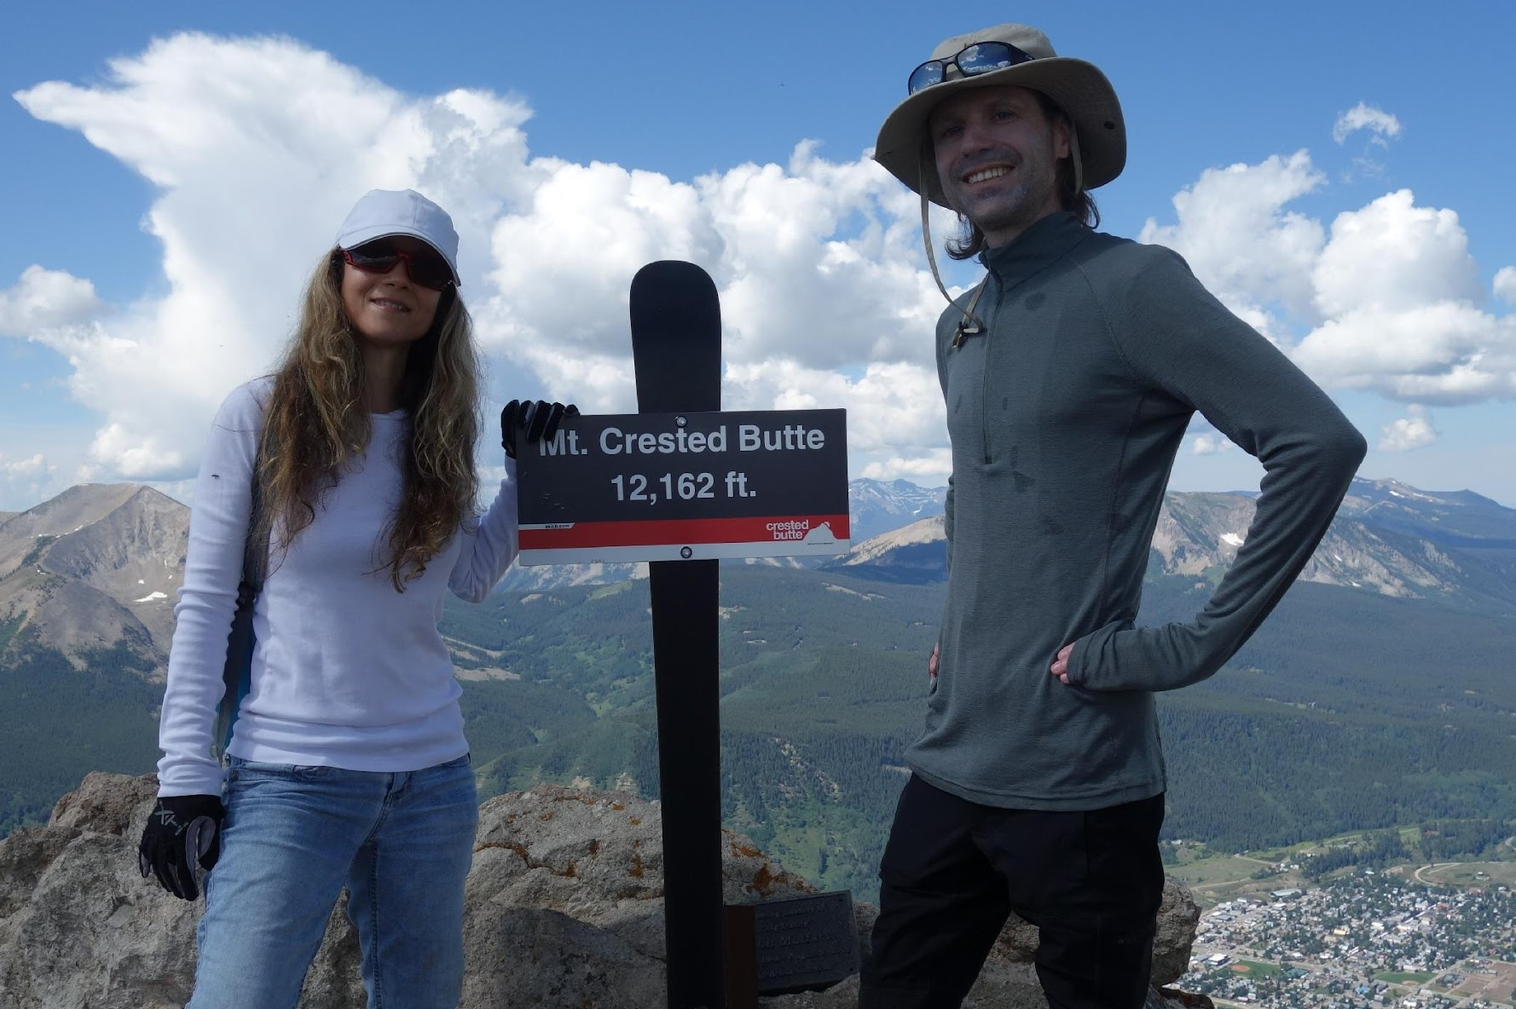
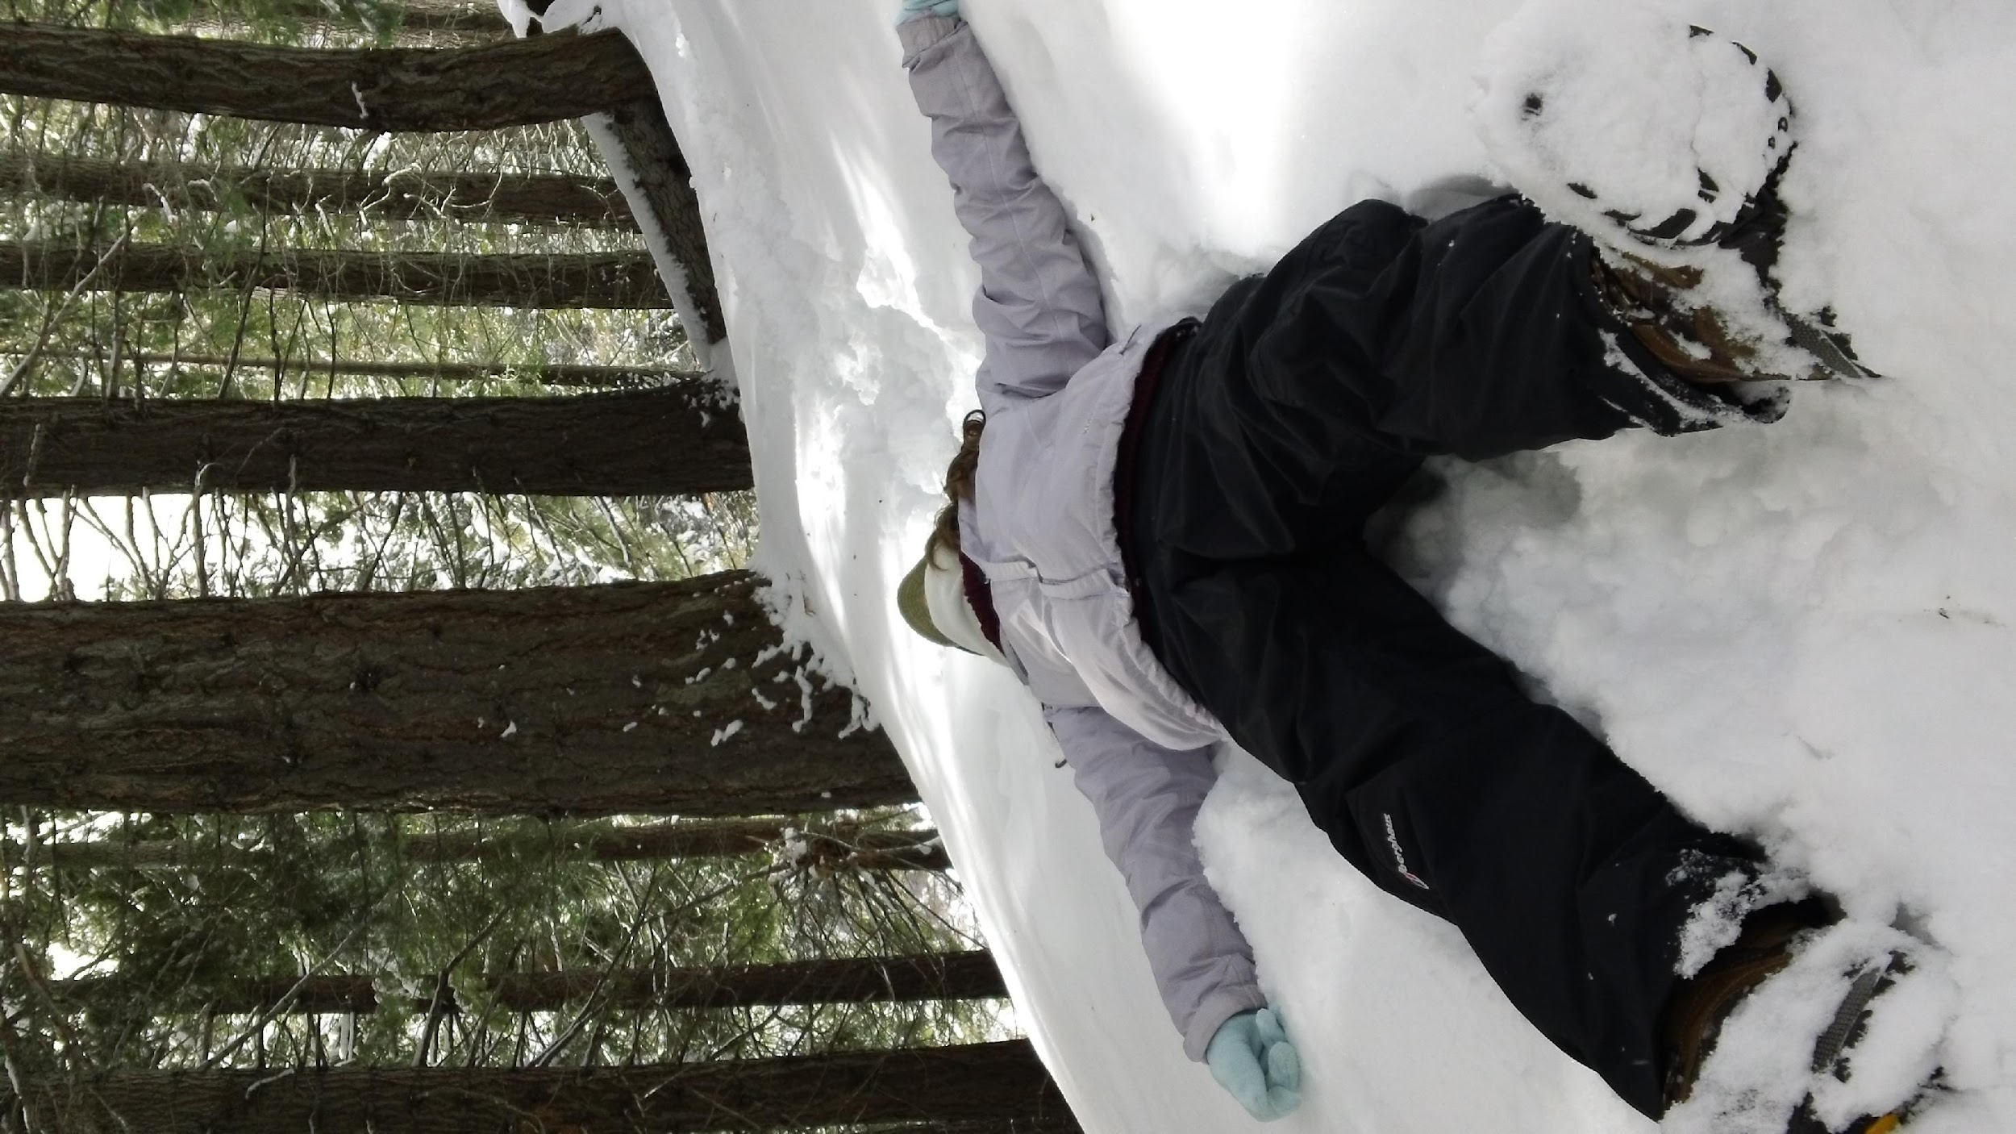
Introduction to Association Rule Mining (ARM) -and – Thinking Outside the Basket with Twitter
Dr. Ami Gates

Slide 2
Where does ARM fit in? Data Science Lifecycle
Idea or Goal
Data Gathering
APIs, Sampling, experimentation, observation, etc.
Decision-Making
Association
Rule Mining
Data Preparation
Cleaning
Formatting per model/method/goal
EDA and Vis
Normalization/Transformation
Sampling
Conclusions/
Communication/ Vis
Analytics and Vis
ML: Unsupervised/discovery
ML: Supervised/classification/modeling
Evaluation/Results/ Vis

Slide 3
Dr. Gates Talks on ARM
Talk 1: Association Rule Mining on Tweets in R
https://www.youtube.com/watch?v=eOOhn9CX2qU
Talk 2: Association Rule Mining on Twitter and Building Network Visualizations in R
https://www.youtube.com/watch?v=AIK_FRzyUEE

Slide 4
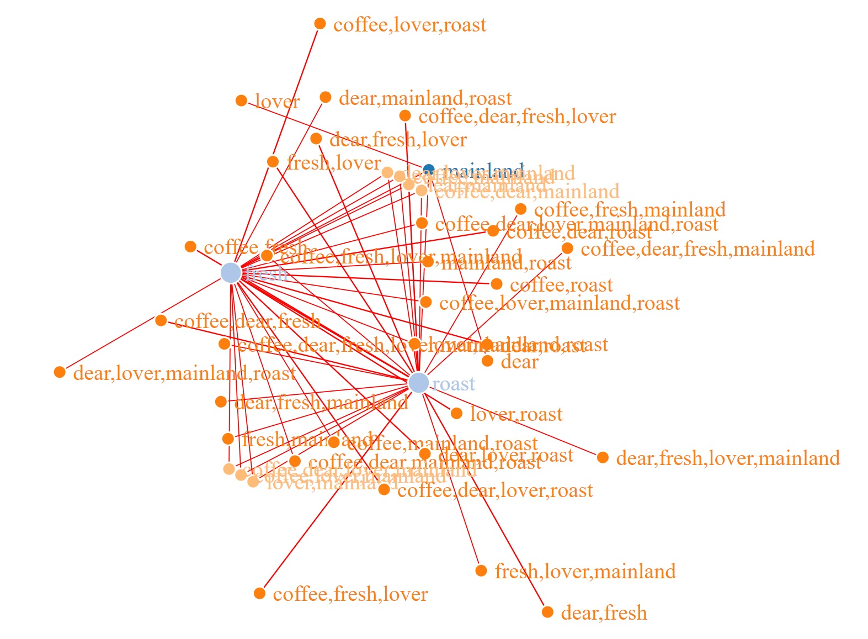
What is Association Rule Mining (ARM)
Unsupervised Learning – no labels – discovery
Evaluates “transactions” for correlations/associations.
Most common example:
Market Basket (Kumar, 2008)
Many applications, including….
- Image identification
- Text Analytics: like Twitter data
- Click streams
- Bio data – binding sites, AA’s in proteins

Slide 5
Thinking About ARM (with Tweets and Coffee)
#coffee
Tweet 1:
The coffee festival was delicious. Loved it. Coffee good.
Tweet 2:
Coffee is good with soymilk. Go to the Festival.
Tweet 3:
The coffee festival had soymilk, almond, and coconut creamers. Delicious! Go!

Slide 6
Convert to Transaction Data
Each Tweet is now a “transaction” made up of words
coffee | festival | delicious | love | good
coffee | good | soymilk | go | festival
coffee | festival | soymilk | almond | coconut | creamer | delicious | go
Where else can we find associations?
Reviews – patient, purchase, people, movie, book, etc.
Documents – speeches, novels
Articles – journal papers, news
Social Posts – Twitter, FB, etc.
Click Streams
Applications and Visual Options
Networks – how are things related?
Sentiment
Topic Modeling
Purchase preferences
Product placement/suggestion

Slide 7
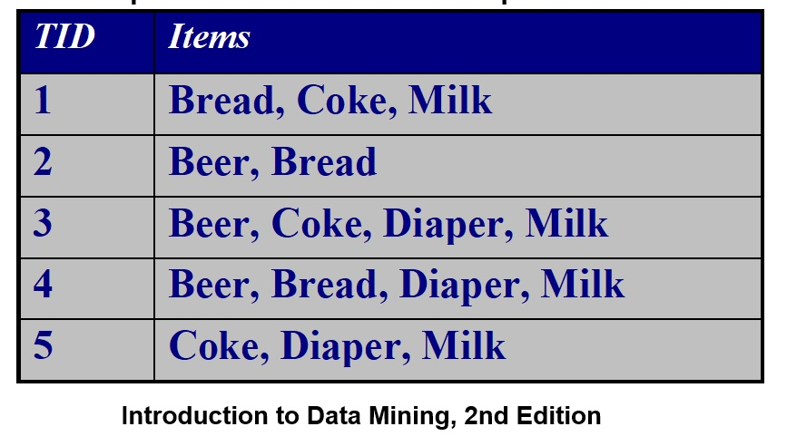
Example 1 The Rules
{Diapers} 🡪 {Beer}
{Milk, Bread} 🡪 {Coke}
{Milk, Bread} 🡪 {Coke, Diaper}
{Diapers} 🡪 {Beer, Bread}
** Association (like correlation) is a measure of co- occurrence NOT causality.

Slide 8
The Market Basket Example
The following few slides will cover the most classic example of ARM.
You can find this is Kumar’s Data Mining book.

Slide 9
The Measures: Support, Confidence, Lift
Let A and B be sets and assume rule A 🡪 B
(Remember, A and B are sets of zero or more items/words)
Support:
Sup(A, B) = P(A, B)
[How often items in A and items in B occur together relative to all transactions.]
(Count of A and B together) / (Total # Trans)
2) Confidence:
Conf(A, B) = P(B|A) = P(A,B)/ P(A)
[How often items in A and items in B occur together – relative to transactions that contain A]
(Count of A and B together) / (Count of A)

Slide 10
Lift
For Rules A 🡪 B
Lift (A, B) = P(A, B) / P(A)P(B) = P(A | B) / P(A)
What is true if Lift(A,B) = 1?
What is true if Lift (A,B) < 1?
What is true if Lift (A,B) > 1?

Slide 11
Lift
For Rules A 🡪 B
Lift (A, B) = P(A, B) / P(A)P(B)
What is true if Lift(A,B) = 1? A and B are independent!
What is true if Lift (A,B) < 1?
What is true if Lift (A,B) > 1?

Slide 12
Lift
For Rules A 🡪 B
Lift (A, B) = P(A, B) / P(A)P(B)
= P(A | B) P(B) / P(A) P(B)
= P(A | B) / P(A)
What is true if Lift(A,B) = 1? A and B are independent
What is true if Lift (A,B) < 1? A and B are negatively correlated
What is true if Lift (A,B) > 1?

Slide 13
Lift
For Rules A 🡪 B
Lift (A, B) = P(A, B) / P(A)P(B)
= P(A | B) P(B) / P(A) P(B)
= P(A | B) / P(A)
What is true if Lift(A,B) = 1? A and B are independent
What is true if Lift (A,B) < 1? A and B are negatively correlated
What is true if Lift (A,B) > 1? A and B are positively correlated
We will consider only the rules with Lift > 1 because we are looking for associations.

Slide 14
Quick Measure Examples
Given: {Diaper}🡪 {Beer}
Sup({Diaper}, {Beer}) = 2/5 = .40 = 40%
Conf({Diaper}, {Beer})
= P ({Diaper}, {Beer}) / P({Diaper})
= (2/5) / (3/5) = 66.7%
Lift ({Diaper}, {Beer}) = Sup({Diaper}, {Beer}) / P({Diaper}) * P({Beer}) = (2/5) / (3/5)* (3/5) = 1.11

Slide 15
Quick Reminder: The apriori algorithm
Based on frequency of itemsets

Slide 16
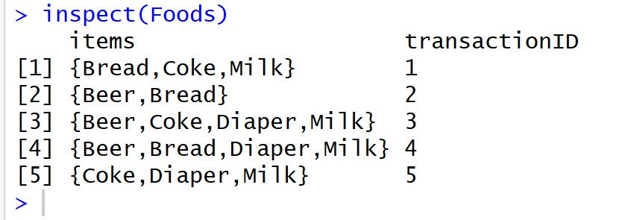
Other Ways to Represent Transaction Data
1 | Bread
1 | Coke
1 | Milk
2 | Beer
2 | Bread
3 | Beer
3 | Coke
3 | Diaper
3 | Milk
4 | Beer
4 | Bread
4 | Diaper
4 | Milk
5 | Coke
5 | Diaper
5 | Milk
TID Bread Coke Milk Beer Diaper
1 1 1 1 0 0
2 1 0 0 1 0
3 0 1 1 1 1
4 1 0 1 1 1
5 0 1 1 0 1

Slide 17
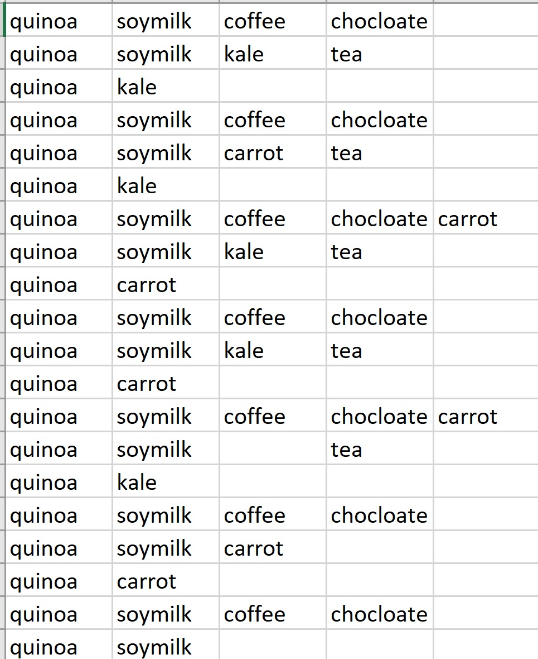
Transaction Data
Notice: It is not necessary to have a numbered transaction ID

Slide 18
Basic ARM R Code

Slide 20
Read Two Common Formats
Foods <- read.transactions("KumarGroceriesTransData.csv",
rm.duplicates = FALSE,
format = "single", ##or basket
sep=",",
skip=0,
cols=c(1,2) ## for single, 1 ID col , 2 is item
## default is NULL for basket. Null means no IDs
)
arules::inspect(Foods)
Foods2 <- read.transactions("KumarGroceriesTransData_ASTRANS.csv",
rm.duplicates = FALSE,
format = "basket",
sep=",",
cols=1 ##ID in col 1 if no ID then cols=NULL
)
arules::inspect(Foods2)

Slide 21
Thinking Outside the Basket Twitter Data
Will need to create a “document of transactions” – one for each Tweet.
** Each row is a Tweet.
Each column is a word (token) in that Tweet.
Order does not matter.
No duplicates

Slide 22
R Association Rules and Twitter: libraries
library(arules)
library(rtweet)
library(twitteR)
library(ROAuth)
library(jsonlite)
#library(streamR)
library(rjson)
library(tokenizers)
library(tidyverse)
library(plyr)
library(dplyr)
library(ggplot2)
#install.packages("syuzhet")
## sentiment analysis
library(syuzhet)
library(stringr)
library(arulesViz) ## load last
## Trouble with arulesViz?
## FIRST - you MUST register and log into github
## install_github("mhahsler/arulesViz")
## RE: https://github.com/mhahsler/arulesViz
## Trouble with arules not working suddenly
## detach("package:arules", unload=TRUE)
## library("arules")

Slide 23
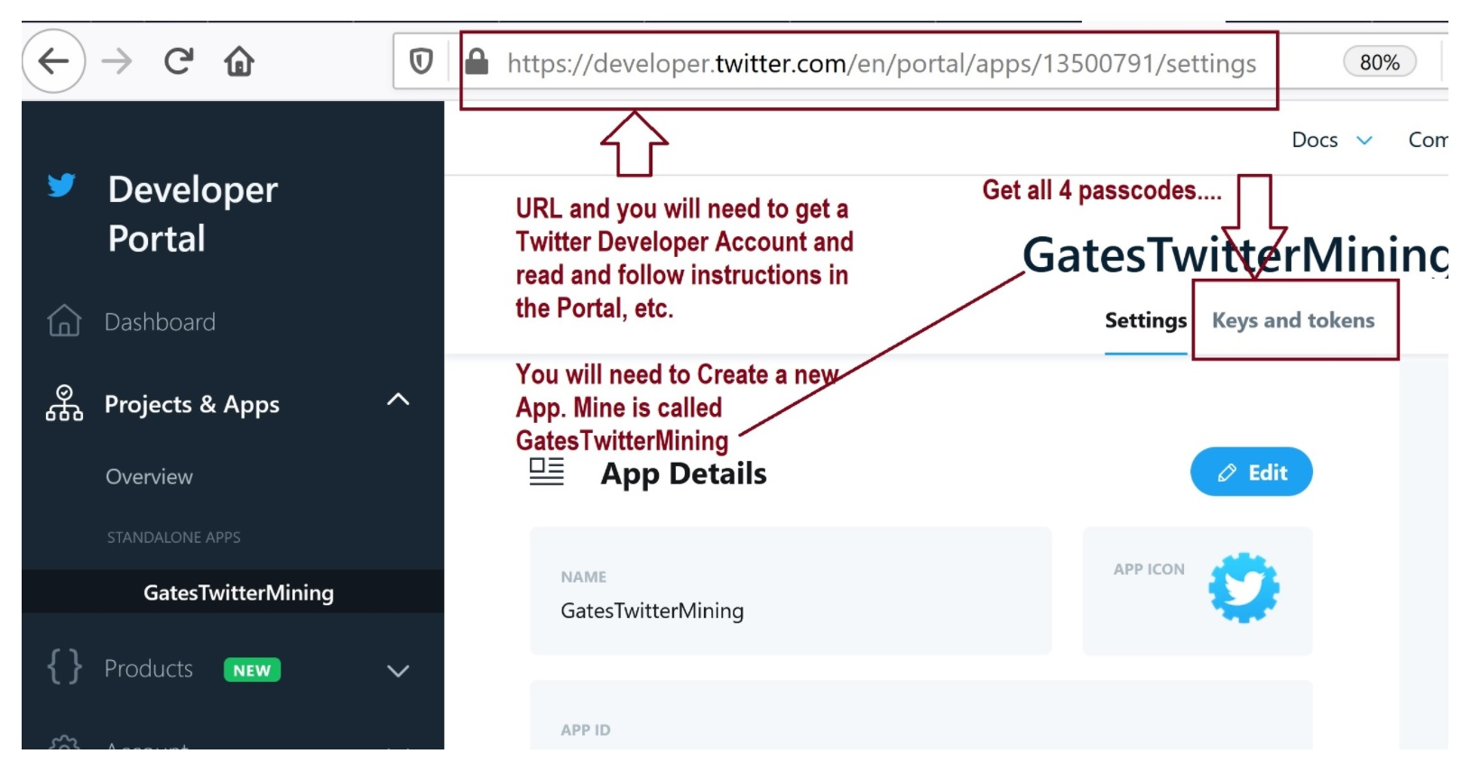
Set Up Twitter Dev Account First
https://developer.twitter.com/en/portal/apps

Slide 24
R Twitter Options

Slide 25
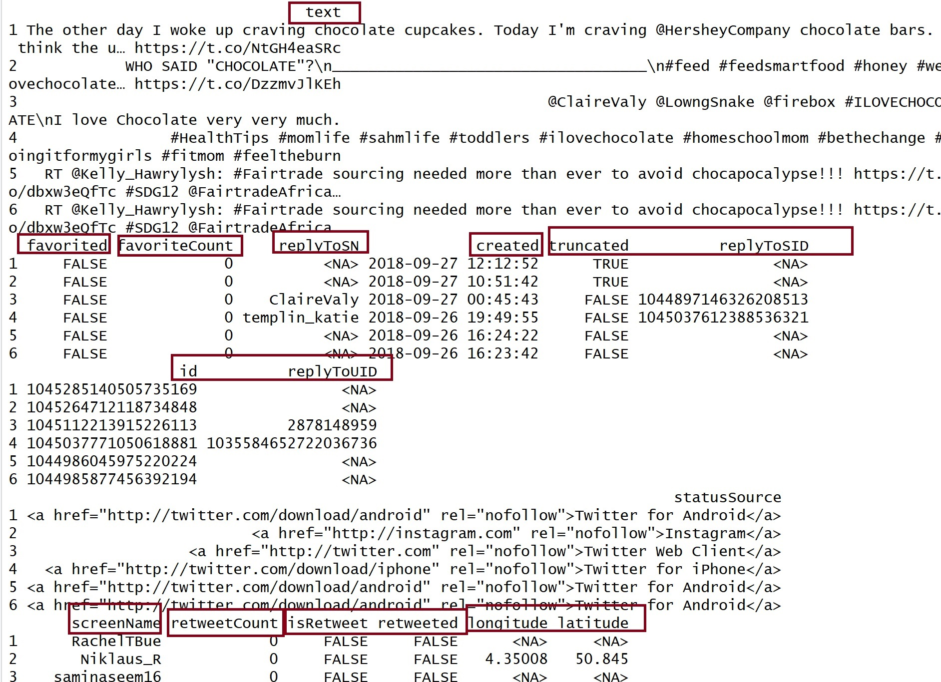
(Search_DF <- twListToDF(Search))

Slide 26
Build the Transaction File: Step 1
Each tweet should be one transaction.
Each word (token) in the tweet should be in its own column.

Slide 27
Build The Transaction File: Step 2

Slide 28
Transaction File: Each Row is a Tweet (Opened with Excel)

Slide 29
Read and Inspect the Transactions

Slide 30
Transaction Sets and Summary

Slide 31
Clean Up

Slide 32
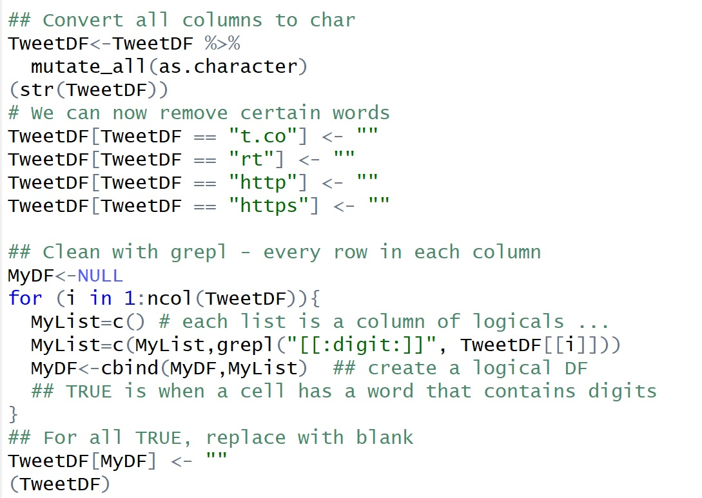
Specifically Remove Words

Slide 34
Our Transactions

Slide 35
Association Rule Mining
Example cleaner tweets as individual transactions.

Slide 37
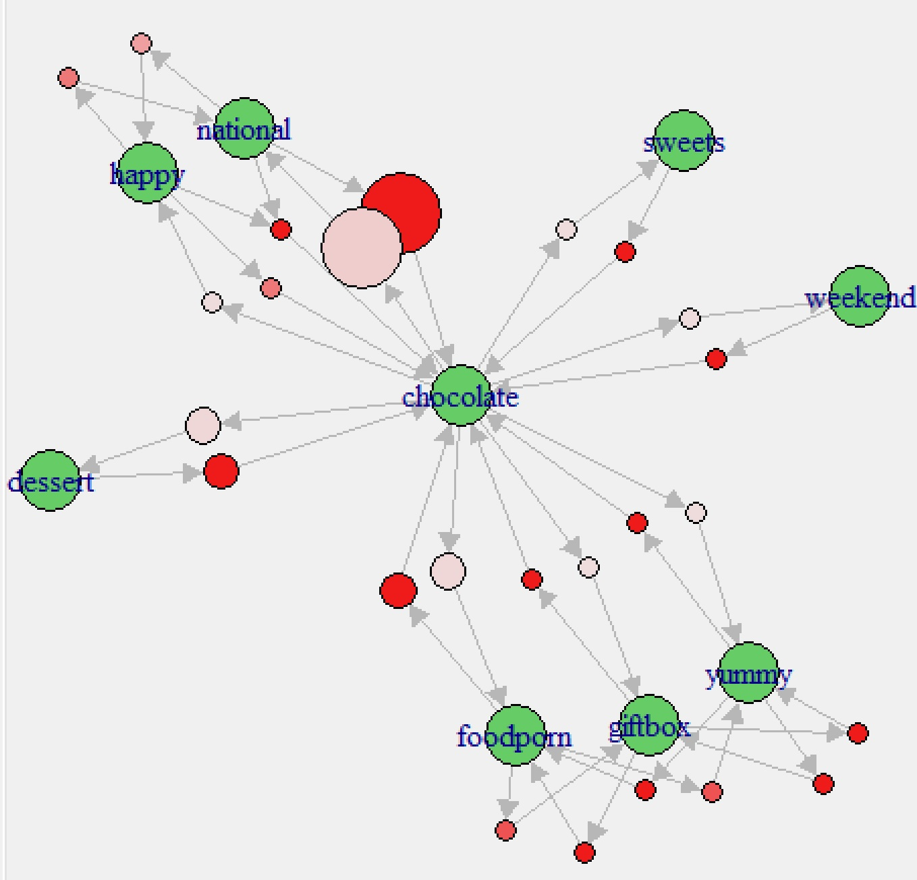
A Quick Plot
Size: support
Color (dark=higher): conf

