Slide 1
Using NetworkD3 and R to Visualize and Explore Relationships in Data
Dr. Ami Gates, Director Analytics
Georgetown University
NOTE: These slides were part of a conference talk I gave in 2019 while I was the Director of Data Science at Georgetown.

Slide 2
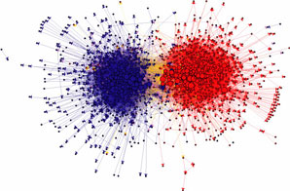
Political Blogs Community Structure
Conservative
Liberal
Image source: Adamic & Glance, 2005
conservative to conservative
conservative to conservative
liberal to liberal
liberal to liberal
between conservative & liberal
between conservative & liberal
Notes:
Discuss what a random network would look like in comparison
- For this network, the cumulative distribution of the incoming links fits a power law, not a normal distribution
- 91% of links originating within either the conservative or liberal communities stays within the community.
84% of conservative blogs link o at least one other blog
82% of conservative blogs receive a link
liberal – 74 and 67%
Conservative blogs have a higher tendency to link to each other.

Slide 3
Networks/Graphs
Simple abstractions.
Model problems involving relationships.
Applications:
Connections/relationships between individuals, groups, organizations, and societies.
Networks are mathematical graphs, with vertices (nodes) and edges (links).

Slide 4
What is a network?
“Network” ≡ “Graph”
Networks are collections of points joined by lines.
node
points | lines
vertices | edges, arcs | math
nodes | links, edges | computer science, biology
sites | bonds | physics
actors | ties, relations | sociology
edge

Slide 5
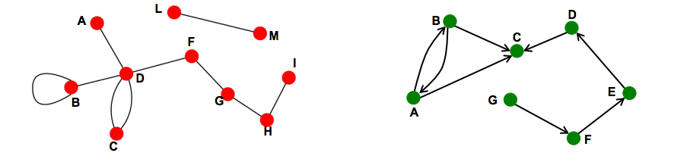
Network (Graph) Types
Undirected
symmetric, reciprocal relationship
Directed
asymmetric, non-reciprocal relationship
Images: Jure Leskovec
Notes:
Undirected:
collaboration, friendship
Directed:
email, phone calls, Twitter, webpages

Slide 6
Adjacency Matrices and Graphs
9
3
6
0 0 2 0 0 0 0 0 0 0 0 0 1 0 0 0 0 2 0 0
0 1 0 4 0 0 0 0 0 0
0 0 0 0 3 0 0 0 0 0
0 0 0 0 0 0 6 0 4 0
0 0 0 0 3 0 0 4 0 0
0 0 0 0 0 0 0 0 0 5
0 0 0 0 0 0 5 0 0 0
3 0 0 0 0 3 0 0 0 0
0 0 0 0 0 0 0 0 0 0
4
3
2
4
8
2
3
5
7
1
5
1
1
6
5
2
3
10
3
4
4
Here, node 1 has a link to node 3 with a value of 2. Node 3 is connected to node 2 with a value of 1.
So, in the matrix, row 1 column 3 has a value of 2 and row 3 column 2 has a value of 1.

Slide 7
R Network Options
igraph
http://www.kateto.net/wp-content/uploads/2015/06/Polnet%202015%20Network%20Viz%20Tutorial%20-%20Ognyanova.pdf
ggnet2
https://briatte.github.io/ggnet/
visNetwork (and visPhysics)
https://www.r-bloggers.com/interactive-network-visualization-with-r/
https://rdrr.io/cran/visNetwork/man/visPhysics.html
https://cran.r-project.org/web/packages/visNetwork/vignettes/Introduction-to-visNetwork.html
Netbiov (for bio and medical data)
https://bioconductor.org/packages/devel/bioc/vignettes/netbiov/inst/doc/netbiov-intro.pdf
Mully
https://www.ncbi.nlm.nih.gov/pmc/articles/PMC6267209/
NetworkD3
https://www.rdocumentation.org/packages/networkD3/versions/0.4
http://christophergandrud.github.io/networkD3/

Slide 8
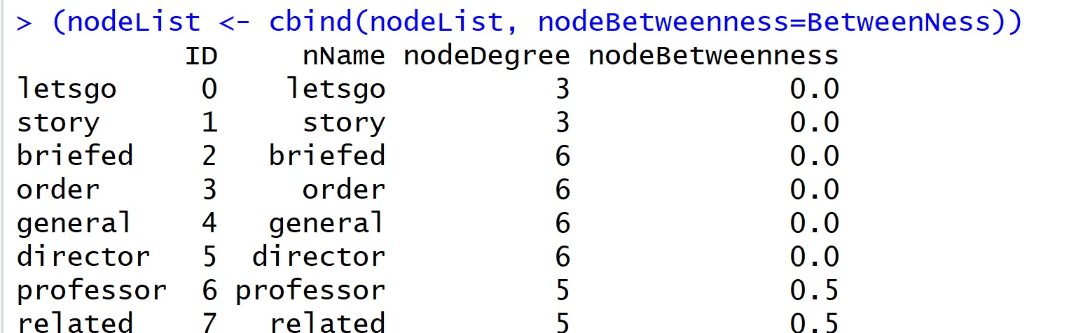
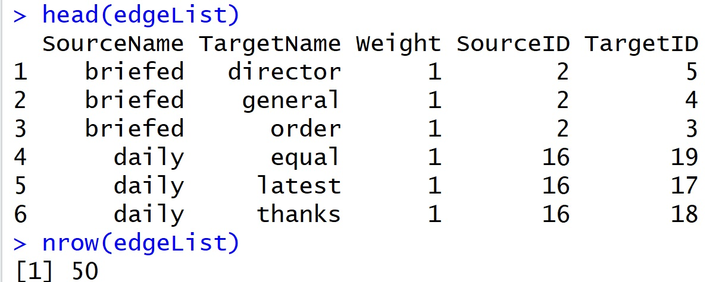
Format Matters:
Node and Edge DataFrames

Slide 9
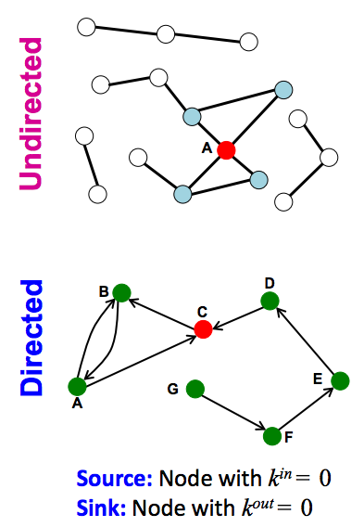
Node Degree:
The number of neighbors an individual node has.
Degree of A = 4
Images: Jure Leskovec
Notes:
Degree:
A = 4
C = In: 2 Out: 1
Discuss Sinks and Sources
No sinks
G is source

Slide 10
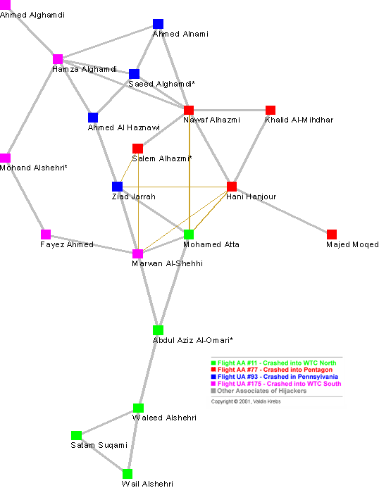
Global Network Properties: Diameter
The diameter is the
max(all shortest paths in the graph)
A shortest path from node i to node j is the least number of edges required to
get from i to j.
There are never loops or cycles in shortest paths.
Notes:
- High level discussion of diameter, density, distributions of degree, etc.

Slide 11
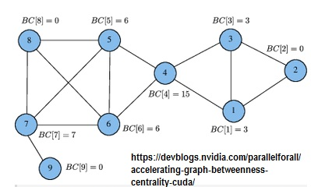
Betweenness for each node

Slide 12
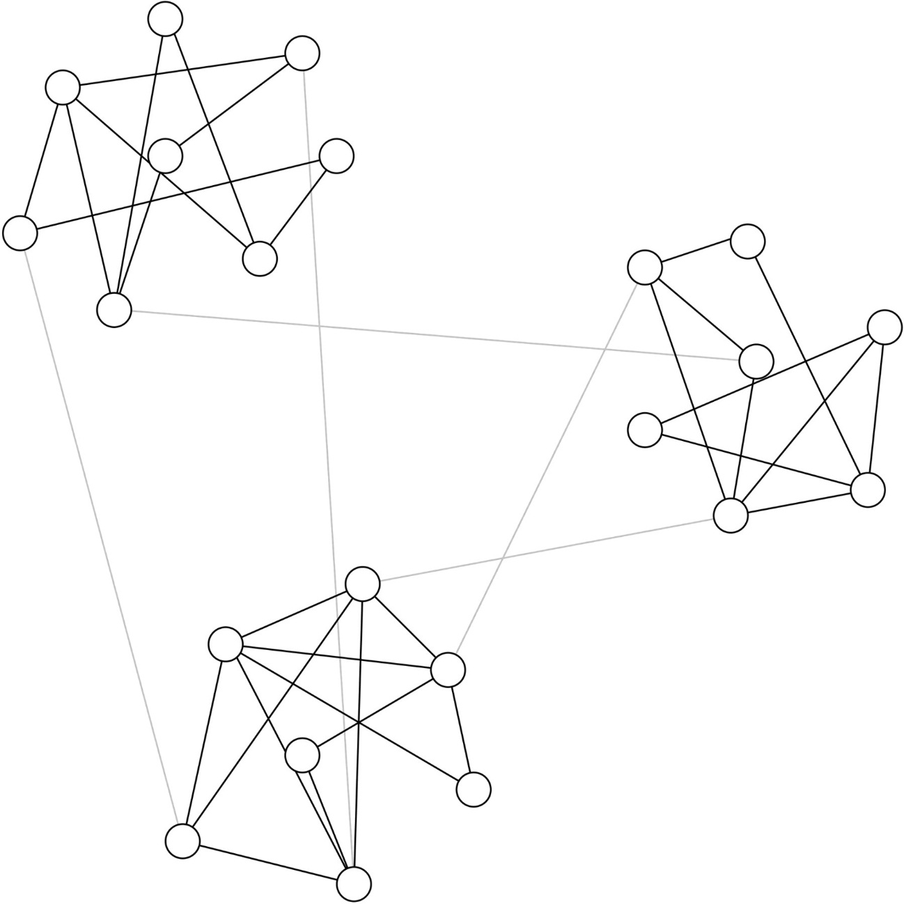
Network Communities
Image Source: M. Girvan, and M. E. J. Newman PNAS 2002;99:7821-7826
Notes:
- Look at properties
- Remind everyone what node betweeness is

Slide 13
Goals of Studying Networks
  Characterize structure
    How robust is the network?
    How quickly does/can information (or other) spread?
  Understand the behavior
    Societies
    Systems
    Changes in conditions?
    How does information, behavior, disease transmit through the network?
  Prediction of behavior and spread/transmission

Slide 14
Terrorist Network
V. Krebs. Uncloaking terrorist networks. First Monday. 7(4). April 1, 2002.

Slide 15
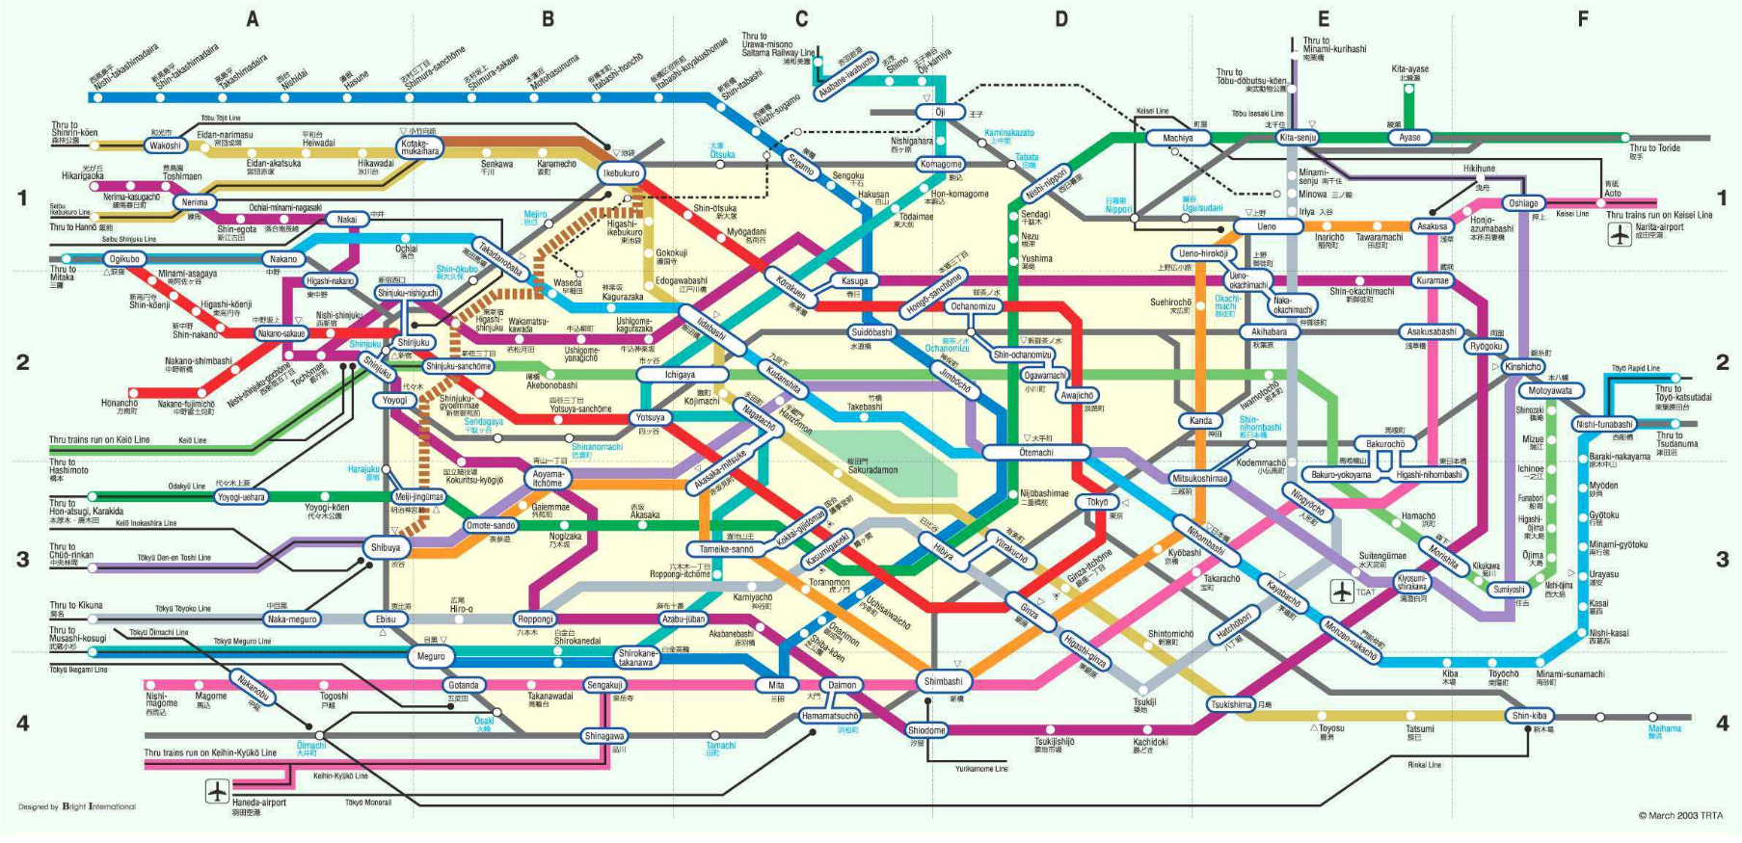
Tokyo Railway Network
Source: TRTA, March 2003 - Tokyo rail map
Notes:
Transportation networks give us insight into populations movements. Where do people live? Where do people work? Where do people visit?
As new lines are added, it shows the movement of populations to new areas. Or the building of an important new entity, e.g. airport.

Slide 16
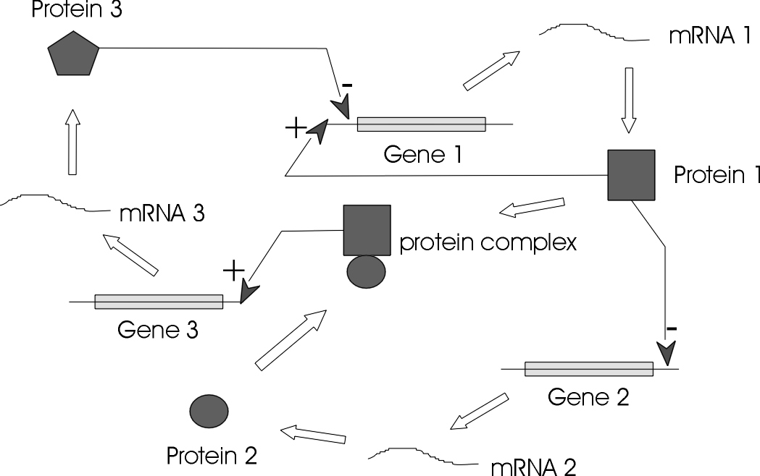
Gene Regulatory Network
Source: http://www.zaik.uni-koeln.de/bioinformatik/regulatorynets.html.en
Notes:
humans have only 30,000 genes, 98% shared with chimps
the complexity is in the interaction of genes
can we predict what result of the inhibition of one gene will be?
Gene regulatory networks represent how genes code for proteins that allow for necessary functions of development or responding to environment.
Yeast example: in yeast, which is a single-celled organism, a gene regulatory network helps it respond to its environment when the yeast cell find itself in sugar water. A gene gets turned on (ie expressed) to produce an enzyme which can process the sugar into alcohol.

Slide 17
NetworkD3 and Twitter in R
HOW TO

Slide 18
Set Up the Environment
library(networkD3)
library(arules)
library(twitteR)
library(ROAuth)
library(jsonlite)
library(rjson)
library(tokenizers)
library(tidyverse)
library(plyr)
library(dplyr)
library(ggplot2)
#install.packages("syuzhet")
## for sentiment analysis
library(syuzhet)
library(stringr)
library(arulesViz)
library(igraph)
filename="TwitterConKey_ConSec_AccTok_AccSec.txt"
tokens<-read.csv(filename, header=TRUE, sep=",")
consumerKey=as.character(tokens$consumerKey)
consumerSecret=as.character(tokens$consumerSecret)
access_Token=as.character(tokens$access_Token)
access_Secret=as.character(tokens$access_Secret)
requestURL='https://api.twitter.com/oauth/request_token'
accessURL='https://api.twitter.com/oauth/access_token'
authURL='https://api.twitter.com/oauth/authorize'

Slide 19
Connect to Twitter and Gather Tweets
##Connect to Twitter (You must have a Twitter Dev Account and the access tokens)
setup_twitter_oauth(consumerKey,consumerSecret,access_Token,access_Secret)
## Use any hashtag and gather n Tweets
Search<-twitteR::searchTwitter("#equality",n=100, since="2019-09-09")
## Convert to a Dataframe
(Search_DF <- twListToDF(Search))
## Look at the TEXT of Tweet 1
(Search_DF$text[1])
## Create a new file for output and cleaned data
TransactionTweetsFile = "TweetResults.csv"

Slide 20
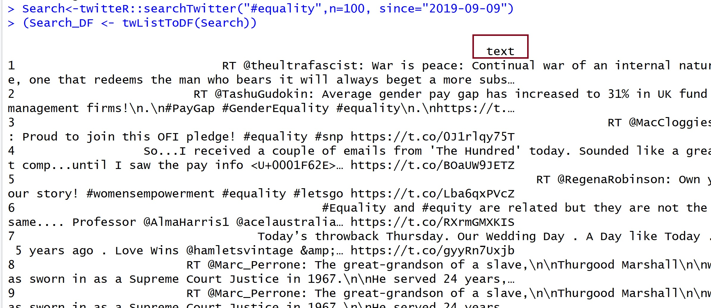
A Look at Some Output

Slide 21
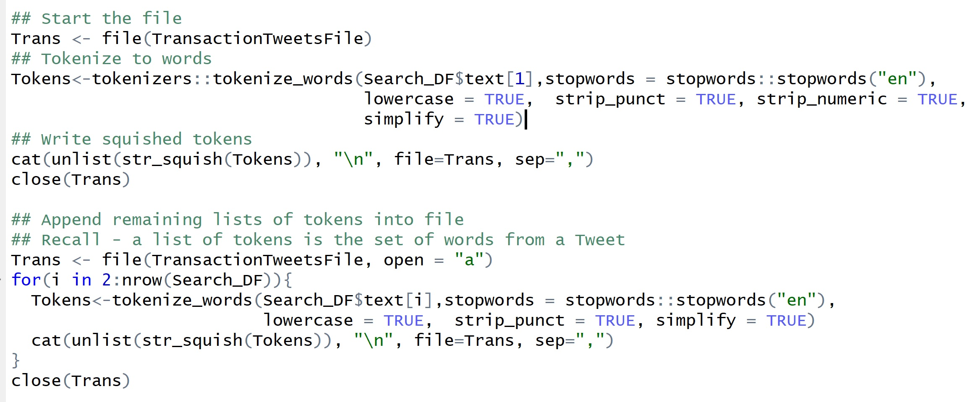
Build a Transaction Files of Tweets

Slide 22
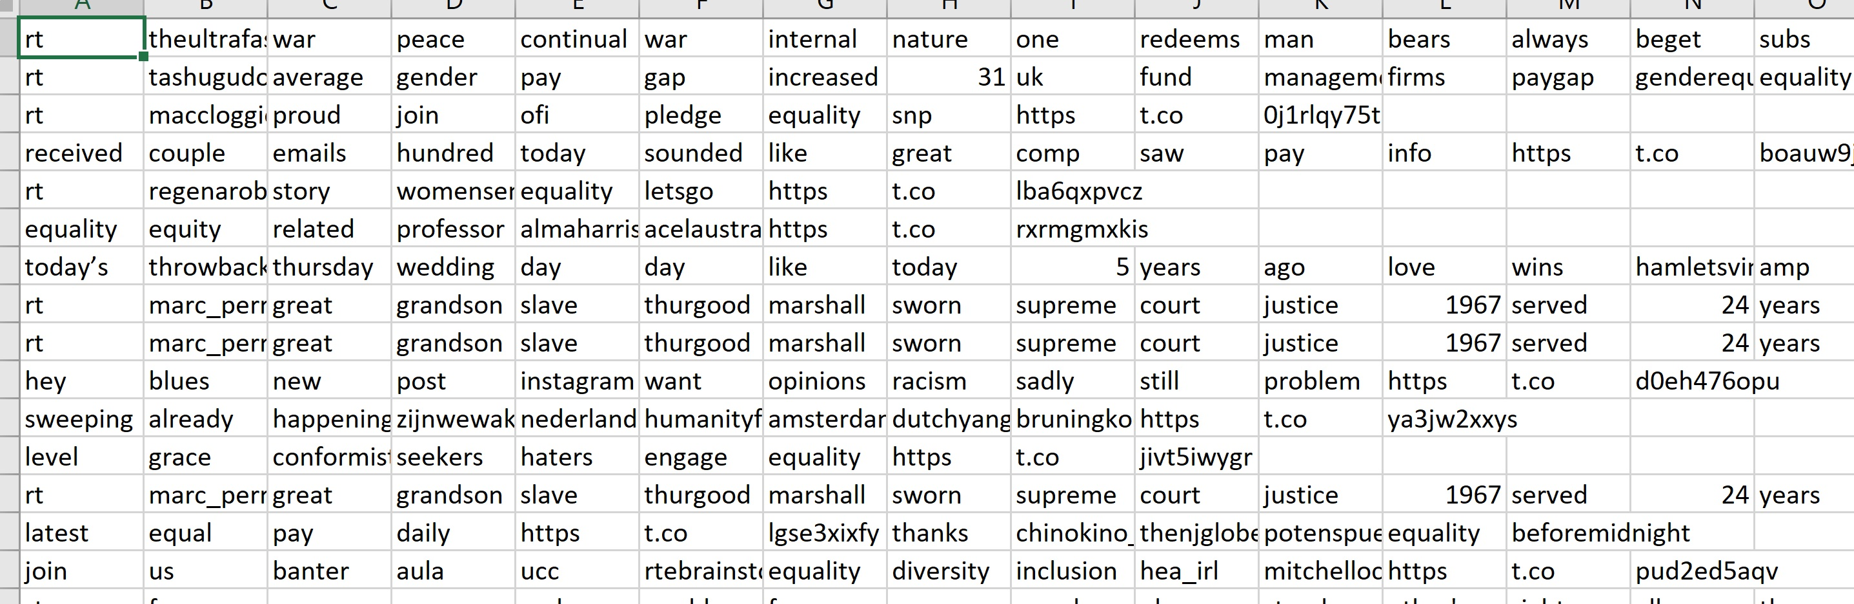
A Look at the Transaction File of Tweets

Slide 23
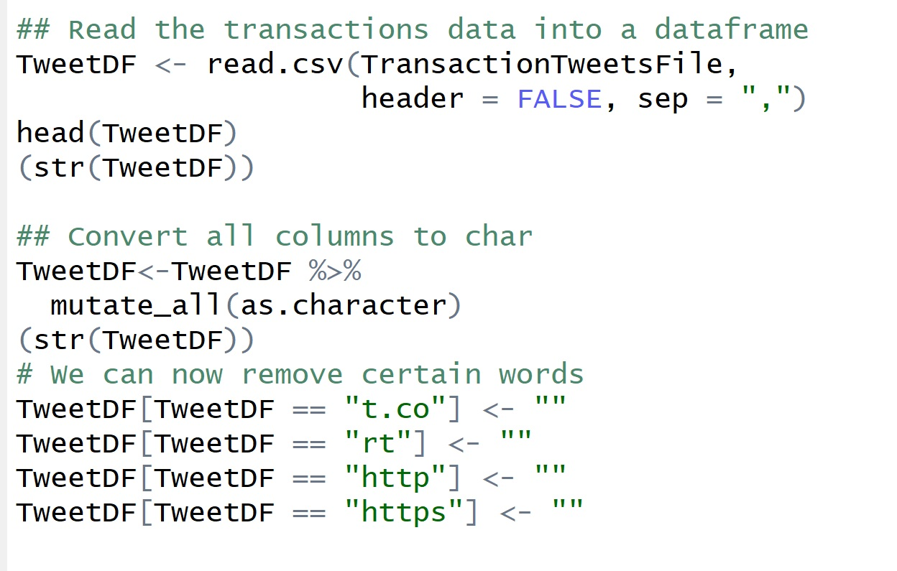
Cleaning Part 1

Slide 24
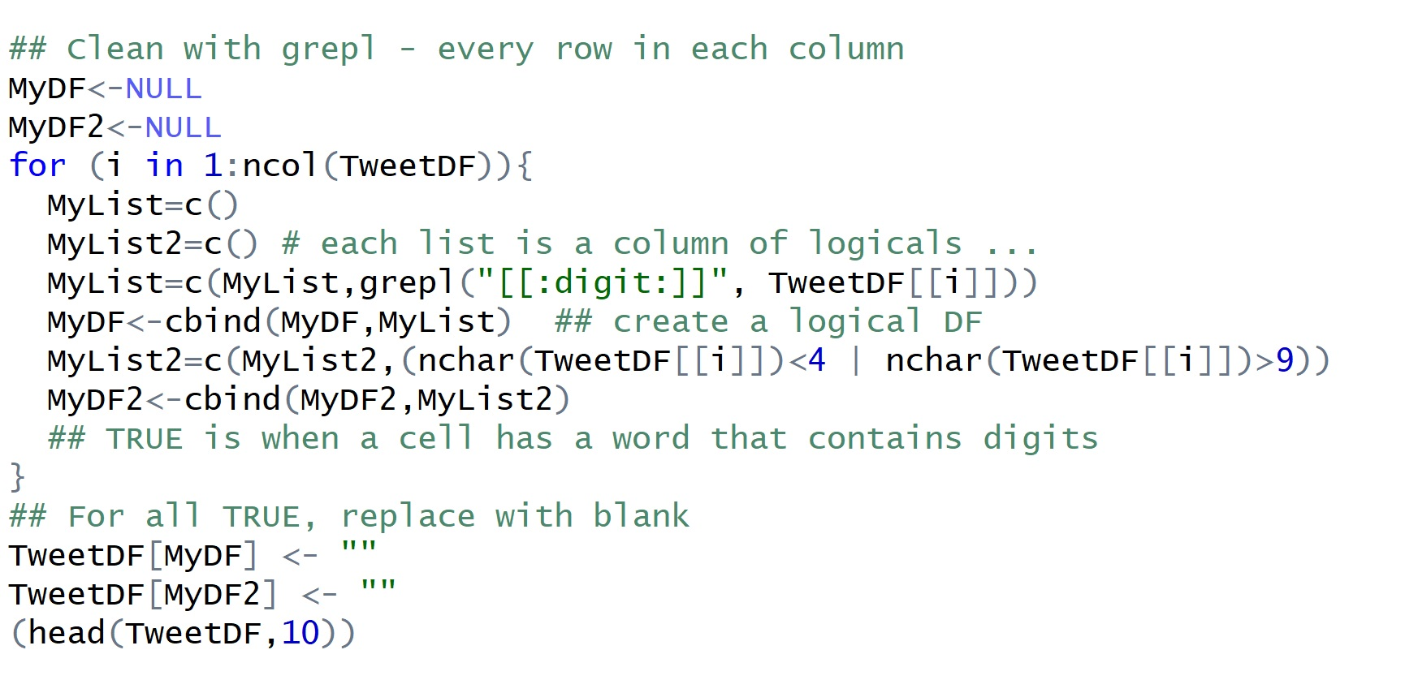
Cleaning Part 2

Slide 25
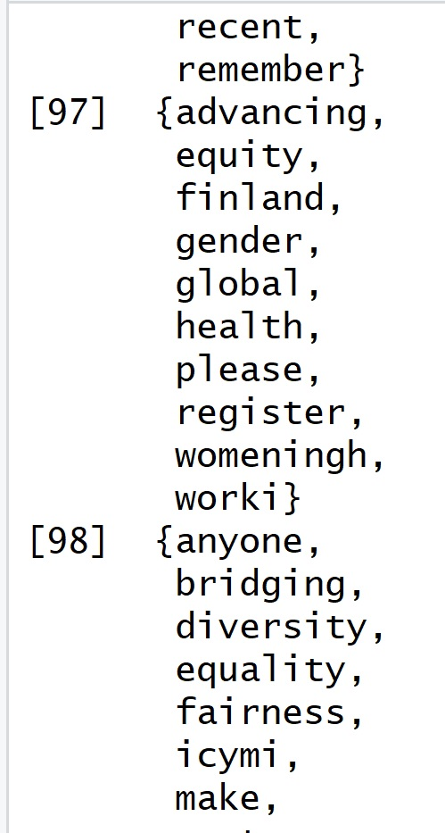
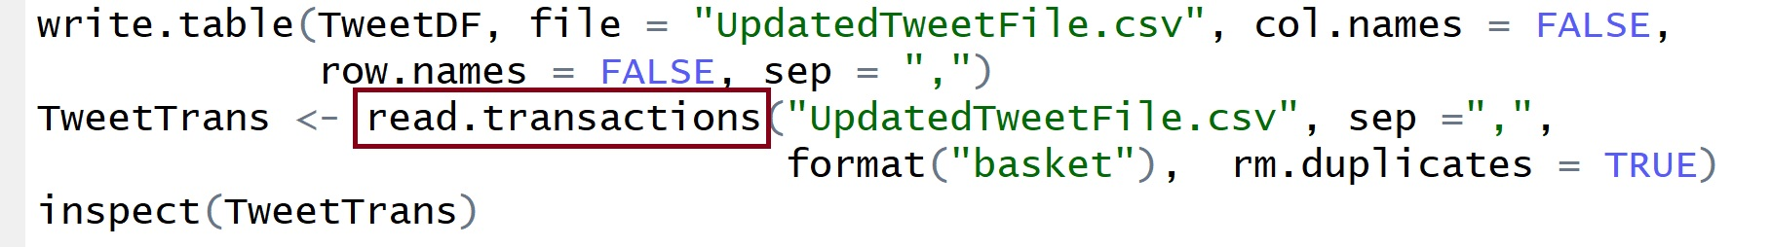
Write Clean Data Back to File –
Then Read it in as Transaction Data

Slide 26
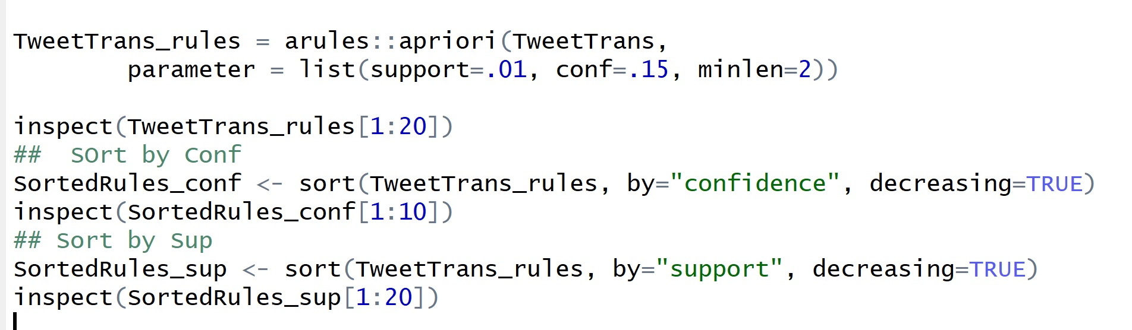
Apriori and the Rules

Slide 27
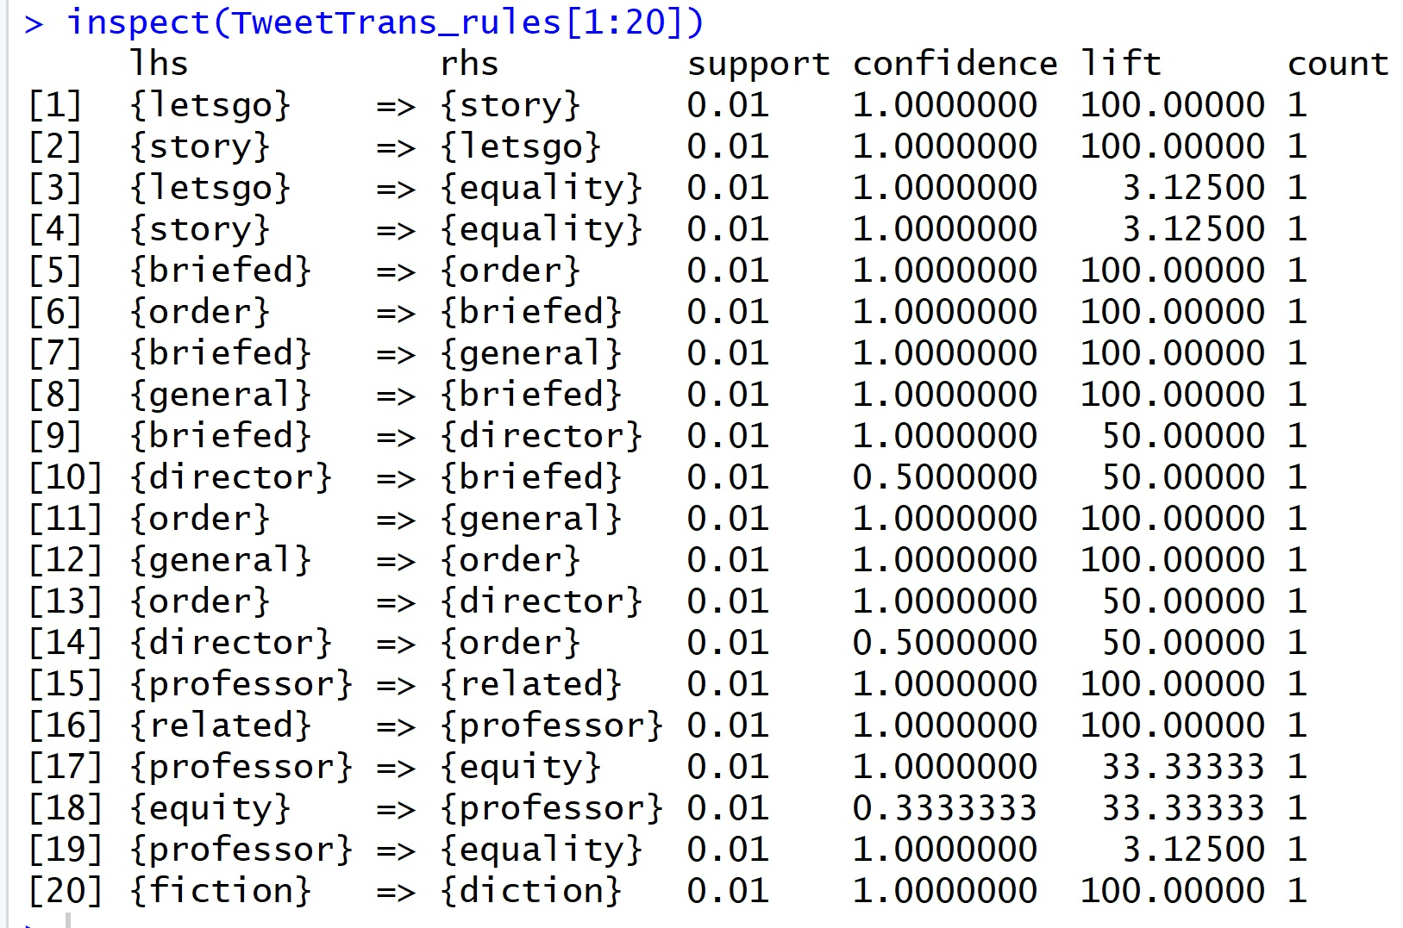
Transaction Rules

Slide 28
Now….for NetworkD3
To build any network, data must be formatted as edges and nodes.
Weights and other attributes must be measured and associated with the edges and nodes.
To use NetworkD3 (or any other graph package), one must know what is needed to build the object.

Slide 29
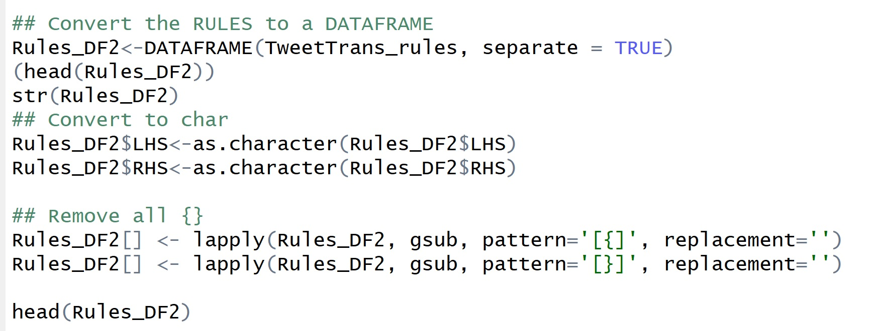
Convert Rules to Dataframe

Slide 30
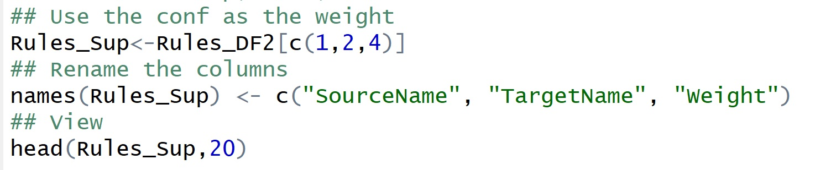
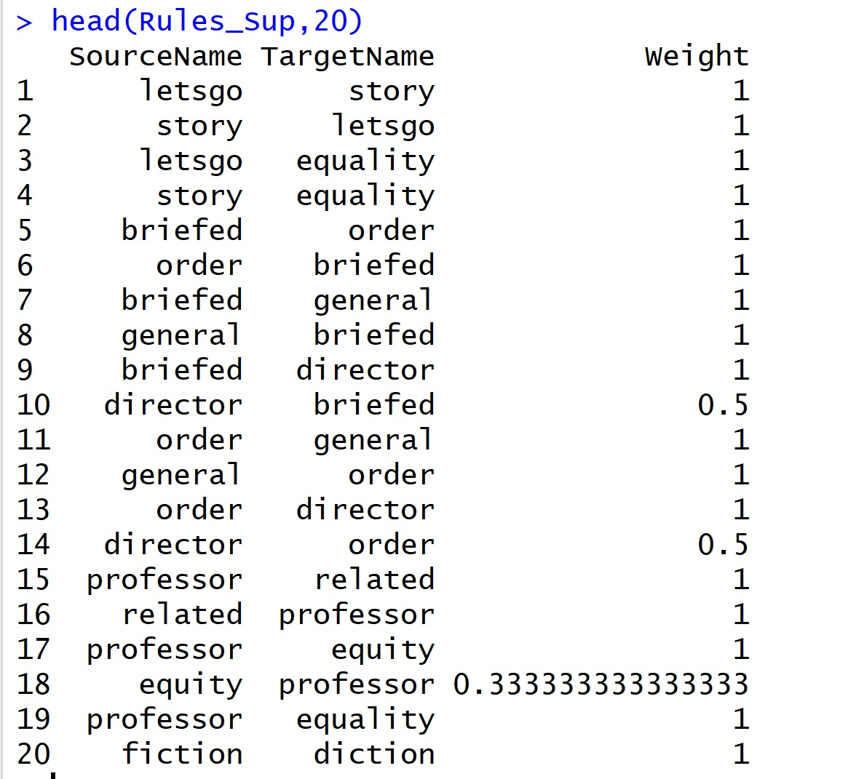
Building the Edges

Slide 31
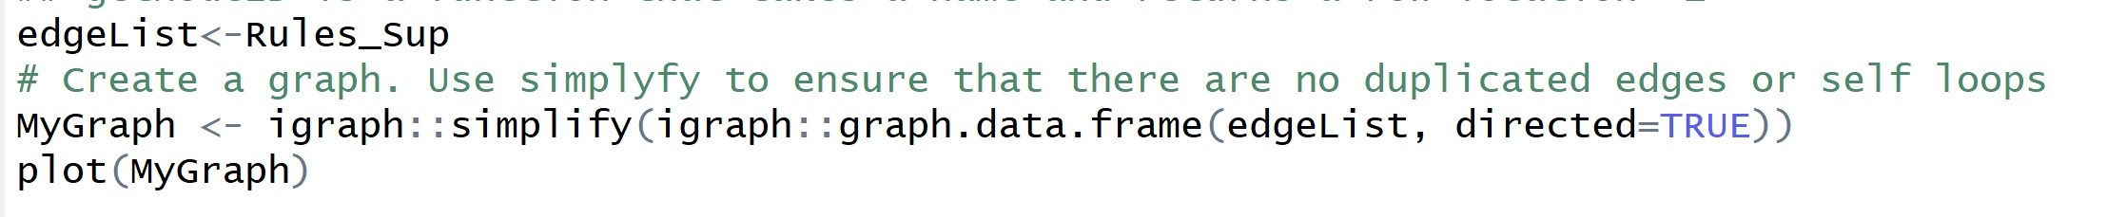
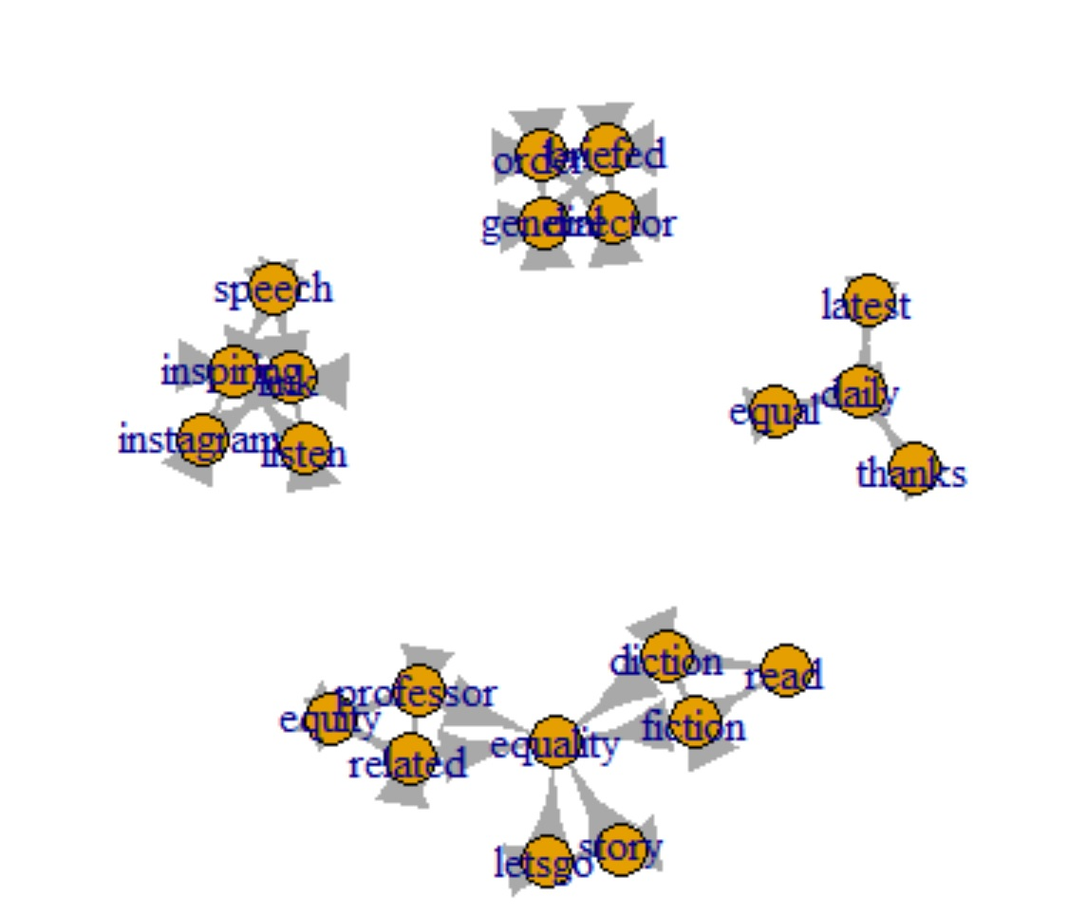
A Quick Look at the iGraph

Slide 32
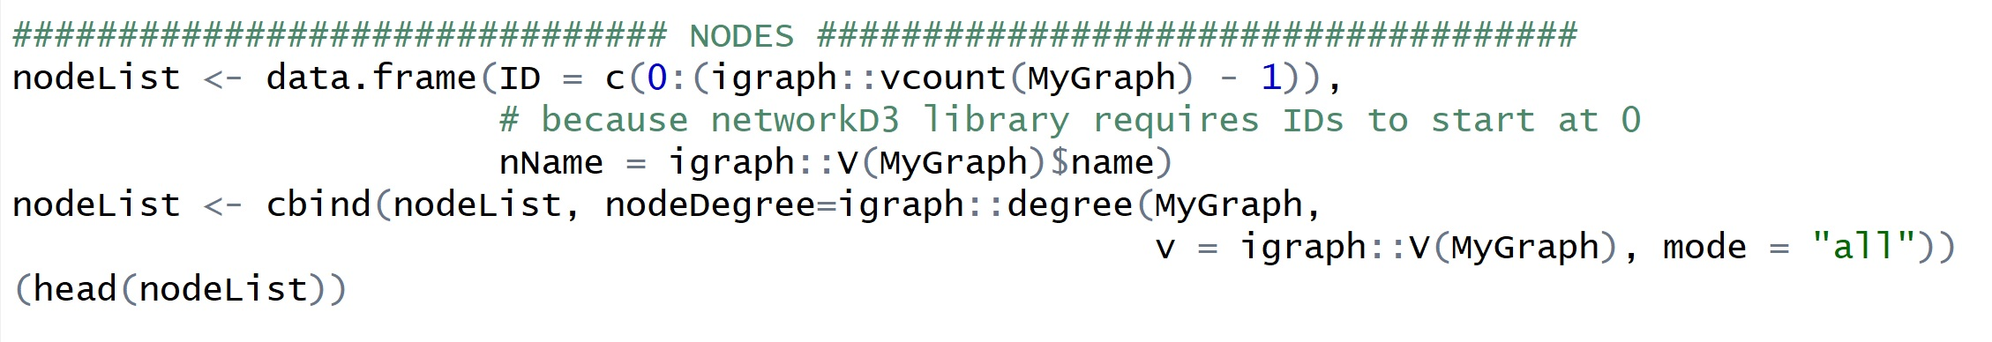
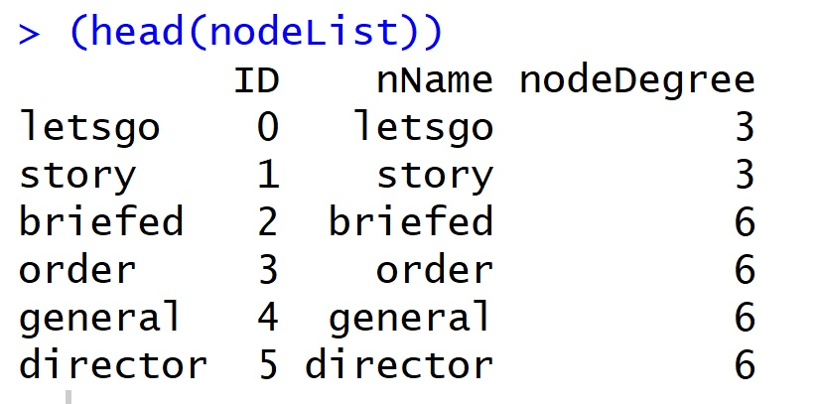
Build the Nodes

Slide 33
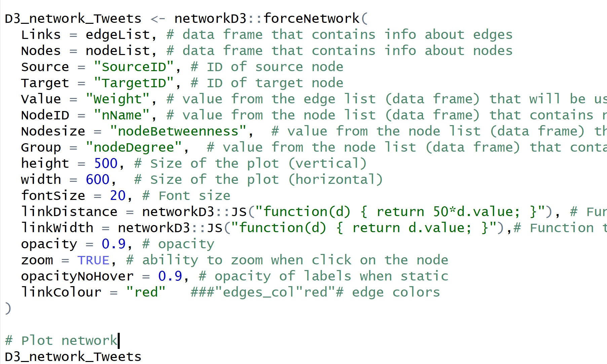
Building the NetworkD3 Object
https://www.rdocumentation.org/packages/networkD3/versions/0.4/topics/forceNetwork

Slide 34
Node Betweenness Centrality - BC
Measure of BC in a graph based on shortest paths.
BC measures the extent to which a vertex/node lies on paths between other vertices.
Vertices with high betweenness have greater influence within a network due to their control/affect of information passing between other nodes.
To disrupt communications in a network, node with greatest BC can be removed.

Slide 35
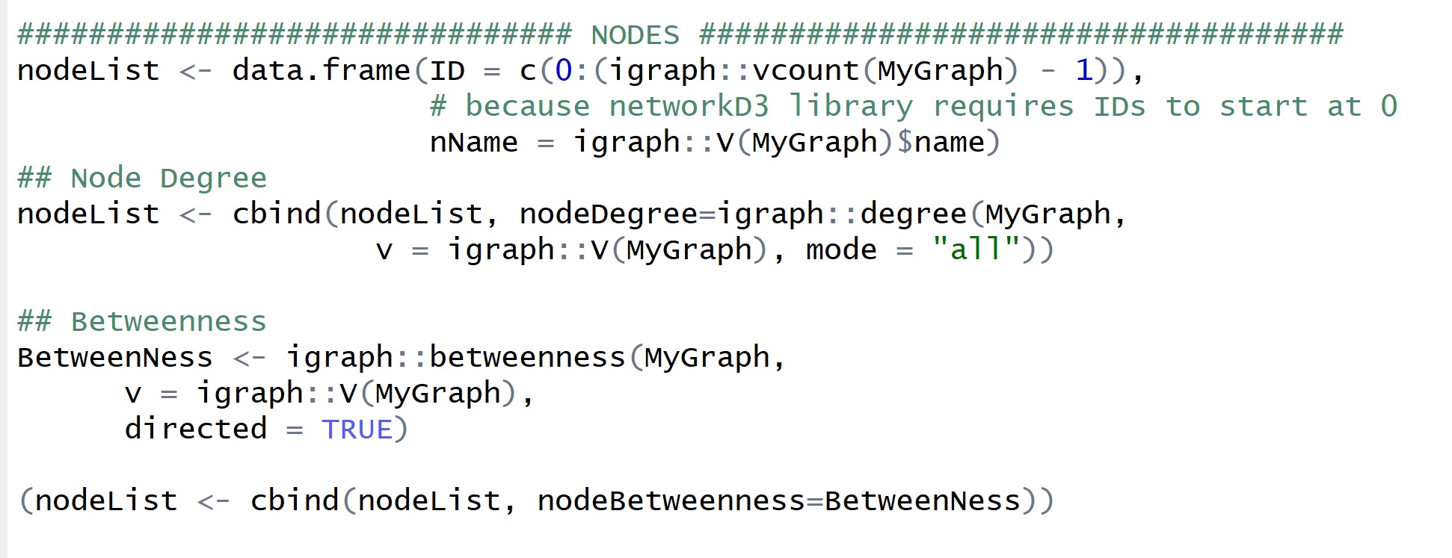
Code for Betweenness and Degree

Slide 36
Building the NetworkD3 Object –
IDs

Slide 37
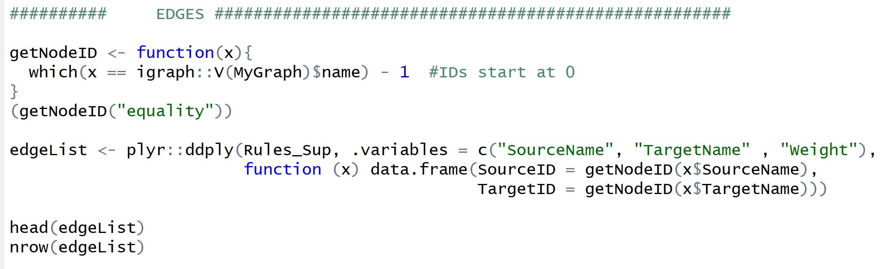
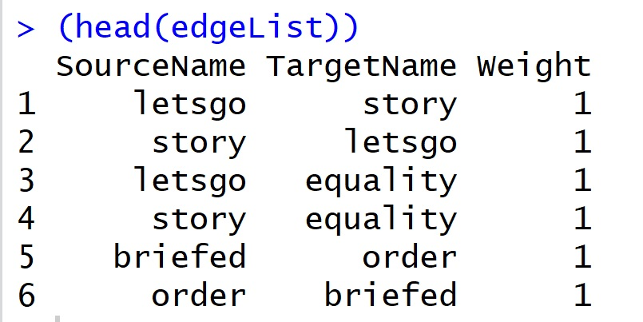
Update edgeList to include SourceID and TargetID

Slide 38
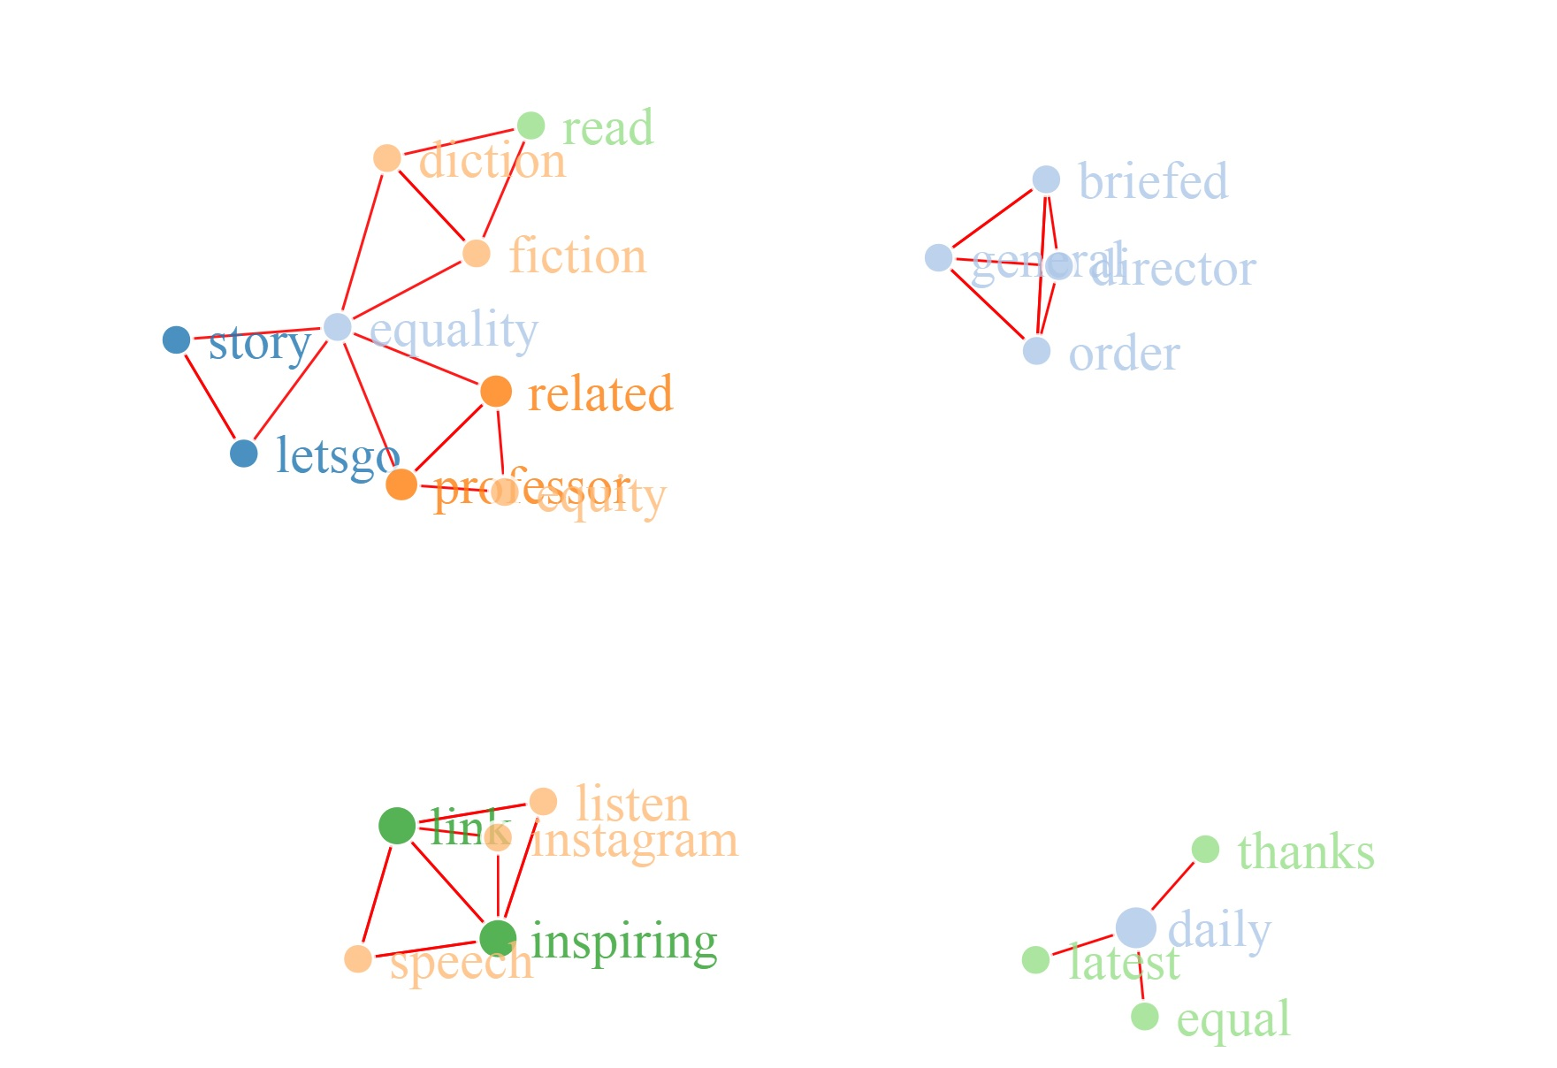
Network Vis

Slide 39
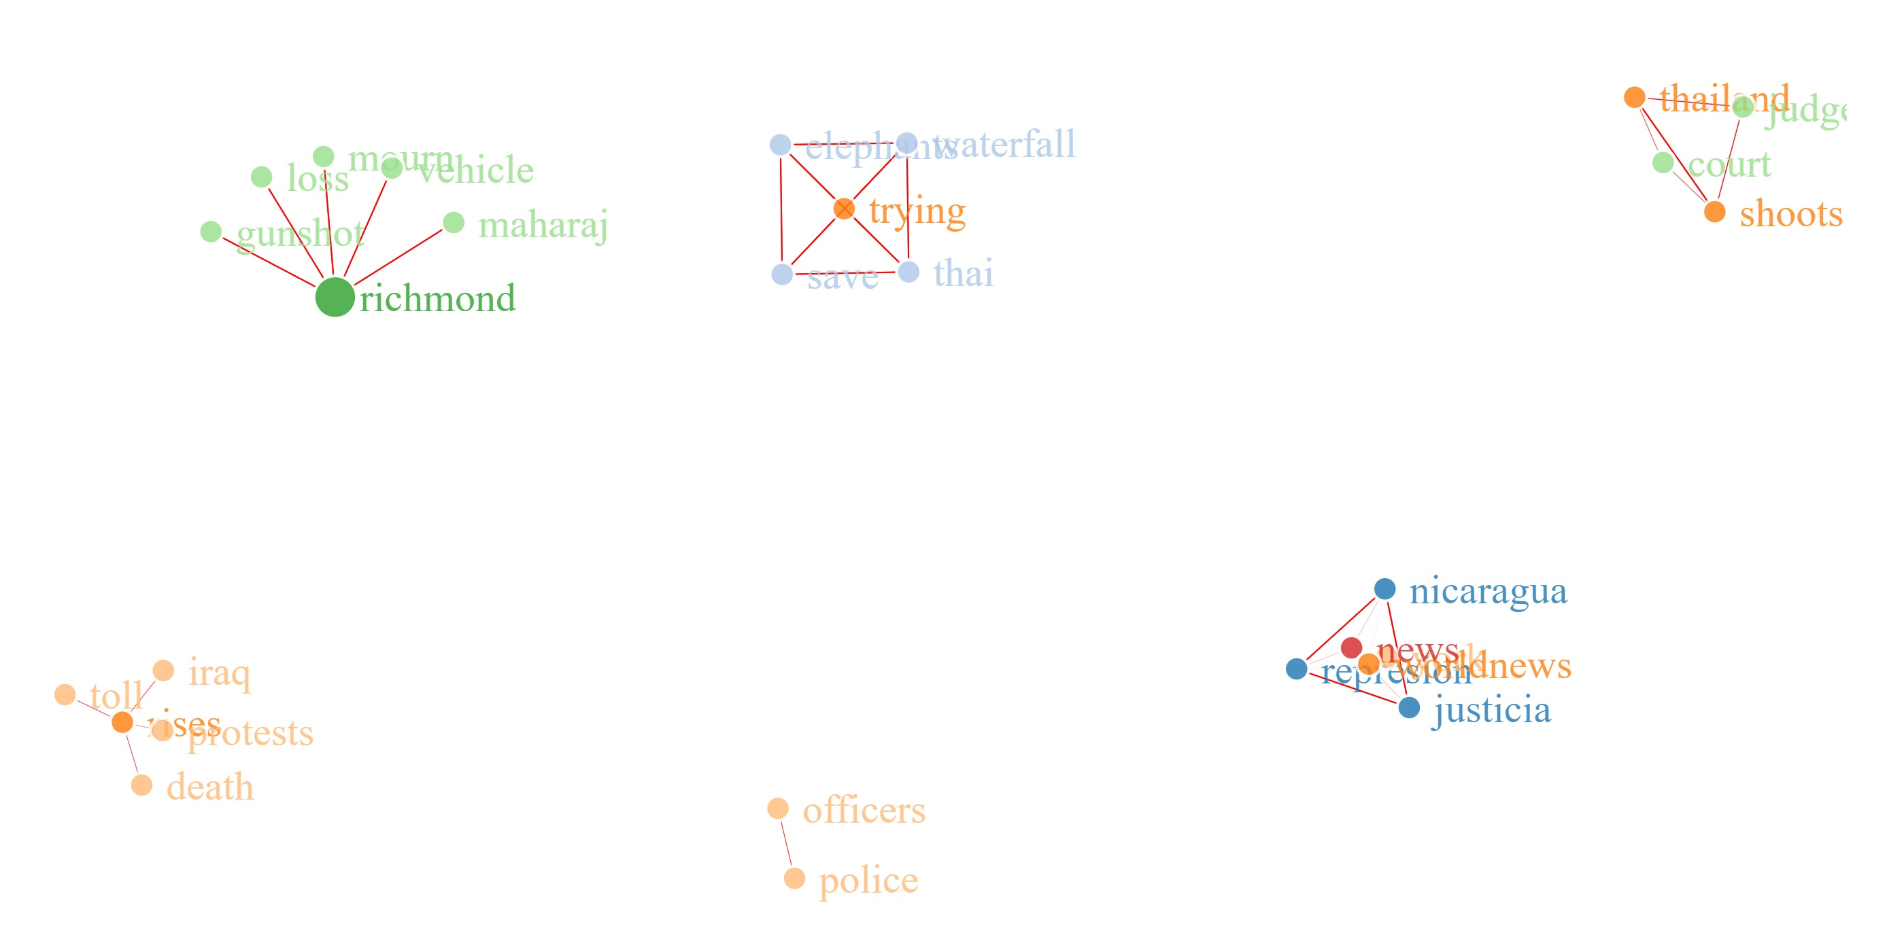
Example 2: #worldnews

Slide 40
Actual Google Search on Net Results
“Thailand judge shoots himself in court after criticising system. A Thai judge shot himself in a courtroom after delivering a rare speech railing against the country's justice system. Kanakorn Pianchana acquitted five Muslim men of murder on Friday before calling for a fairer judiciary.7 hours ago.”
“Richmond triple shooting: Two men killed, one in critical condition.”
“Six elephants die in Thai waterfall trying to save their own”
“The violence brought to 72 the total number of people killed over five days of protests, deepening the country's political crisis. The semi-official Iraqi High Commission for Human Rights, affiliated with the parliament, put the death toll at 94. It said nearly 4,000 people have been wounded since Tuesday.9 hours ago”

