Slide 1
Introduction to ML – Stats – DL The Big Picture
Gates
Reference:
Chapters – part of1 - 6
https://www.deeplearningbook.org/

Slide 2
The Big Picture
Prob & Stats & Math
Machine Learning.
Deep Learning.

Slide 3
Learning Algorithms
Learning: A computer program is said to learn from experience, E, with respect to some class of tasks, T and performance measure, P, if its performance at tasks in T, as measured by P improves with experience E.”
Tasks (T): ML solves tasks (problems) too difficult for non-learning programs.
Suppose “a robot walking” is a TASK.
- We can program the robot to LEARN to walk or
- We can directly program the robot to walk

Slide 4
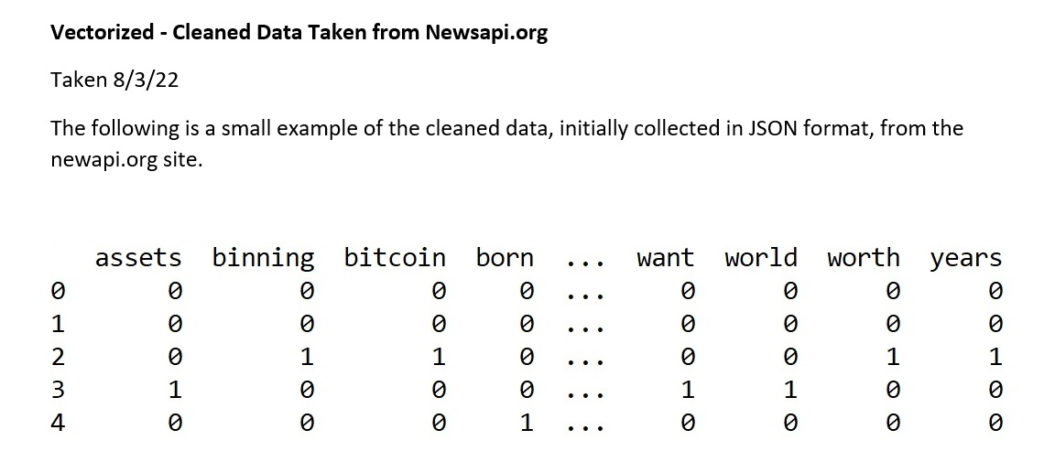
Examples and Features
Label | Gender | Cholesterol | MaritalStatus | Weight | Height | StressLevel
Risk | M | 251 | S | 267 | 70 | 5
NoRisk | F | 105 | M | 103 | 62 | 1
Medium | M | 156 | S | 193 | 72 | 3
NoRisk | F | 109 | M | 100 | 63 | 2
Example = Observation = Row = Vector = Instance
Features = Columns = Variables = Fields
(Note – while “record” data is rows/columns, not all data is this way)

Slide 5
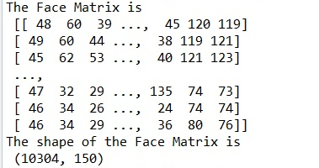
The Mathy Expression
Here, x is a vector (row, example, observation) in the dataset and x has n features (variables). Each xi is a feature.

Slide 6
Quick Data Format Overview
Gates

Slide 7
Image Data with 576 Features

Slide 8
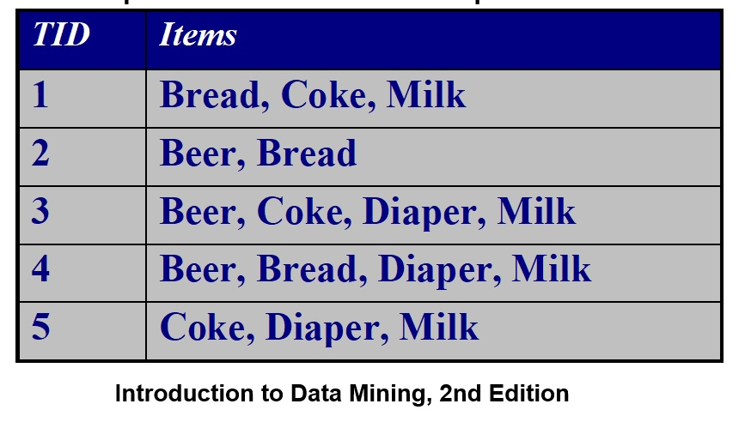
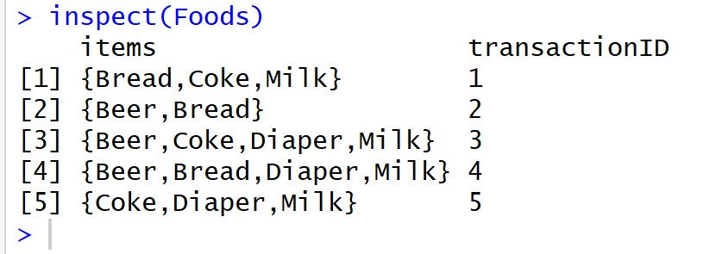
Transaction Data
1 | Bread
1 | Coke
1 | Milk
2 | Beer
2 | Bread
3 | Beer
3 | Coke
3 | Diaper
3 | Milk
4 | Beer
4 | Bread
4 | Diaper
4 | Milk
5 | Coke
5 | Diaper
5 | Milk
TID Bread Coke Milk Beer Diaper
1 1 1 1 0 0
2 1 0 0 1 0
3 0 1 1 1 1
4 1 0 1 1 1
5 0 1 1 0 1

Slide 9
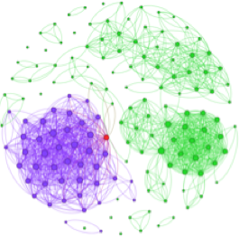
Nature of Data – Graph/Network Data
A graph can be generated from any data that has objects and connections between those objects.
Network data must be clearly define vertices (nodes) and relationships (edges).
Notes:
Examples: Generic graph and HTML Links
This is a dolphin network. Each node is a dolphin and each edge means that the dolphins were seen together.

Slide 10
Network Data Example

Slide 11
Network Example
2
2
2
Moreno. The Sociometry Reader. 1960
Ada
Louise
1
Lena
1
1
1
Adele
Marion
2
2
1
2
2
1
2
Jane
2
1
2
Cora
2
1
Frances
2
1
Eva
1
Maxine
1
2
1
1
Mary
2
1
Anna
1
1
Edna
Ruth
Robin
1
Martha
2
1
Betty
2
2
1
2
2
2
Jean
1
2
1
2
1
2
1
Laura
Alice
1
2
Helen
Hazel
Hilda
2
1
Ellen
1
2
Ella
Irene
Girls’ school dormitory dining-table partner choices (this is the relationship)
First and second choices shown as weighted edges.
The Girls are the nodes (vertices)

Slide 12
Network Data Example 2: Chemical Data
H
Benzene Molecule: C₆H₆
H
C
C
H
C
C
H
C
C
H
H

Slide 13
Nature of Data – Ordered Data
Notes:
Sequences of transactions

Slide 14
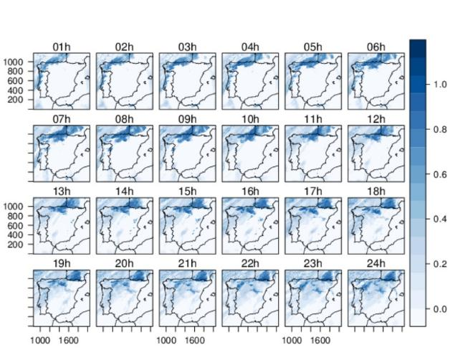
Nature of Data – Spatio-Temporal Data
http://oscarperpinan.github.io/spacetime-vis/spacetime.html

Slide 15
What Can ML Do
1) Classification
2) Classification with Missing Inputs
3) Regression
4) Transcription
5) Translation
6) Structured Output
7) Anomaly Detections
8) Synthesis and Sampling
9) Density Estimation (Prob Mass Function Estimation)

Slide 16
Classification
Classification: Predict which of c classes (categories/groups) that an input belongs to.
When y = f(x), the model will assign to input vector x a category y.
Math-wise: Produce a function f such that
f: R^{n} → {1 , …, c}
Classification can also output a probability distribution over the classes or can identity objects or images, etc.

Slide 17
Regression
Goal: Computer program predicts a numeric value for a given input.
f: R^{n} → R
This is similar to classification – but – the output is different.

Slide 18
Translation
Input: Sequence of symbols in some language
Output Goal: Convert to a different language
This is connected to the area of NLP (Natural Language Processing)

Slide 19
Density Estimation (pmfs & pdfs)
Goal: Learn a p_model: Rn → R, where p_model(x) can be interpreted as a pdf (if x is continuous) or a pmf (if x is discrete).
The algorithm must learn the structure of the data it sees.
Application: - with a density estimation (pdf/pmf) we can solve the missing value imputation task.

Slide 20
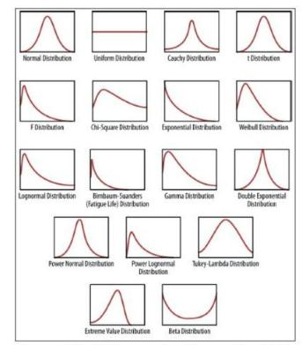
Common Distributions

Slide 21
Performance
To evaluate the ability of an ML algorithm, we must design/choose a quantitative measure of performance.
Classification: Here, we use the accuracy – how many inputs it predicts correctly.
Accuracy = correct/total
Error Rate = incorrect/total

Slide 22
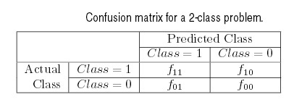
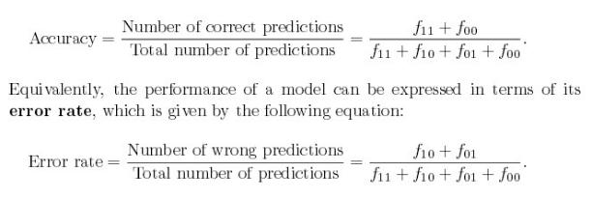
Performance Evaluation: Accuracy and Error Rate
Total Num Correct =
f11 + f00
The performance of a classification model can be based on
counts of test records correctly or incorrectly predicted.
f11: Record was class 1 and was predicted as class 1 correctly
f01: Record was class 0 and incorrectly predicted as Class 1
http://www-users.cs.umn.edu/~kumar/dmbook/ch4.pdf, page 5

Slide 23
Metrics for Performance Evaluation: Confusion Matrix
Confusion Matrix:
 | PREDICTED CLASS
ACTUAL CLASS |  | Class=Yes | Class=No
 | Class=Yes | True Positive | False Negative
 | Class=No | False Positive | True Negative
Notes:
We can measure performance by applying our model to the test set to get an unbiased estimate of its generalized error. Accuracy or error rate computed from the test set can also be used to compare the relative performance of different classifiers on the same domain.

Slide 24
Example when Accuracy is not a good measure:
Consider a 2-class problem
Number of Class 0 examples = 9990
Number of Class 1 examples = 10
If the model predicts everything to be in class 0, accuracy is 9990/10000 = 99.9 %
Accuracy is misleading because model does not detect any class 1 examples.
Poorly balanced data may not model well.

Slide 25
Using a Cost Matrix
 | PREDICTED CLASS
ACTUAL CLASS | C(i|j) | Class=Yes | Class=No
 | Class=Yes | C(Yes|Yes) | C(No|Yes)
 | Class=No | C(Yes|No) | C(No|No)
C(i|j): Cost of misclassifying class j, as class i

Slide 26
EXAMPLE: Computing Cost of Classification
This the actual prediction from the model
This is the Cost Matrix
Model M₁ | PREDICTED CLASS
ACTUAL CLASS |  | + | -
 | + | 150 | 40
 | - | 60 | 250
Cost Matrix | PREDICTED CLASS
ACTUAL CLASS | C(i|j) | + | -
 | + | -1 | 100
 | - | 1 | 0
Accuracy
= (150+ 250) / (150+40+60+250) = 80%
Cost
= (150)(-1) + (40)(100) + (60)(1) +
(250)(0) = 3910

Slide 27
Cost-Sensitive Measures
Measure of
Sensitivity
Measure of
Specificity

Slide 28
Experience E → Unsupervised vs. Supervised
Machine learning algorithms can be broadly categorized as unsupervised or supervised by what kind of experience they are allowed to have during the learning process.
Unsupervised Learning: Such ML algorithms experience the entire dataset. The algorithm learns properties about the structure of the dataset. With respect to deep learning, a goal would be to learn the distribution of the population from which the data originated. Here, we DO NOT use labeled data. GOAL: p(x)
Supervised Learning: This requires labeled training data. The label may be continuous or categorical and may be known as a target. GOAL: p(y } x)
NOTE: These are not “formal” concepts and the line between them can be blurred. They can also be used together.

Slide 29
Examples of Supervised and Unsupervised
Supervised:
Regression
Classification (DT, RF, NB, SVMs, NN)
Unsupervised
Clustering
Density Estimation
PCA/ICA
Association Rules Mining

Slide 30
Regression - Supervised with Continuous targets (labels)

Slide 31
Training the Model
For regression, we will use a TRAINING SET – a large subset of the labeled data to perform the regression.
Once we have our model, we can then use a TEST SET to measure the accuracy of the model.
The TEST and TRAIN sets should be disjoint. Why?

Slide 32
Performance

Slide 33
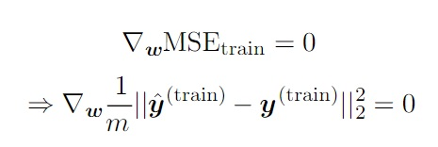
Making this into ML – Improving the Weights by Learning
1) To make this an ML algorithm, we need to improve the weights so that we also REDUCE the MSE.
2) The algorithm should gain experience by observing the labeled TRAINING data.
One method is to MINIMIZE the MSE by setting the gradient to 0 and solving for w.

Slide 34
A Look At the Math for Minimizing MSE
Normal Equations

Slide 35
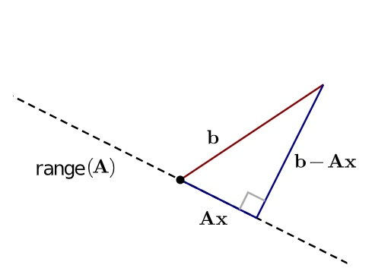
The Normal Equations
Normal equations are equations obtained by setting equal to zero the partial derivatives of the sum of squared errors (least squares); normal equations allow one to estimate the parameters of a multiple linear regression.
https://fncbook.github.io/fnc/leastsq/qr.html

Slide 36
Overfitting and a Validation Set
Underfitting occurs when the model is not able obtain a sufficiently low error value on the training set.
Overfitting occurs when the gap between the training error and test error is too large.

Slide 37
Capacity and Hypothesis Space
Control a model by altering its capacity.
Informally, a model’s capacity is its ability to ﬁt a wide variety of functions – such as linear, quadratic, etc.
Models with low capacity may struggle to ﬁt the training set.
Models with high capacity can overﬁt by memorizing properties of the training set that do not serve them well on the test set.
One way to control the capacity of a learning algorithm is by choosing its hypothesis space, the set of functions that the learning algorithm is allowed to select as being the solution.
For example, the linear regression algorithm has the set of all linear functions of its input as its hypothesis space.

Slide 38
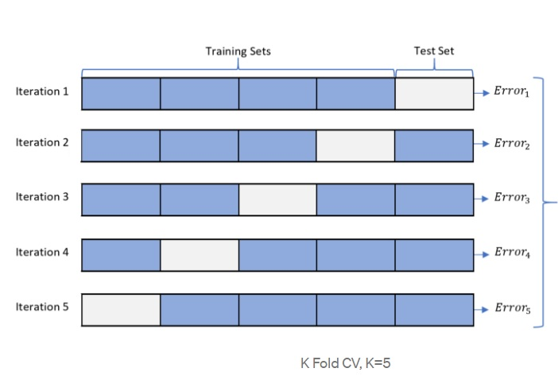
Cross-Validation
Repeating the training and testing computation on diﬀerent randomly chosen subsets or splits
of the original dataset. The most common of these is the k-fold cross-validation procedure

Slide 39
Generalization
The central challenge in machine learning is that our algorithm must perform well on new, previously unseen inputs—not just those on which our model was trained. The ability to perform well on previously unobserved inputs is called generalization.
When training a machine learning model, we have access to a training set.
We can compute some error measure on the training set, called the training error
We can reduce this training error - optimization problem.
What separates machine learning from optimization is that we want the generalization error, also called the test error, to be low as well.

Slide 40
Regularization
Regularization is any modification we make to a learning algorithm that is intended to reduce its generalization error but not its training error.
The behavior of a ML algorithm is strongly affected not just by how large the set of functions allowed in its hypothesis space, but by the specific identity of those functions.
The learning algorithm for linear regression, has a hypothesis space consisting of the set of linear functions of its input.
These linear functions can be useful for problems where the relationship between inputs and outputs is truly linear.
Regularize a model that learns a function f(x;θ) by adding a penalty called a regularizer to the cost function. Example: weight decay.
This creates preferences for one function over another and can control a model’s capacity.

Slide 41
Point Estimation
Point estimation is the attempt to provide the single “best” prediction of some quantity of interest – a single parameter or a vector of parameters (such as the weight vector in LR or NN).
Frequentist perspective on statistics: Assume that the true parameter value, θ, is fixed but unknown, while the point estimate ˆθ is a function of the data.
Since the data is drawn from a random process, any function of the data is random.
Therefore ˆθ is a random variable.

Slide 42
Function Estimators and Bias
Goal: Predict a variable y given an input vector x.
Assume that there is a function f(x) that describes the approximate relationship between y and x.
In function estimation, we are interested in approximating f with a model or estimate ˆf.
Function estimation is largely the same as estimating a parameter, θ, but the function estimator ˆf is simply a point estimator in function space.

Slide 43
Prob & Statistics in Machine Learning
Distributions, Parameter Estimation, and Bias:
Bernoulli
Gaussian
- Mean and Variance
Maximum Likelihood
Bayesian Statistics
MAP Estimation
Probabilistic Supervised Learning

Slide 44
Example 1: Bernoulli Estimation and Bias

Slide 46
Gaussian Estimator of Mean

Slide 48
Proof and Comparison: Unbiased Estimator for Variance (Gaussian) Example 1
bias = E(^var) – var
= (m – 1)(var)/m – var
= (m – 1)(var)/m - (m(var)/m
= var((m-1/m) – m/m)
= var (-1/m)
= -var/m

Slide 50
Maximum Likelihood
On the past few slides, we saw some estimates for parameters, such as means and variances for various distributions.
But – where do estimators come from?
The Maximum Likelihood can be used to derive functions that are good estimators.

Slide 51
Taking the Log of the Max Likelihood

Slide 52
KL Divergence

Slide 54
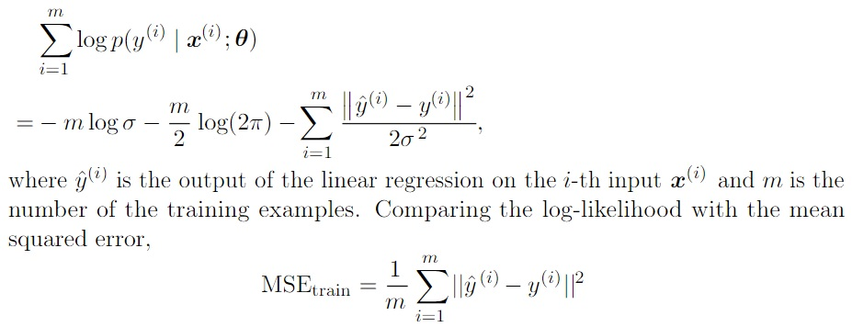
Linear Regression and Maximum Likelihood: Example
Linear Regression takes an input vector x and produces a value output y^.
The mapping from vector x to output y^ is selected to MINIMIZE the mean squared error (MSE).
For this example, let’s apply maximum likelihood and instead of producing a single y^, let’s produce a conditional probability over y^ given the vector x. P(y | x)
Define p(y | x) = N(y; y^(x, w), s²), where N is normal and s² is the variance.
Note that y^(x, w) gives the perdition of the mean of the Gaussian.

Slide 55
Result
Maximizing the log-likelihood with respect to w yields the same estimate of the parameters w as does minimizing the mean squared error.
The two criteria have different values but the same location of the optimum.
This justifies the use of the MSE as a maximum likelihood estimation procedure.

Slide 56
MAP (Maximum a posteriori)
Bayesian

Slide 57
Gradient-Based Optimization
Optimization: minimizing or maximizing some function f(x) by altering x.
Min f(x) ← → Max – f(x)
Objective Function/Criterion/Cost Function/Loss Function/ Error Function →
The function we want to optimize.
Terminology:
x* = arg min f(x)

Slide 58
Illustration: Gradient Descent
https://www.deeplearningbook.org/

Slide 62
Stochastic Gradient Descent (SGD) and Minibatch
The gradient is an expectation which may be approximately estimated using a small set of samples – a minibatch of examples B={x(1), . . . , x(m)} drawn uniformly from the training set.

