Slide 1
Convolutional Neural Networks
gates
NOTICE - Many images in these slides are borrowed from several sites
References: https://www.youtube.com/watch?v=Lakz2MoHy6o

Slide 2
Images are Numbers

Slide 3
Kernels Can Detect Features

Slide 4
Example of Features of a “9”

Slide 5
Kernels for “9” Features

Slide 6
Kernel – Slide and Sum/Avg

Slide 7
The “1” here Shows a Feature

Slide 8
Kernels can detect “eyes”

Slide 9
Multiple Kernels in a Conv. Layer

Slide 10
A Possible Conv NN

Slide 11
Definitions: Convolution vs Cross-Correlation

Slide 12
Convolution and Cross-Correlation

Slide 13
Convolution and Cross-Correlation

Slide 14
Convolution and Cross-Correlation

Slide 15
Output size
Here – the input I is “9”
The Kernel K is 4
So the output Y (which we call y_hat)
is 9 – (4 + 1) = 4

Slide 16
This was Cross-Correlation (not convolution!)
Here – this operation of multiplying each value of the input matrix (in the window) by each corresponding (adjacent value) in the kernel is actually called cross-correlation
In Python, the numpy “*” will do this.

Slide 17
For Convolution – we must first Rotate 180 degrees

Slide 18
Example of a Matrix that Rotates Matrices

Slide 19
Relationship Between Cross-Correlation and Convolution
Cross-correlation and convolution are both operations applied to images. Cross-correlation means sliding a kernel (filter) across an image. Convolution means sliding a flipped kernel across an image.

Slide 20
Operators

Slide 21
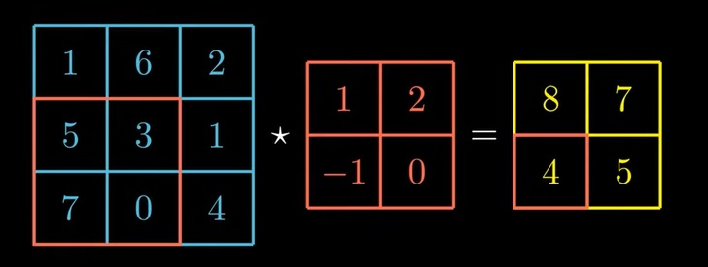
Methods for Performing CC – “Valid” Method

Slide 22
Methods for Performing CC – “Full” Method

Slide 23
Methods for Performing CC - Full

Slide 24
Methods for Performing CC - Full

Slide 25
Methods for Performing CC - Full

Slide 26
Image Depth
1) Let’s first think about images.
2) If an image is b & w, it may have a “depth” of one pixel.
3) If an image is RGB, it will have a “depth” of three pixels...
What does this mean?
How does this affect CNNs and image classification?

Slide 27
Image Classification
What is Image Classification?
Image classification is the process of segmenting images into different categories based on their features.
A feature could be the edges in an image, the pixel intensity, the change in pixel values, and many more.
An image consists of the smallest indivisible segments called pixels.
Every pixel has a strength often known as the pixel intensity.
Digital images usually comes with three color channels - Red-Green-Blue (RGB)
Why RGB? - Because it has been seen that a combination of these three can produce all possible color pallets.

Slide 28
B & W

Slide 29
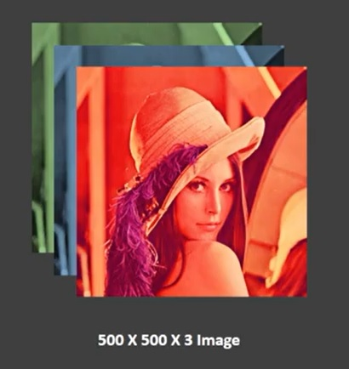
RGB Color

Slide 31
A Convolutional Layer

Slide 32
A Convolutional Layer – cont.

Slide 33
A Convolutional Layer – cont.

Slide 34
Same for Second Kernel

Slide 35
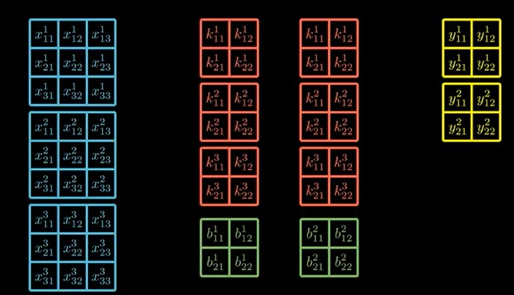
Simplified Notation for the Math

Slide 36
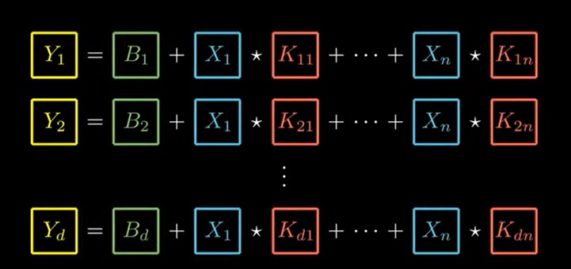
Combinations
Each kernel-set + bias → output
Depth of kernel-set = depth input
Num outputs = num kernel-sets

Slide 37
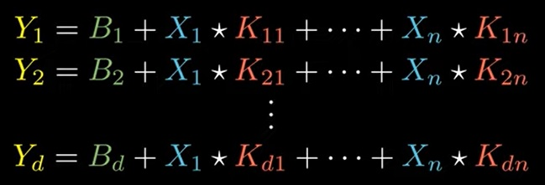
Combinations Equation
Note – while this looks very similar to the non-convolutional layers – the K and X, etc. are MATRICES (not scalars)
Also, the stars are not multiplication – but rather are cross-correlation.

Slide 38
Here – the . | * pretend symbol means that we perform cross-correlation between the matrices and sum up the values as shown on the previous slides.

Slide 39
1) This formula looks exactly like our linear combination formula for “normal FF networks” (called a Dense Layer).
2) However – these are MATRECIES OF MATRICES here and the operation is cross-correlation.
3) However, if we assume that our input “matrices” are 1 by 1, then this reduces to the equation of the “Dense” layer.
4) Cross-correlation between two 1 by 1 matrices is actually the 1d matrix containing the product of the elements – so a simple dot product.
The Convolutional layer is actually a generalization of the Dense layer.

Slide 40
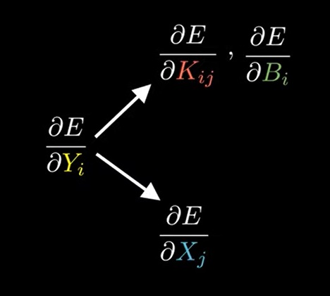
The Math – Gradients for Convolution
Let E be the Error (or Loss) function.
We want the derivative of E with respect to a given predicted output Yi.
In other words – how would changing Yi affect the Error?
To solve this – we need to consider what Y is made up of.
Y (the predicted output –( we call this y_hat) - is affected by:
- the biases (B) and
- the Kernels (K) and
- the inputs (X)

Slide 41
Resolving the Derivatives
This last equation is a simplified version of the general case. Let’s start with this to try to find patterns....

Slide 42
A Convolutional Layer – cont.

Slide 43
Before moving forward – RECALL...

Slide 44
Breakdown of Simple Case

Slide 45
dE/dY and dE/dK

Slide 46
dE/dk via Y Chain Rule

Slide 48
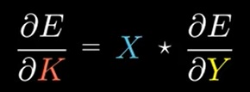
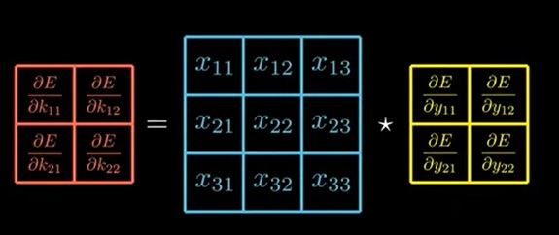
The Pattern

Slide 49
So Far – We Looked at a Simplified Version
The actual equation for the predicted outputs Yi (we call this Y^i) is the following.
However, there is a pattern – let’s find it by fully expanding this equation....

Slide 50
Expansion of Full Equation (Conv Layer)

Slide 51
Derivatives for the full Equation
Recall that we are trying to find dE/y^. To do this, we will look at dE/dK. We might be thinking....
BUT!!! We cannot do the following directly because these are all matrices!

Slide 52
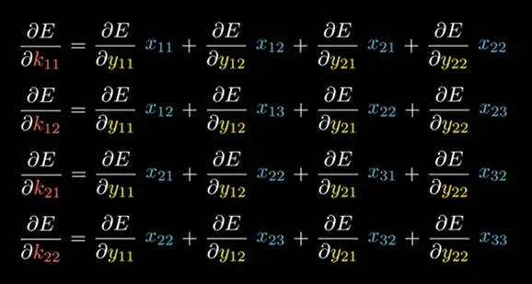
Remember – in the Simple Case we had values – not matrices. Notice the lowercase k’s and y’s ☺

Slide 53
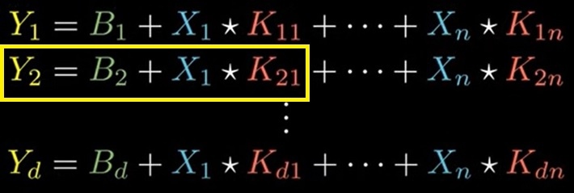
Solution: Take the derivative for each Kij.
First – recall that our full equation is:
Next, let’s just look at dE/dK21
Notice that ONLY Y2 is affected by K21
This gives us a specific result for K21 *AND* a general result for Kij:

Slide 54
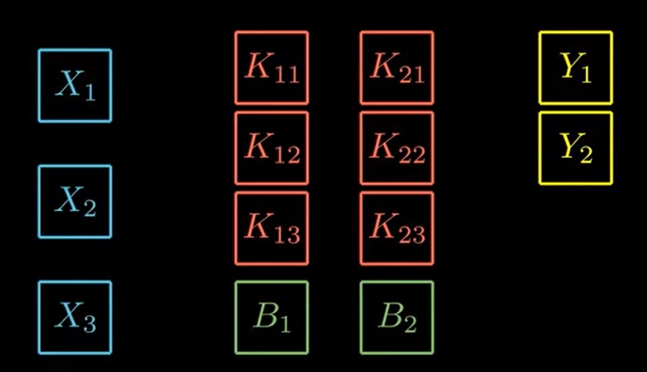
Gut Check

Slide 55
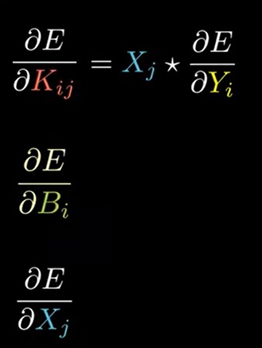
Where Are We?
Recall that we know that dE/Y^ requires these three derivatives.
So far, we have a resolution for dE/dKij
Next – let’s get dE/dB – for the biases.
This will be the same as for dE/dKij, but without the Xj

Slide 56
Recall that for one input, one kernel, and one output, we have:

Slide 57
Just Look at dE/b11 for the simple case

Slide 58
Derivative Result for B for full Equation. This is simple b/c B1 is only in Y1. So we can generalize to Bi affecting only Yi.

Slide 59
Why? Recall:

Slide 60
Almost There! So Far we have:

Slide 61
Getting the dE/dXj

Slide 62
Looking at dE/dx11

Slide 63
All dE/dX

Slide 64
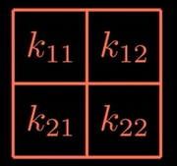
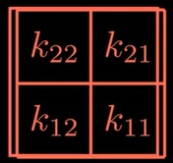
These dE/dX set of Derivatives has a Pattern!
To get this set of derivatives – we must perform a “full” convolution between dE/dyij and K
Superficially, for K1, we first ROTATE it by 190 degrees counter clockwise.
rotated 180d

Slide 65
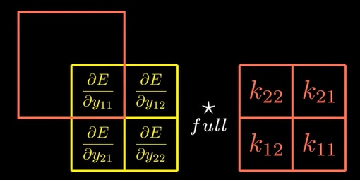
Next – perform a “full” Cross-Correlation
Recall that if you rotate the matrix by 180 degrees (counter-clockwise) first and THEN perform the cross-correlation, this is called “matrix convolution”.
Recall also that FULL cross-correlation goes through all inner AND outer edges:

Slide 66
Each derivative is the result of one “window”:

Slide 70
Conclusion for dE/dX: The input gradient (dE/dX) is equal to the output gradient (dE/dY^) “fully” convolved with the kernels (K)
Top equation is written out.
Bottom equation is the SAME but using a SUM

Slide 71
Three Equations (derivatives) needed for the back-propagation

Slide 72
Now we must derive dE/dY
This depends on E! (The selected Loss function).
For example – we might use categorical cross entropy – or binary cross entropy – etc.
Let’s look at dE/dY for Binary Cross Entropy...

Slide 73
Binary Cross Entropy and dE/dY

Slide 74
Recall that our Goal is to get dE/dY^
Note again that Y (here) is our Y^

Slide 75
Derivative dE/dy1

Slide 76
Generalized: dE/dY (again this is our Y^ and the Y’s are matrices here)
Generalized for all yi in Y
Reminder. Here, Y is predicted and Y* is known/actual label.

Slide 77
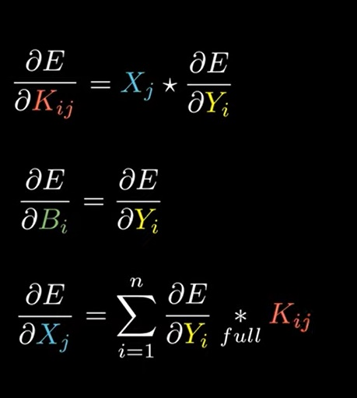
All Derivatives (assuming binary cross entropy as the Loss function E)
AND

