Slide 1
Encoder – Decoder NN - image transcription - sentiment analysis - translation
GATES

Slide 2
Encoder – Decoder Application 1
AKA: Sequence to Sequence (Seq2Seq) model
Related to RNNs
https://blog.keras.io/a-ten-minute-introduction-to-sequence-to-sequence-learning-in-keras.html
Encoder decoder models: machine learning model generates a sentence to describe an image.
Input: An image
Output: A sequence of words.
(This also works with videos.)

Slide 3
Example

Slide 4
Encoder – Decoder Application 2
Sentiment Analysis
These models understand the “meaning and emotions” of the input sentence - and - output a sentiment score.
It is usually rated between -1 (negative) and 1 (positive) where 0 is neutral.
It is used in call centers to analyze the evolution of the client’s emotions and their reactions to certain keywords or company discounts.

Slide 5
Encoder – Decoder Application 3
Translation
This model reads an input sentence,
“Understands “the message and the concepts
Translates it into a second language.
Google Translate is built upon an encoder decoder structure, for more detail follow this paper.
https://arxiv.org/abs/1609.08144

Slide 6
Google Translate

Slide 7
What is an encoder decoder model?
RE: https://towardsdatascience.com/what-is-an-encoder-decoder-model-86b3d57c5e1a
The best way to understand the concept of an encoder-decoder model is by playing Pictionary.
The rules of the game are very simple:
Player 1 randomly picks a word from a list and needs to sketch the meaning in a drawing.
Player 2 must analyze the drawing and identify the word which it describes.

Slide 8
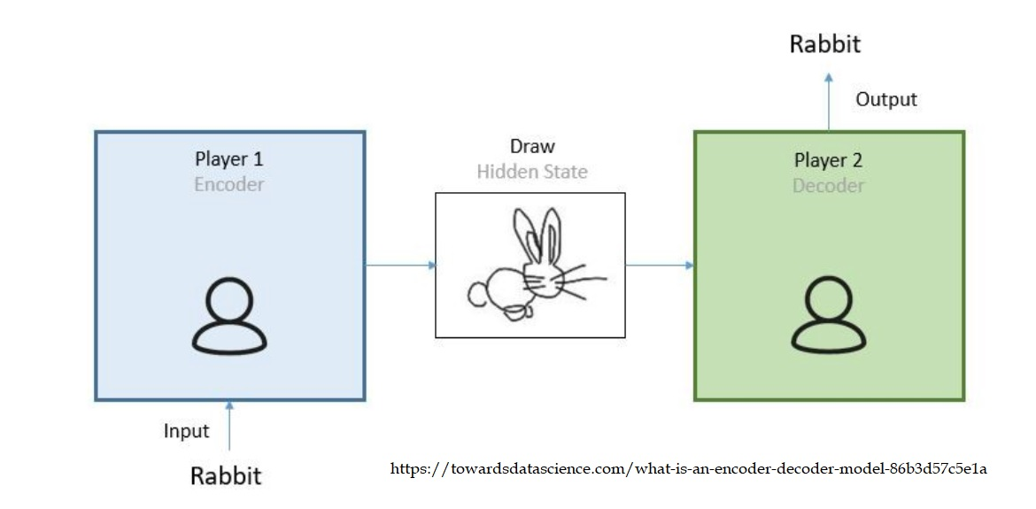
Elements
Three important elements:
1) Player 1 converts the word into a drawing.
2) Player 2 guesses the word from the drawing.

Slide 9
Translate into ML Concepts

Slide 10
Encoding - Input
Encoding means to convert data into a required format.
In the Pictionary example we convert a word (text) into a drawing (image).
In the machine learning context (for example) one might convert a sequence of words in Spanish into a two-dimensional vector, this two-dimensional vector is also known as hidden state.
The encoder is built by stacking recurrent neural networks (RNNs).
RNNs have a structure that allows the model to understand the context and temporal dependencies of the sequences.
The output of the encoder, the hidden state, is the state of the last RNN timestep.

Slide 11
Simple Example Image

Slide 12
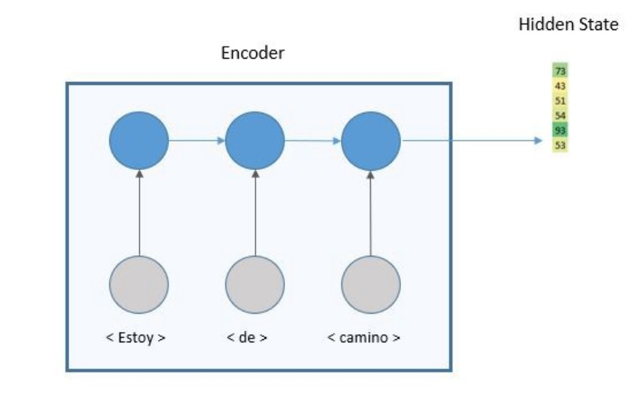
Encoder – Output (Hidden State)
The output of the encoder is a two-dimensional vector that encapsulates the whole meaning of the input sequence.
The length of the vector depends on the number of cells in the RNN.

Slide 13
Decoder
To decode means to convert a coded message into intelligible language.
Recall that a “coded message” might be an image, a video, something that describes emotion, or one language that must be “decoded” into another language.
Example:
The second person in the team playing Pictionary will convert the drawing into a word.
In the machine learning model, the role of the decoder will be to convert the two-dimensional vector into the output sequence, the English sentence.
It is also built with RNN layers and a dense layer to predict the English word.

Slide 14
Decoder

Slide 16
Code for English – Spanish Encoder - Decoder
https://gatesboltonanalytics.com/?page_id=719

Slide 17
Advantages
One of the major advantages of this model is that the length of the input and output sequences may differ.
This opens the door for very interesting applications such as video captioning or question and answer.

Slide 18
Limitations
The major limit of this simple encoder decoder model is that all the information needs to be summarized in one dimensional vector, for long input sequences that can be extremely difficult to achieve.
Having said that, understanding encoder decoder models is key for the latest advances in NLP because it is the seed for attention models and transformers.

Slide 19
How to Build an encoder decoder translation model using LSTM with Python and Keras
See Python
and
https://keras.io/examples/nlp/lstm_seq2seq/
https://www.youtube.com/watch?v=f-JCCOHwx1c
https://blog.keras.io/a-ten-minute-introduction-to-sequence-to-sequence-learning-in-keras.html

