Slide 1
RNNs Recurrence Relations Transfer Learning Attention Memory
gates

Slide 2
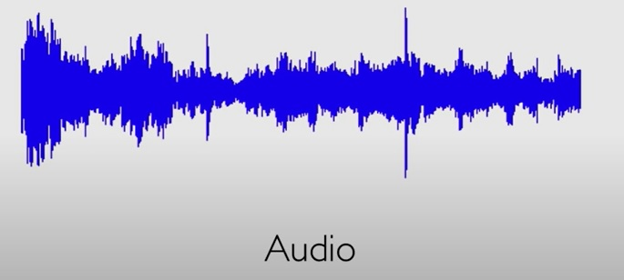
What is Sequential Data?
Audio Data – sequence of sound waves
Text – Sequence of words (groups of words) etc.
Stock Prices over time
Biological data

Slide 3
MIT’s Overview
The following few slides are visualizations borrowed from MIT’s conceptual overview of RNNs.

Slide 4
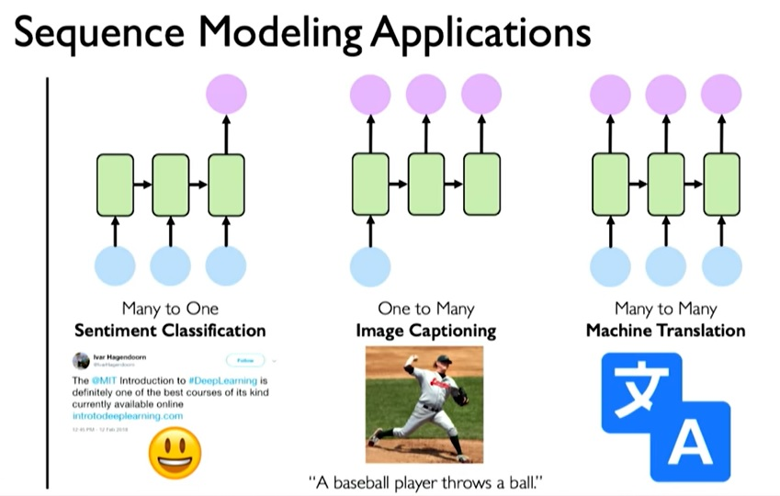

Slide 5
Neurons with Recurrence

Slide 8
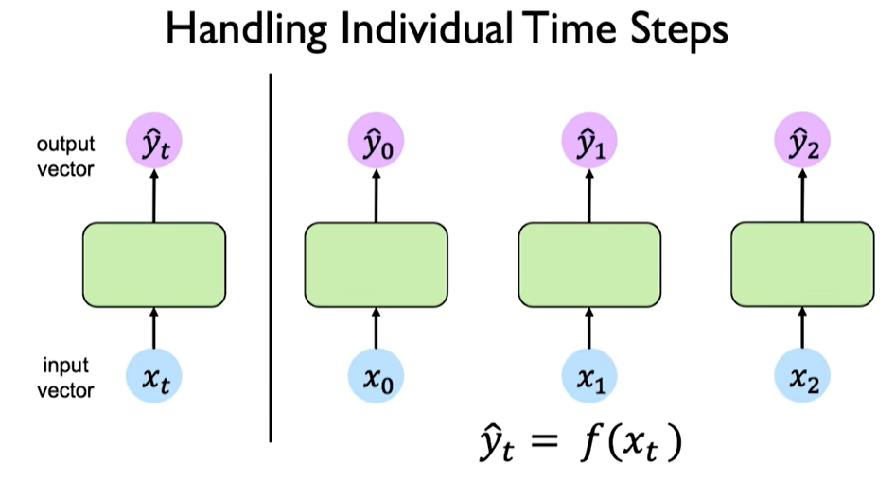
Each Time Step
Apply the same series of operations again and again, one for each “time step”

Slide 9
Sequential Data
Our goal is to create and maintain a relationship (dependency) between past and current data/information flow.
Consider the output as having a relationship to current input and past information. Therefore, we need a way to propagate this information forward through time.
This is done via a recurrence relation.

Slide 11
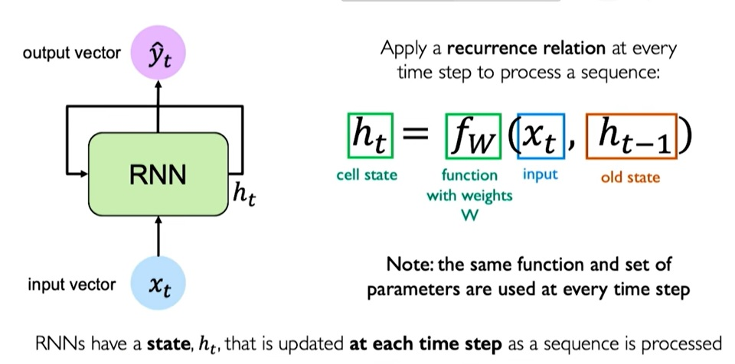
The RNN maintains an internal state, ht. This will be updated at every step.
ht is a function of the current input and the prior state. The ht is parameterized using a weight matrix, W, which will be learned. The key is that this set of weights is the SAME across all time step through the sequence.

Slide 12
Pseudocode RNNs:What is the next word?

Slide 13
Updating the Hidden State

Slide 14
Unrolling

Slide 15
Training an RNN: The Loss

Slide 16
A Deeper Look at RNNs
1) RNNs are a family of NN’s for processing sequential data of variable length.
2) RNNs share parameters across different parts of the model.
3) Note that if we had separate parameters for each time index, it would not be possible to generalize sequence lengths.
For example:
Sentence 1: “I went to Nepal in 2021”
Sentence 2: “In 2021, I went to Nepal.
A traditional fully connected
FF would have separate parameters for each input feature, so it would need to learn all the rules of the language separately at each position in the sentence. By comparison, a RNN shares the same weights across several time steps
Goal – to recognize the year whether
it is the 6th or 2nd word.

Slide 17
Defining the Problem
1) RNNs operate on a sequence of vectors x(t), where t ranges from 1 to T.
2) For simplicity, we will focus on one sequence of vectors. However, in practice, minibatches of sequences are used, each with its own T.
What is a sequence of vectors?
Suppose we one-hot-encode a vocabulary.
Then, we have “encoded words”: [1 0 0 .. 0 ] [0 0 1 0 .. 0 ] ... [ 0 1 0 ... 0 ]
This might say: “I like cake”
There are many methods for representing and encoding.

Slide 18
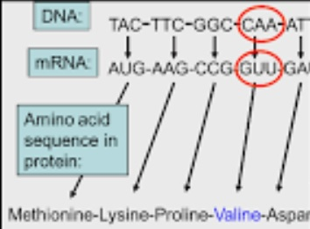
RNN’s “Time”
The notion of “sequence” does not have to refer to the passage of time – though it can.
This sequence of amino acids must remain in order so as to represent a protein.
Similarly, sentences have “order” that can be related to both time/context, as well as grammar, etc.
Stock prices are temporal.
While we will not go this deep, RNNs can also engage in multidimensional time/space as well as go back in time.

Slide 19
Classical Dynamical System
Each node represents a state at some time t, and the function f maps the state at time t to the state at time t+1.
** Important: The same set of parameters is used to parameterize f at all time steps.
(In other words, the same weight matrix is used)

Slide 20
Recurrence Relations: Tower of Hanoi
This is the recurrence relation
This is the “Unfolding”

Slide 21
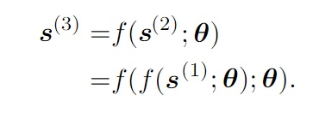
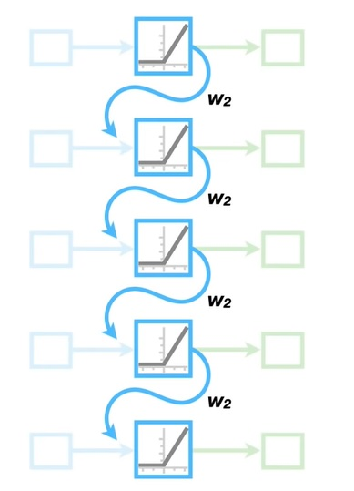
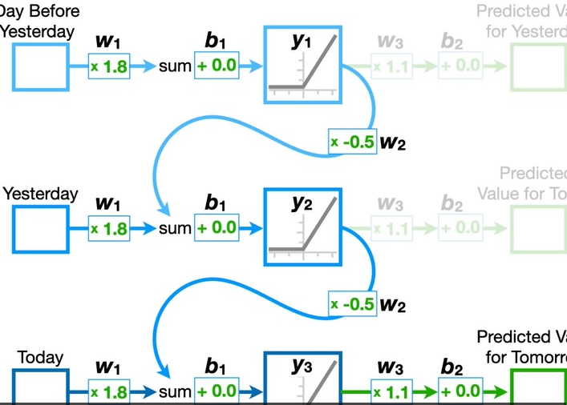
Unfolding
For T finite, a recurrence relation can be “unfolded” and can yield an expression that does not involve the recurrence.
In this case, the new expression can be represented by a directed acyclic graph.

Slide 22
RNN (left) and Unfolded (right)

Slide 24
Advantages

Slide 25
“Lossyness” and Memory
1) When an RNN is trained to predict the future from the past, the RNN learns to use h(t) as a kind of “lossy” summary of relevant past inputs up to time t.
2) It is “lossy” because its length may be quite large but it maps to a fixed length h(t).
3) It might selectively keep some aspects of the past with more precision than other aspects.
4) The amount of history retained varies by RNN and goal. Auto-encoders retain all history, other RNN’s use “Attention” to focus on more “important” aspects.
5) The use of “transfer learning” can also assist by “bringing” past knowledge into the system.
Example: When predicting the next word in a sequence, one can store only enough information to predict – rather than “all” the information.

Slide 26
RNN Design Notes

Slide 27
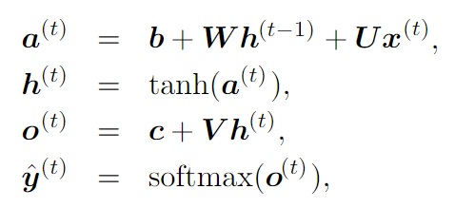
Loss Sum
RNN that produces an output at each time step and have recurrent connections between hidden units

Slide 29
Runtime
1) The gradient computation involves performing a forward pass (left to right) of the unrolled (unfolded) graph.
2) The runtime is O(T) and it cannot be reduced via parallelization because the graph is sequential (dependent of the previous values).
3) Memory cost is O(T) because all states must be stored until they are reused during the backward pass.
4) This type of network is workful, but expensive to train.
(More on BPTT - Back Propagation Through Time - later)
5) An alternative (less powerful ) network that is less expensive is one with connections only from the output ONLY at one time step to the hidden unit at the next time step.

Slide 30
RNN w/recurrence feedback only from output to hidden layer.

Slide 31
RNN that Summarizes a Sequence
This RNN has only a single output at the end.

Slide 32
Computing the Gradient: RNNs Back Prop Through Time (BPTT)
1) General idea: Apply the back propagation algorithm to the unrolled (unfolded) graph.
2) No specialized algorithms are necessary.

Slide 33
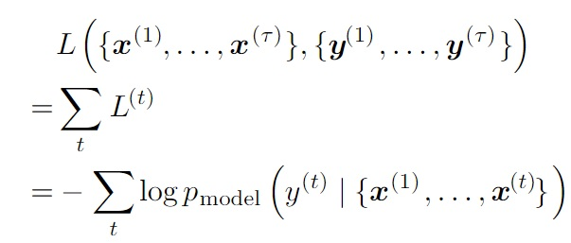
BPTT Example: Given these nodes functions, and Loss

Slide 34
(Apply softmax and compare y_hat to y)
Loss Sum
RNN that produces an output at each time step and have recurrent connections between hidden units

Slide 35
From Your Book
Details for the derivatives can be found here:
https://www.deeplearningbook.org/contents/rnn.html

Slide 36
A More Gentle Look at the Derivatives

Slide 37
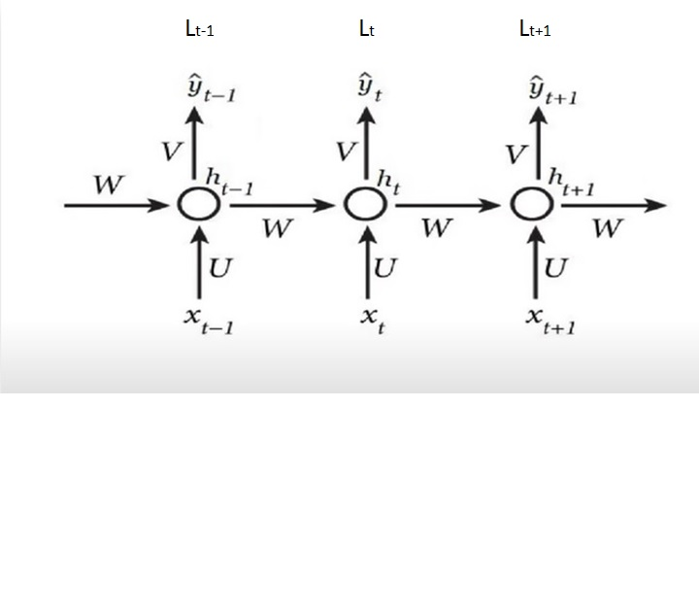
W, U, and V do not change with time.
In other words – all the “W”’s here are the same W.
Same for U and for V.

Slide 38
Find dLt/dV
(Recall that when using softmax and cross entropy, the combined error/derivative is the simple difference between y^ and y)
Note: L, the total loss is the SUM over all the L’s.
L = SUMt to T of Lt
y^t = a(V*ht) where a is softmax
zt= V*ht
dLt/dV = dLt/dy^t * dy^t/dzt * dzt/dV
dLt/dV = (y^t – yt) ht, (outer product)
dL/dV = SUMk:0→T (y^k – yk) ht
V = V – LR * SUMt dLt/dV

Slide 39
Look at dL1/dW
zt=Vht
dL1/dW = dL1/dy^1 * dy^1/dz1 * dz1/dh1 * dh1/dW
= (y^1 – y1) * V * ??
For dh1/dW, first, what was ht?
In our case (though this can be different for diff activation functions) we used tanh.
Recall: ht = tanh(xtU + Wht-1)
Therefore, h1 = tanh(x1U + Wh0)
Using this, dh1/dW is
(1 – tanh^2(x1U + Wh0))*h0, where h0 is not dependent on anything and is not an actual hidden layer.
dL1/dW = dL1/dy^1 * dy^1/dz1 * dz1/dh1 * dh1/dW

Slide 40
Look at dL2/dW
zt=Vht
dL2/dW = dL2/dy^2 * dy^2/dz2 * dz2/dh2 * dh2/dW
= (y^2 – y2) * V * ??
Recall: ht = tanh(xtU + Wht-1)
Therefore, h2= tanh(x2U + Wh1)
TO get dh2/dW, we need the derivative of
(1 – tanh^2(x2U + Wh1))*h1 wrt W and also wrt to h1 which is defined in terms of W.
dh2/dW => dh2/dW + [(dh2/dh1)(dh1/dW)]
In this term, we treat h1 as a constant.
In this term, we treat h1 as a function of W where h1 affects h2 and W affects h1.
Before we resolve the terms – let’s find dL3/dW to see if we can find the PATTERN!
dL2/dW = dL2/dy^2 * dy^2/dz2 * dz2/dh2 * dh2/dW + [(dh2/dh1)(dh1/dW)]

Slide 41
Look at dL3/dW
zt=Vht
dL3/dW = dL3/dy^3 * dy^3/dz3 * dz3/dh3 * dh3/dW
= (y^3 – y3) * V * ??
dh3/dW => dh3/dW + [(dh3/dh2)(dh2/dW)]
but plug in dh2/dW and get....
dh3/dW => dh3/dW + [(dh3/dh2)[(dh2/dW + [(dh2/dh1)(dh1/dW)])]]
dL3/dW = dL3/dy^3 * dy^3/dz3 * dz3/dh3 * dh3/dW + [(dh3/dh2)[(dh2/dW + [(dh2/dh1)(dh1/dW)])]]

Slide 42
What is the Pattern? What is dL/dW?
dL1/dW = dL1/dy^1 * dy^1/dz1 * dz1/dh1 * dh1/dW
dL2/dW = dL2/dy^2 * dy^2/dz2 * dz2/dh2 * dh2/dW + [(dh2/dh1)(dh1/dW)]
dL3/dW = dL3/dy^3 * dy^3/dz3 * dz3/dh3 * dh3/dW + [(dh3/dh2)[(dh2/dW + [(dh2/dh1)(dh1/dW)])]]
Pattern:
dLt/dW = dLt/dy^t * dy^t/dzt * dzt/dht* dht/dW + [(dht/dht-1)[(dht-1/dW + [(dht-1/dht-2)(dht-2/dW)])]]
dL/dW = SUMt:1 to T SUMk:1 to t [ dLt/dy^t * dy^t/dzt * dzt/dht* [ PROD m:k-1 to t (dhm/dhm-1) ] * dhk/dW
dhk/dW can be written as hk-1
dL/dW = SUMt:1 to T SUMk:1 to t [ dLt/dy^t * dy^t/dzt * dzt/dht* [ PROD m:k-1 to t (dhm/dhm-1) ] CP hk-1,
where CP is outerProduct

Slide 43
dL/dU (Similar to dL/dW)
dL/dU = SUMt:1 to T SUMk:1 to t [ dLt/dy^t * dy^t/dzt * dzt/dht* [ PROD m:k-1 to t (dhm/dhm-1) ] CP xk
where CP is outerProduct

Slide 47
Vanishing Gradients Cont.
As the gap (distance) between what is current and what is “important” gets larger, RNN performance decreases. This is caused by the vanishing gradient problem.

Slide 48
Choosing “Better” Activations

Slide 49
Using Identify for Weight

Slide 50
LSTM: Long Short Term Memory Networks

Slide 51
LSTM – Track and Store Information

Slide 52
LSTMs Uses Gates

Slide 53
Forget – Store – Update – Output Selective Updating

Slide 54
Enables Gradient Flow

Slide 56
RNNs in Tensorflow/Keras

Slide 57
RNNs in Tensorflow/Keras

Slide 58
Application Example: Sentiment Analysis
Sentiment analysis is a common applications in Natural Language processing.
Such examples include customer service sentiment analysis, reviews, feedback, etc.
This example will train an RNN classifier on movie reviews form the IMDB data set.
We will use Recurrent Neural Networks, and in particular LSTMs, to perform sentiment analysis in Keras. Conveniently, Keras has a built-in IMDb movie reviews data set that we can use.

Slide 59
Code Set Up and Dataset
import numpy as np
import tensorflow as tf
from tensorflow.keras import datasets, layers, models
import matplotlib.pyplot as plt
from tensorflow.keras.datasets import imdb
vocabulary_size = 5000
(X_train, y_train), (X_test, y_test) = imdb.load_data(num_words = vocabulary_size)
print("Loaded dataset with {} training samples, {} test samples".format(len(X_train), len(X_test))

Slide 60
Output

Slide 61
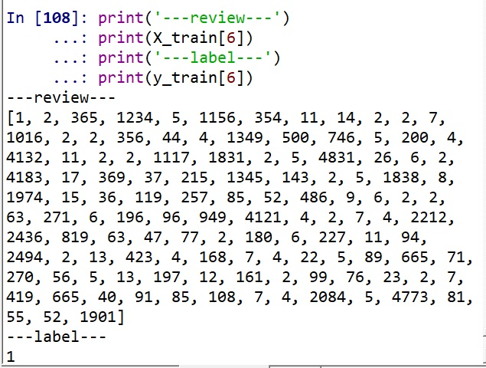
View the data
print('---review---')
print(X_train[6])
print('---label---')
print(y_train[6])

Slide 62
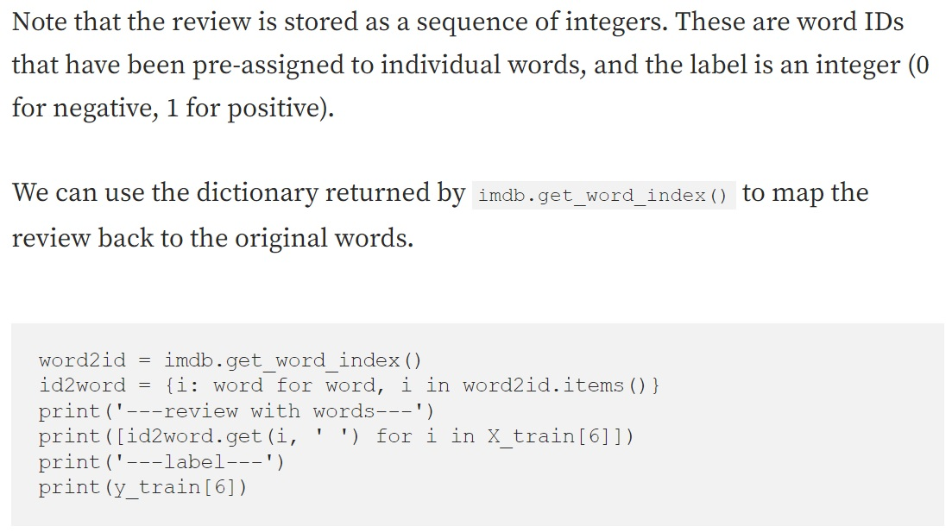
Word Mapping

Slide 63
Word Mapping Output

Slide 64
Min and Max Review Length
print("Maximum review length: {}".format(len(max((X_train + X_test), key=len))))
print("Minimum review length: {}".format(len(min((X_test + X_test), key=len))))
Maximum review length: 2697
Minimum review length: 14

Slide 65
Padding Sequences
In order to feed this data into our RNN, all input documents must have the same length.
Limit the maximum review length to max_words by truncating longer reviews and padding shorter reviews with a null value (0).
Method: pad_sequences() function in Keras.
Set max_words to 500.
from keras.preprocessing import sequence
## IMPORTANT NOTE:
## If the above creates an error – use the following instead
## from tensorflow.keras.preprocessing import sequence
max_words = 500
X_train = sequence.pad_sequences(X_train, maxlen=max_words)
X_test = sequence.pad_sequences(X_test, maxlen=max_words)

Slide 66
Design an RNN Model for Sentiment Analysis
from tensorflow.keras import Sequential
from tensorflow.keras.layers import Embedding, LSTM, Dense, Dropout
embedding_size=32
model=Sequential()
model.add(Embedding(vocabulary_size, embedding_size, input_length=max_words))
model.add(LSTM(100))
model.add(Dense(1, activation='sigmoid'))
print(model.summary())
1) Recall that our input is a sequence of words that are coded as “integer word IDs”.
2) We set our maximum length to “max_words”.
3) Our output is a binary sentiment label, 0 or 1.

Slide 67
Model Summary
Our model is a simple RNN model with 1 embedding, 1 LSTM and 1 dense layers. 213,301 parameters in total need to be trained

Slide 68
Compile the Model
1) Compile and specify a Loss function
2) Specify an optimizer
3) Select evaluation metrics
model.compile(loss='binary_crossentropy', optimizer='adam', metrics=['accuracy'])

Slide 69
Train and Validate the Model
Once compiled, the model can be trained.
There are two important training parameters to specify — batch size and number of training epochs, which together with our model architecture determine the total training time.
Training may take SEVERAL minutes ☺
batch_size = 64
num_epochs = 3
## Learn more about the validation set and the training here
## https://keras.io/guides/training_with_built_in_methods/
X_valid, y_valid = X_train[:batch_size], y_train[:batch_size]
X_train2, y_train2 = X_train[batch_size:], y_train[batch_size:]
model.fit(X_train2, y_train2, validation_data=(X_valid, y_valid), batch_size=batch_size, epochs=num_epochs)

Slide 70
Output

Slide 71
Test the Model on Unseen Data
Once we have trained our model, it’s time to see how well it performs on unseen test data.
scores[1] will correspond to accuracy if we pass metrics=[‘accuracy’]
scores = model.evaluate(X_test, y_test, verbose=1) print('Test accuracy:', scores[1])

Slide 72
Test Output (Verbose = 1)

Slide 73
Example 2: RNNs/LSTM on MNIST
import tensorflow.keras
from tensorflow.keras.datasets import mnist
from tensorflow.keras.models import Sequential
from tensorflow.keras.layers import LSTM, Dense, Dropout, LSTM
from tensorflow.keras.optimizers import Adam
import matplotlib.pyplot as plt
from tensorflow.keras import layers

Slide 74
Import the Data
#Importing the data
(X_train, y_train),(X_test, y_test) = mnist.load_data() # unpacks images to x_train/x_test and labels to y_train/y_test
#Normalizing the data
X_train = X_train.astype('float32') / 255.0
X_test = X_test.astype('float32') / 255.0
print(X_train[4])
print(y_train[4])
plt.imshow(X_train[3])
print(X_train.shape)
print(X_train.shape[1:])
print(y_train.shape)
print(X_test.shape)
print(y_test.shape)

Slide 75
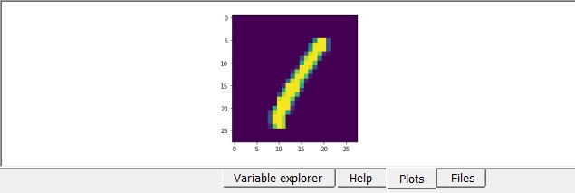
Viewing Data and Shapes
9
(60000, 28, 28)
(28, 28)
(60000,)
(10000, 28, 28)
(10000,)

Slide 76
Build the Model
model = tensorflow.keras.models.Sequential()
#Adding the model layers
# The number of units is the number of neurons connected to the
#layer holding the concatenated vector of hidden state and input
model.add(tensorflow.keras.layers.LSTM(128, input_shape=(X_train.shape[1:]), return_sequences=True))
model.add(tensorflow.keras.layers.Dropout(0.2))
model.add(tensorflow.keras.layers.LSTM(128))
model.add(tensorflow.keras.layers.Dense(64, activation='relu'))
model.add(tensorflow.keras.layers.Dropout(0.2))
model.add(tensorflow.keras.layers.Dense(10, activation='softmax'))

Slide 77
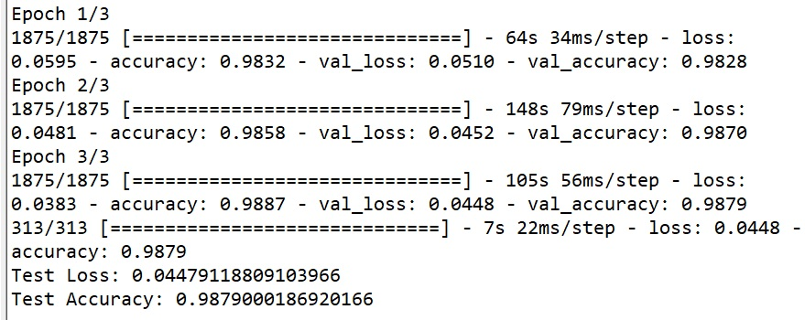
Compile and Fit the Model
#Compiling the model
model.compile( loss='sparse_categorical_crossentropy',
optimizer = tensorflow.keras.optimizers.Adam(lr=0.001, decay=1e-6), metrics=['accuracy'] )
#Fitting data to the model and saving the history
history = model.fit(X_train, y_train, epochs=3, validation_data=(X_test, y_test))

Slide 78
Evaluate and View Loss
test_loss, test_acc = model.evaluate(X_test, y_test)
print('Test Loss: {}'.format(test_loss))
print('Test Accuracy: {}'.format(test_acc))
train_loss = history.history['loss']
val_loss = history.history['val_loss']
train_acc = history.history['accuracy']
val_acc = history.history['val_accuracy']
313/313 [==============================] - 4s 14ms/step - loss: 0.0448 - accuracy: 0.9879
Test Loss: 0.04479118809103966
Test Accuracy: 0.9879000186920166

Slide 79
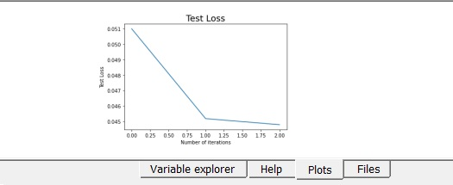
Visualizing the change in the validation loss
#visualizing the change in the validation loss
plt.plot(val_loss)
plt.title("Test Loss",size=18)
plt.xlabel("Number of iterations")
plt.ylabel("Test Loss")
plt.show()

Slide 80
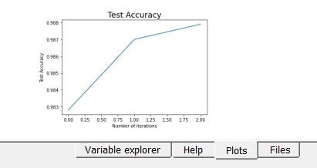
Visualizing the change in the validation loss
#visualizing the change in the validation loss
plt.plot(val_acc)
plt.title("Test Accuracy",size=18)
plt.xlabel("Number of iterations")
plt.ylabel("Test Accuracy")
plt.show()

Slide 81
Examples
https://towardsdatascience.com/a-beginners-guide-on-sentiment-analysis-with-rnn-9e100627c02e
https://www.youtube.com/watch?v=I4_lyJVnpMg
https://www.youtube.com/watch?v=Wu9BsMSKqyk

Slide 82
Examples
https://www.youtube.com/watch?v=QvkQ1B3FBqA&list=RDLVQvkQ1B3FBqA&index=1
https://www.youtube.com/watch?v=SEnXr6v2ifU&t=849s
https://www.youtube.com/watch?v=rZufA635dq4
https://towardsdatascience.com/a-beginners-guide-on-sentiment-analysis-with-rnn-9e100627c02e
https://www.tensorflow.org/text/tutorials/text_classification_rnn
https://www.analyticsvidhya.com/blog/2021/06/natural-language-processing-sentiment-analysis-using-lstm/

