Slide 1
RNNs Transformers Attention Memory
Gates

Slide 2
ANN

Slide 3
CNN

Slide 4
RNN

Slide 5
Transformers
Transformers - type of neural network architecture that have been gaining popularity.
Transformers were recently used by OpenAI in their language models, and also used recently by DeepMind for AlphaStar — their program to defeat a top professional Starcraft player.
https://towardsdatascience.com/transformers-141e32e69591

Slide 6
Transformers
Transformers were developed to solve the problem of sequence transduction, or neural machine translation.
That means any task that transforms an input sequence to an output sequence.
This includes speech recognition, text-to-speech transformation, etc.

Slide 7
Sequence Transformation/Transduction
Input sequences → Output sequences
Examples:
Speech recognition
Translation
Protein Secondary structure prediction
text-to-speech

Slide 8
Memory
For models to perform sequence transduction, it is necessary to have some sort of memory.
For example let’s say that we are translating the following sentence to another language such as French:
“The Transformers” are a Japanese [[hardcore punk]] band. The band was formed in 1968, during the height of Japanese music history”

Slide 9
Looking Back – Context and Reference
In this example, the words “the band” in the second sentence refer to the band “The Transformers” introduced in the first sentence.
When you read about the band in the second sentence, you know that it is referencing to the “The Transformers” band.
That is important for translation.
There are many examples where words in some sentences refer to words in previous sentences.

Slide 10
Dependencies
For translating sentences like that, a model needs to figure out these sort of dependencies and connections.
Recurrent Neural Networks (RNNs) and Convolutional Neural Networks (CNNs) have been used to deal with this goal....

Slide 11
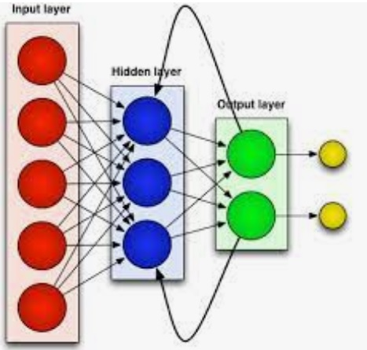
RNNs (Recurrent NNs)
Recurrent Neural Networks have loops in them, allowing information to persist.
A loop allows information to be passed from one step to the next.
This chain-like nature shows that recurrent neural networks are clearly related to sequences and lists. To translate text - set each input as the word in that text.
The Recurrent Neural Network passes the information of the previous words to the next network that can use and process that information.

Slide 12
Long-Term Dependency
RNNs can learn to use past information and figure out what is the next word for this sentence.
But there are cases where we need more context.
For example, let’s say that you are trying to predict the last word of the text:
“I grew up in France… I speak fluent …”.
Recent information suggests that the next word is probably a language, but if we want to narrow down which language, we need context of France, - that is further back in the text.

Slide 13
Challenges of RNNs
RNNs become very ineffective when the gap between the relevant information and the point where it is needed become very large.
RNNs - due to chain length – can suffer from exploding or vanishing gradients.
In theory, RNNs could learn this long-term dependencies. In practice, they don’t seem to learn them very well.
LSTM, a special type of RNN, tries to solve this kind of problem.

Slide 14
Long-Short Term Memory (LSTM)
When arranging one’s calendar for the day, we prioritize our appointments. If there is anything important, we can cancel some of the meetings and accommodate what is important.
RNNs don’t do that. Whenever it adds new information, it transforms existing information completely by applying a function.
The entire information is modified, and there is no consideration of what is important and what is not.

Slide 15
LSTMs: Long Short Term Memory
LSTMs make small modifications to the information by multiplications and additions.
With LSTMs, the information flows through a mechanism known as cell states.
In this way, LSTMs can selectively remember or forget things that are important and not so important.

Slide 16
LSTM -
http://colah.github.io/posts/2015-08-Understanding-LSTMs/

Slide 17
Attention
In neural networks, attention is a technique that is meant to mimic cognitive attention.
The effect enhances some parts of the input data while diminishing other parts — the motivation being that the network should devote more focus to the small, but important, parts of the data.

Slide 18
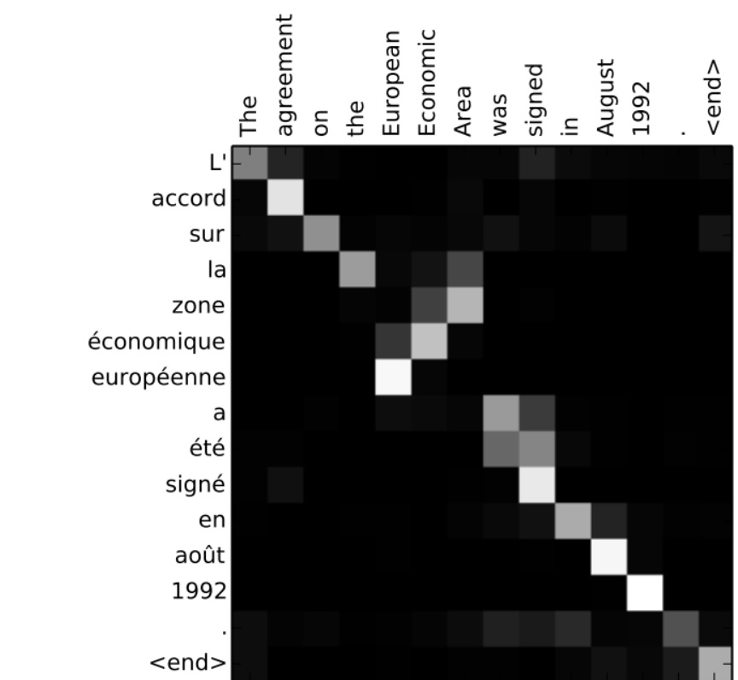
Translation and Attention
For example, when translating the sentence “L’accord sur la zone économique européenne a été signé en août 1992.” from French to English - how much attention it is paid to each input.

