Slide 1
Clustering and Distance
GATES

Slide 2
Clustering: Grouping - Categorizing
1) Clustering is “unsupervised”. This means that the data is not labeled or categorized.
2) Clustering is used to “discover” if groups/categories exist and if so – what they are.
3) Clustering can be used to determine if the data in a dataset fits into any type of groups/categories/classes.
4) If categories can be identified, this information then be used to classify or predict other vectors.
5) Clustering reduces dimensionality.
6) Clustering can be used to create labels.

Slide 3
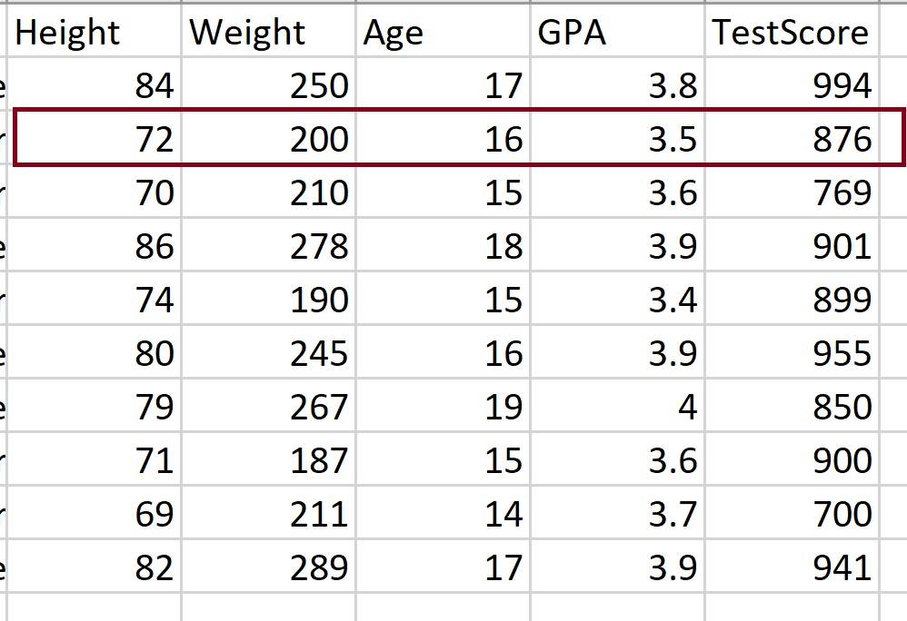
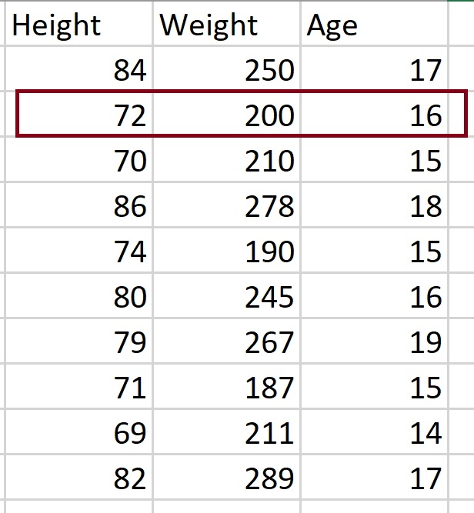
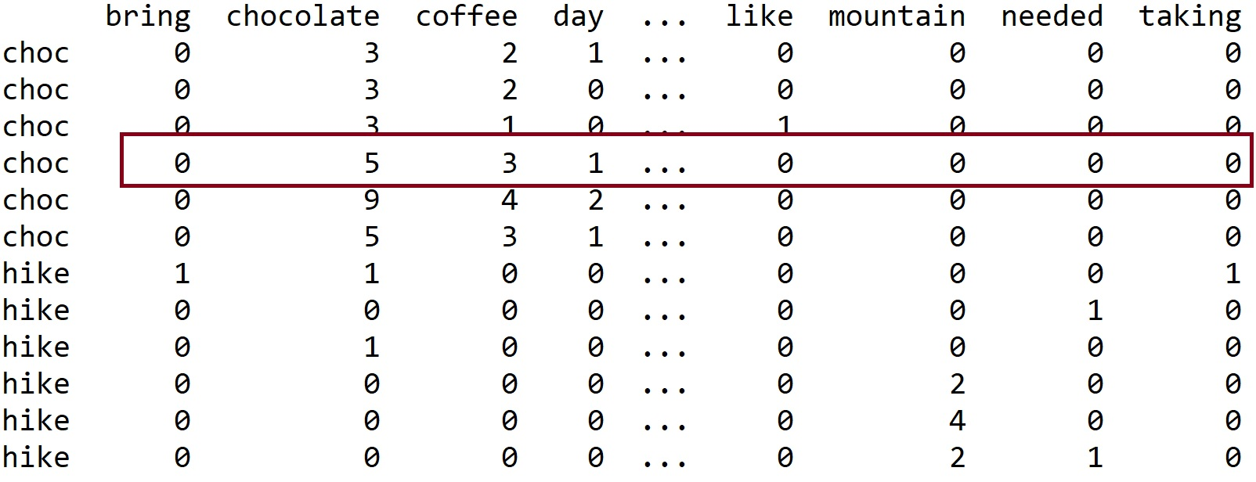
What is a VECTOR (in a dataset)?

Slide 4
Distance by Hand…Which is “closer” – rows 1 and 2 OR 1 and 3?
Using Manhattan:
Dist(1, 2):
[251 267 70]
[105 103 62]
|(251-105)| + |(267-103)| + |(70-62)| = 318
Dist(1, 3)
[251 267 70]
[156 193 72]
abs(251-156) + abs(267-193) + abs(70-72) = 171

Slide 5
Very general goal of clustering

Slide 6
Applications of clustering
1) There are an enormous number of applications for clustering, as clustering is a method for discovering similarity (and differences) between data vectors/rows.
2) One can cluster books, articles, or documents by topics.
3) Once can cluster customers by common attributes – such as purchase similarities, location similarities, expenditure similarities, etc.
4) One can cluster social data by attributes such as common interests, common career areas, etc.
5) One can cluster radiation data collected from objects is space to determine if they are star, planets, galaxies, etc.
6) One can cluster music into categories – think about this for a second – how do you think Pandora does this?
Clustering can also be used for outlier detection. This is especially true for visual EDA (exploratory data analysis).

Slide 7
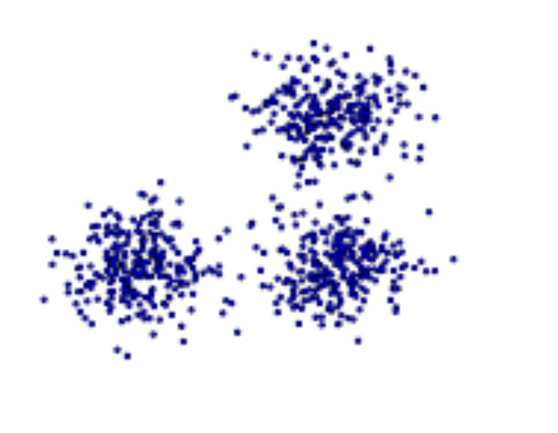
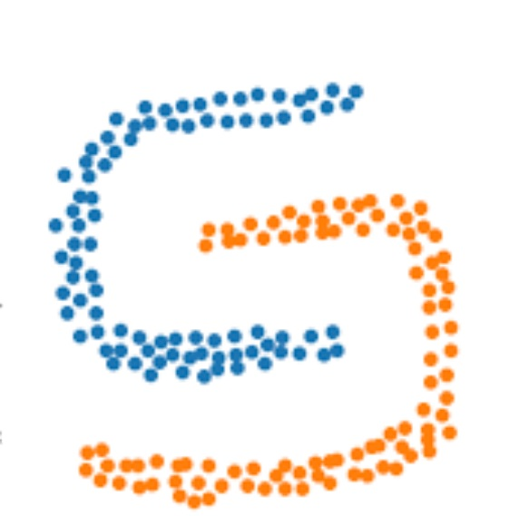
Challenges of clustering
1) Clustering is powerful and excellent for discovery. However, it also has many challenges associated with it:
- High Dimension
When data vectors (each row of data) have many attributes (variable values), it is not possible to visualize this data.
In addition, the higher the dimensionality, the less accurate some measure of similarity can be become. For example, the Euclidean distance loses accuracy. Why? Because at very high dimension, any two points are very far apart with respect to this type of distance.
For higher D data, other similarity measures such as NN (nearest neighbor) or Cosine similarity.
- Clusters may be based on density or on distance.

Slide 8
Common Clustering Categories
Partitional Clustering (such as k – means): divides data objects into nonoverlapping groups. No object can be a member of more than one cluster, and every cluster must have at least one object.
Hierarchical Clustering : determines cluster assignments by building a hierarchy. This is implemented by either a bottom-up or a top-down approach. These methods produce a tree-based hierarchy of points called a dendrogram. - Agglomerative or divisive
Density Based Clustering : determines cluster assignments based on the density of data points in a region. This approach doesn’t require the user to specify the number of clusters. Instead, there is a distance-based parameter that acts as a tunable threshold. Example : DBSCAN (Density-Based Spatial Clustering of Applications with Noise)

Slide 9
Measures of similarity/distance
1) The goal of clustering is to group together “similar” data vectors (also called data rows) while distinguishing between non-similar vectors.
2) To determine if two vectors are similar, a measure of similarity is needed.
TWO GENERAL DISTANCE MEASURE TYPES:
(a) Euclidean distance – used to measure real-valued attributes and dense points.
Euclidean distance is based on the location (as an x, y, z, .. coordinate) of each vector (point) in space.
(b) non-Euclidean
This type of measure is based on the properties of the vectors rather than their location in a defined space.

Slide 10
Some fun math: the axioms of a distance measure
1) For any measure D to be a “distance measure” it must meet the following properties:
(a) Given any two vectors x and y, D(x,y) >= 0. In other words, distance cannot be negative.
(b) D(x, y) = 0 iff x = y. In other words, the only way the distance between two vectors is 0 is if they are the same vector.
(c) D(x,y) = D(y,x). Direction does not matter.
(d) D(x, y) <= D(x,z) + D(z,y). This is called the Triangle Inequality.

Slide 11
Note: The L3 norm, cubes the differences and so no.
The L1 norm is often called the Manhattan distance as it is based on the idea of “block distance” rather than point to point direct distance.

Slide 12
A comparison

Slide 13
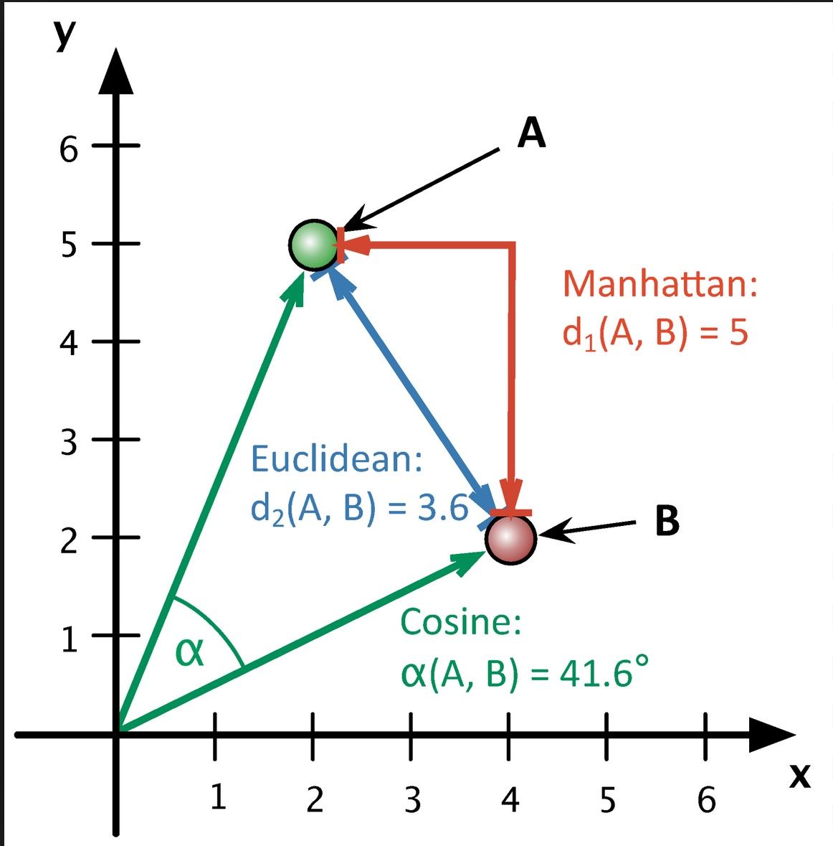
Cosine Similarity is non-Euclidean.

Slide 15
import numpy as np
def cosine_sim(x, y):
x = np.array(x)
y = np.array(y)
if len(x) != len(y) :
return None
dot_product = np.dot(x, y.T)
# Magnitudes of x and y
magnitude_x = np.sqrt(np.sum(x**2))
magnitude_y = np.sqrt(np.sum(y**2))
# Cosine Sim and angle as degrees
cos_sim = dot_product / (magnitude_x * magnitude_y)
angle=np.arccos(cos_sim)
angle=np.degrees(angle)
return cos_sim, angle
CS, Cos_angle=cosine_sim([[251,267,70]], [[105,103,62]])
print(CS)
print(Cos_angle)
from sklearn.metrics.pairwise import cosine_similarity
import pandas as pd
DF = pd.read_csv("C:/Users/profa/Desktop/UCB/ML CSCI 5622/Data/HeartRisk_JustNums.csv")
print(cosine_similarity(DF, DF))

Slide 16
Normalization
## Normalizing
DF_MinMaxNorm = (df-df.min()) / (df.max() - df.min())
print(DF_MinMaxNorm)

Slide 17
Non-Euclidean distances
http://infolab.stanford.edu/~ullman/mining/pdf/cs345-cl.pdf

Slide 18
http://infolab.stanford.edu/~ullman/mining/pdf/cs345-cl.pdf

Slide 19
Cosine similarity
Good for high D data.
1) Imagine that each row or data vector is a numerical vector.
2) Next, no matter what dimension you are using, the origin is (0, 0, …0)
So in 2D the origin is (0,0) in 3D its (0,0,0) and so on.
3) Next, Any two vector points in any D space create an angle between them.
4) The COS of any angle is defined as the normalized dot product:
(V1 . V2) / |V1| |V2|
Example: Suppose vector 1 (V1) is [1, 3] and suppose vector 2 (V2) is [2,2]
Then, the dot product V1 . V2 = (1*2) + (3*2) = 8
Next, |V1| = sqrt(1^2 + 3^2) = sqrt(10)
|V2| = sqrt(2^2 + 2^2) = sqrt(8)
So COS() = 8 / (sqrt(8)*sqrt(10)) = .894
To solve for the angle, find the arccos (.894) = 26.6 degrees

Slide 20
Visual of cos measure

Slide 21
Edit distance
1) The Edit Distance between any two strings or sequences of characters is the number of inserts and deletes of characters needed to make the strings identical.
2) First, the longest common subsequence (LCS) is defined as the longest string obtained by deleting from x and y.
Then, d(x,y) = |x| + |y| - 2|LCS(x,y)|

Slide 22
Distance measures for nominal data

Slide 23
Measure by matches
D(I,j) = (3) - (0) / (3) = 1 (farthest possible distance)
However, we can categorize the numerical data.
Example: Salary Range 1: 0 – 30K, Range 2: 31K – 50K, Range 3: 51K – 89K, Range 4: 90K – 130K, etc.
Then, D(I,j) = (3) - (1) / (3) = 2/3
Pages 69-79 Kumar (2005)

Slide 25
Document similarity comparison (distance): an example of the need and value of normalization
1) The goal is to utilize the word types and frequencies in documents to determine how similar the documents are.
2) Recall that similarity is a measure of distance.
3) First, think about the problem itself. Imagine three documents. Suppose the first has 100 words and the second has 5000 words, and the third has 10,000 words. Simply by the number of words, it will appear that Doc 2 and Doc 3 are more similar.
4) Therefore, before comparing documents, weighting and normalization must be used.
5) TF- IDF
TF stands for TERM FREQUENCY
IDF stands for INVERSE DOC FREQUENCY
TF-IDF is considered a “weight”

Slide 26
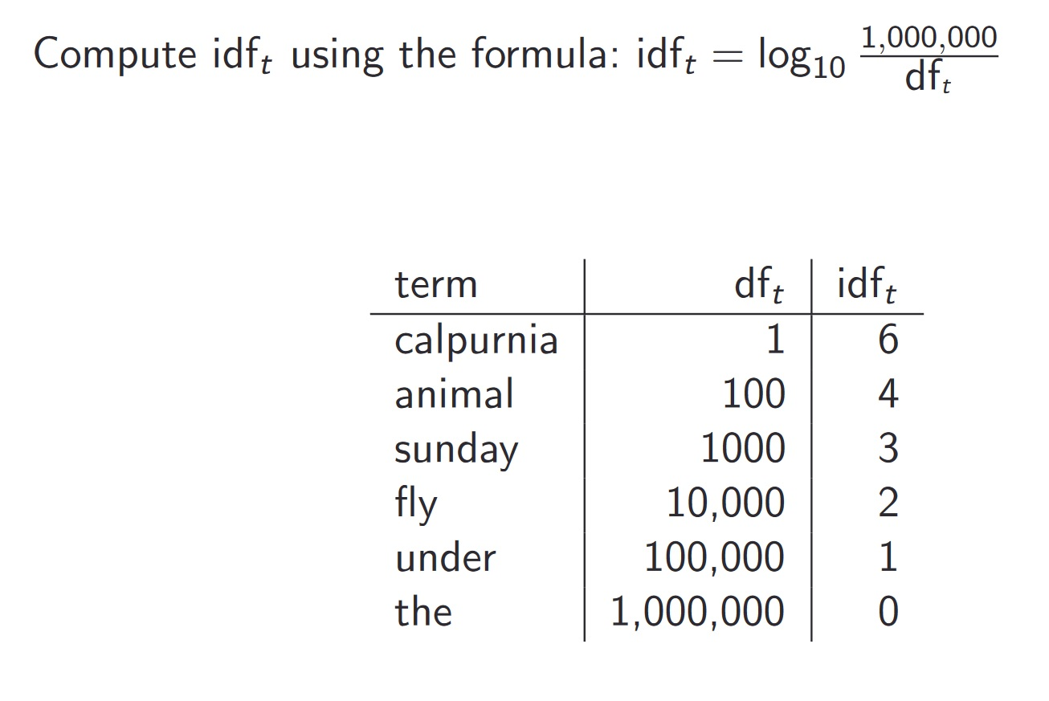
TF - IDF
TF: Term Frequency, which measures how frequently a term occurs in a document. Since every document is different in length, it is possible that a term would appear much more times in long documents than shorter ones. Thus, the term frequency is often divided by the document length (aka. the total number of terms in the document) as a way of normalization:
TF(t) = (Number of times term t appears in a document) / (Total number of terms in the document).
IDF: Inverse Document Frequency, which measures how important a term is. While computing TF, all terms are considered equally important. However it is known that certain terms, such as "is", "of", and "that", may appear a lot of times but have little importance. Thus we need to weigh down the frequent terms while scale up the rare ones, by computing the following:
IDF(t) = log_e(Total number of documents / Number of documents with term t in it).

Slide 27
TF-IDF Example
Example:
Consider a document containing 100 words wherein the word cat appears 3 times.
TF for cat = (3 / 100) = 0.03.
Now, assume we have 10 million documents and the word cat appears in one thousand of these.
IDF = log(10,000,000 / 1,000) = 4.
Thus, the TF-IDF weight is the product of these quantities: 0.03 * 4 = 0.12.

Slide 28
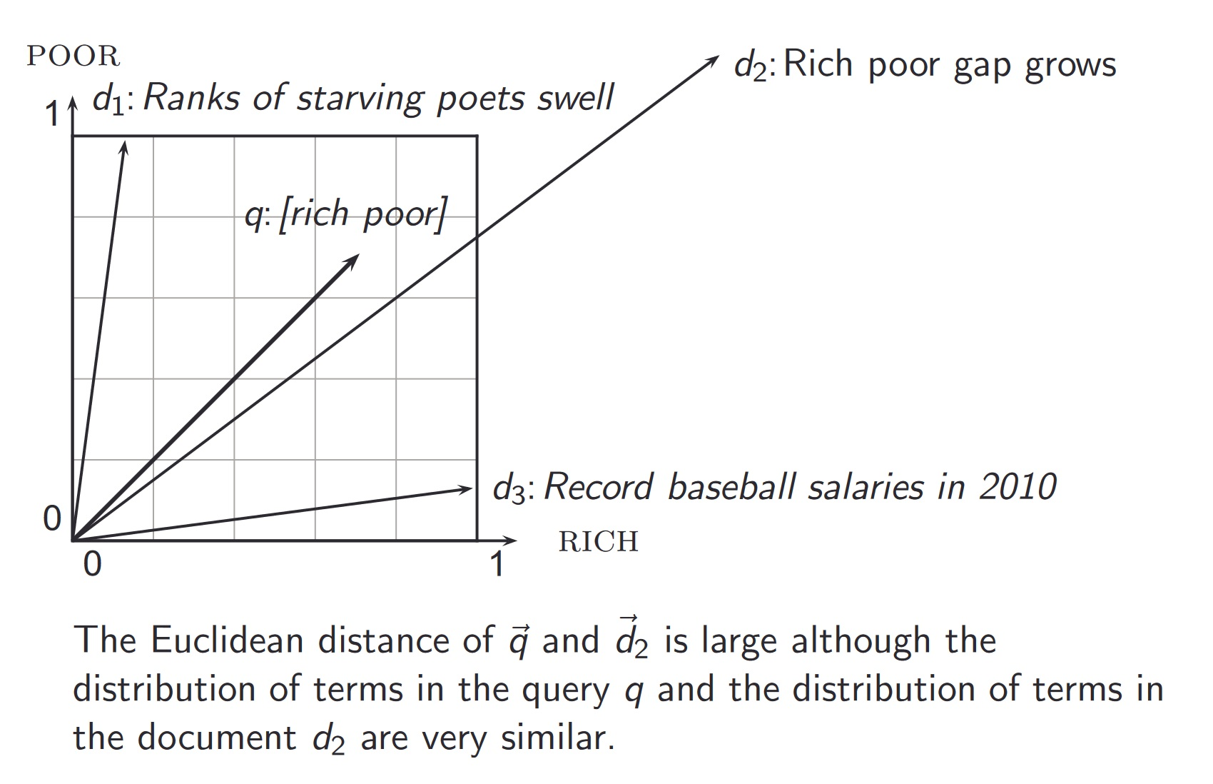
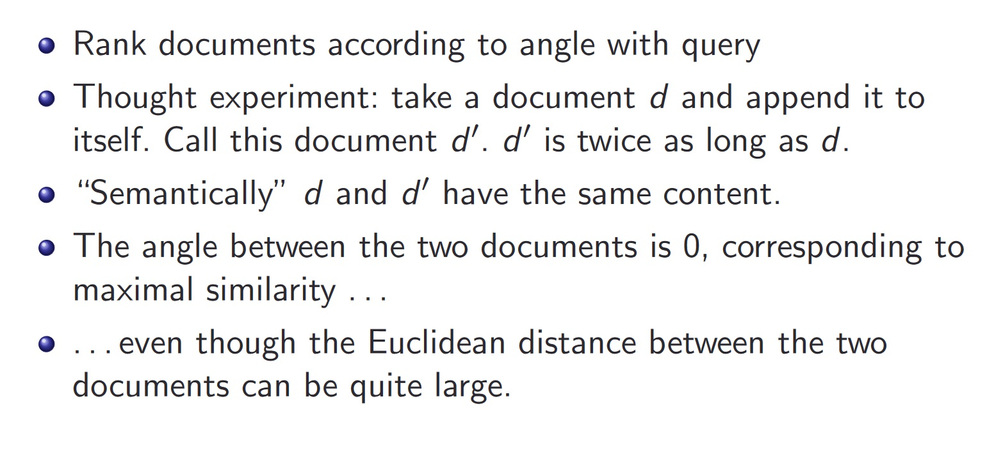
Similarity measures: measuring the “distance” between document vectors in d space.
Options for measuring the Distance (or similarity) between documents:
Euclidean – this is not a good idea, as the greater the dimension, the less accurate the measure. (recall that the number of words you are looking at IS the dimension). Euclidean distance can be very large for vectors of different length.
Angles between vectors is a better measure… COSINE SIMILARITY

Slide 29
Length normalization using cosine (L2 norm)

Slide 30
Cosine similarity example

Slide 32
Back to clustering: two main types
1) Partitioned (also known as point assignment) – top down – divide objects into non-overlapping
k-means, k-medoids, CLARANS
EM – Expectation Maximization (Prob of cluster membership)
2) Hierarchical – bottom up – all points start as their own cluster – then merge and grow into larger clusters based on closeness/similarity.
DIANA (DIvisive ANAlysis Clustering), AGNES (Agglomerative Nesting), BIRCH (Balanced, Iterative, Reductive), ROCK (Robust CLustering), CHAMELEON
3) DBSCAN

Slide 33
Partition vs. Hierarchical

Slide 34
Other special clustering types

Slide 35
Well separated clusters (easier to manage) and center-based

Slide 36
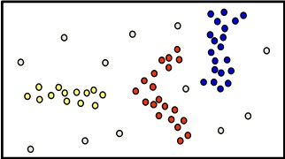
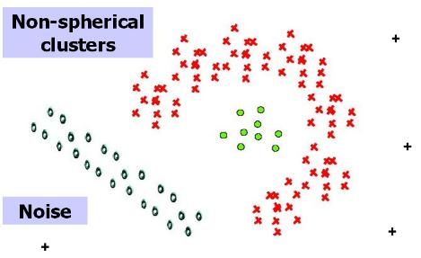
Types of Clusters: Density-Based
Density-based
A cluster is a dense region of points, which is separated by low-density regions, from other regions of high density.
Used when the clusters are irregular or intertwined, and when noise and outliers are present.

Slide 38
Visual Example of k - means
1) Choose k
2) Randomly choose k centroids
3) Place all points into one of the k clusters based on distance.
4) Update the centroids
5) Re-assign points to closest cluster
Repeat steps 4 and 5 for N iterations

Slide 39
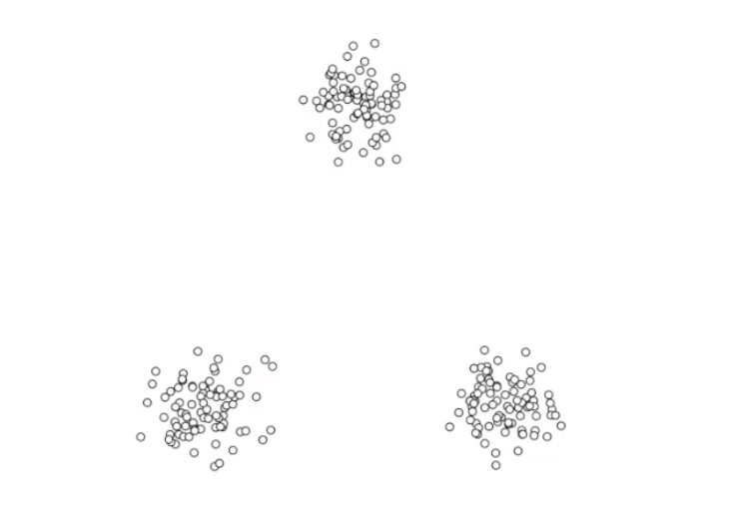
Choose k = 3

Slide 40
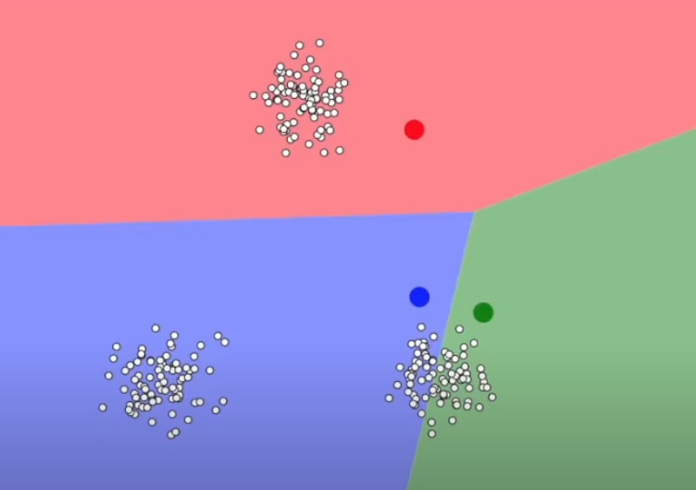
Randomly Choose Initial Centroids

Slide 41
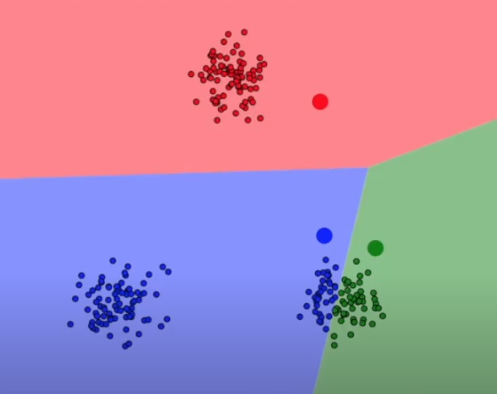
Place Points into Closest Cluster

Slide 42
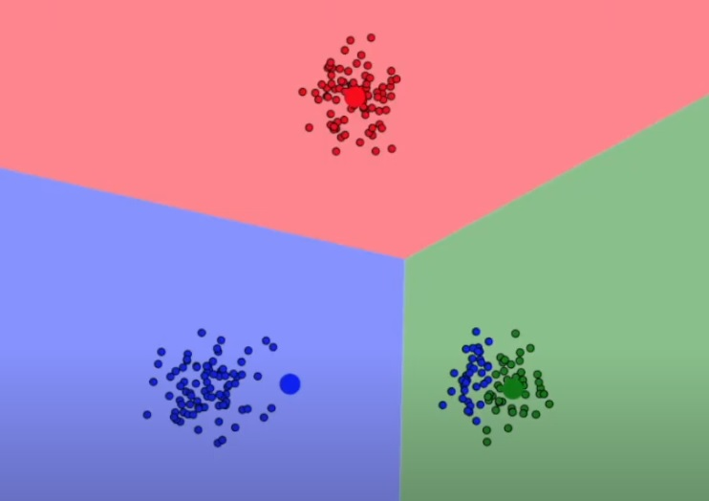
Update Centroids

Slide 43
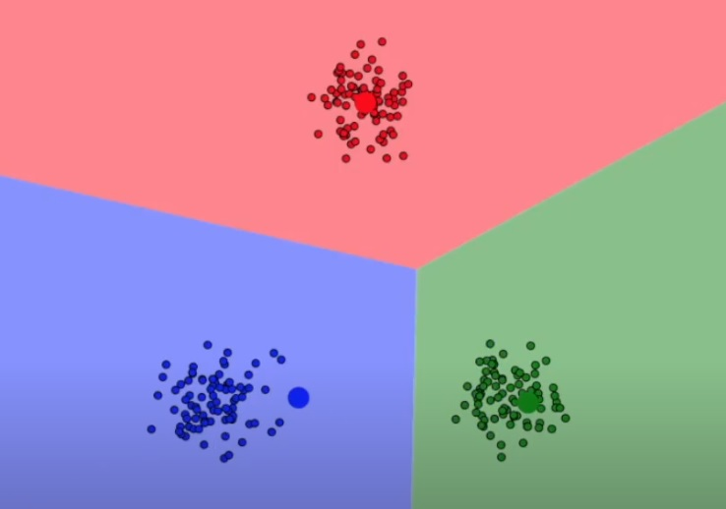
Re- calculate ALL distances from points to centroids and re-assign points to centroids as needed.

Slide 44
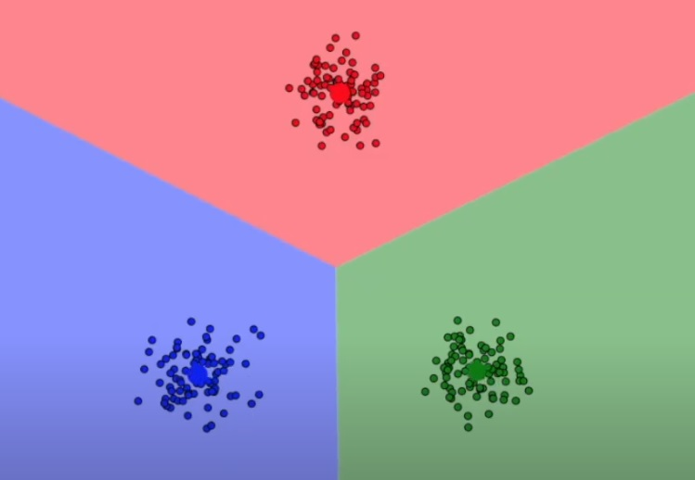
Recalculate Centroids

Slide 45
K means clustering example by hand and in R NOTE: For ease and example – we will place one point at a time. However, most k means algorithms place all points or batches of points at once.

Slide 46
Results by hand

Slide 49
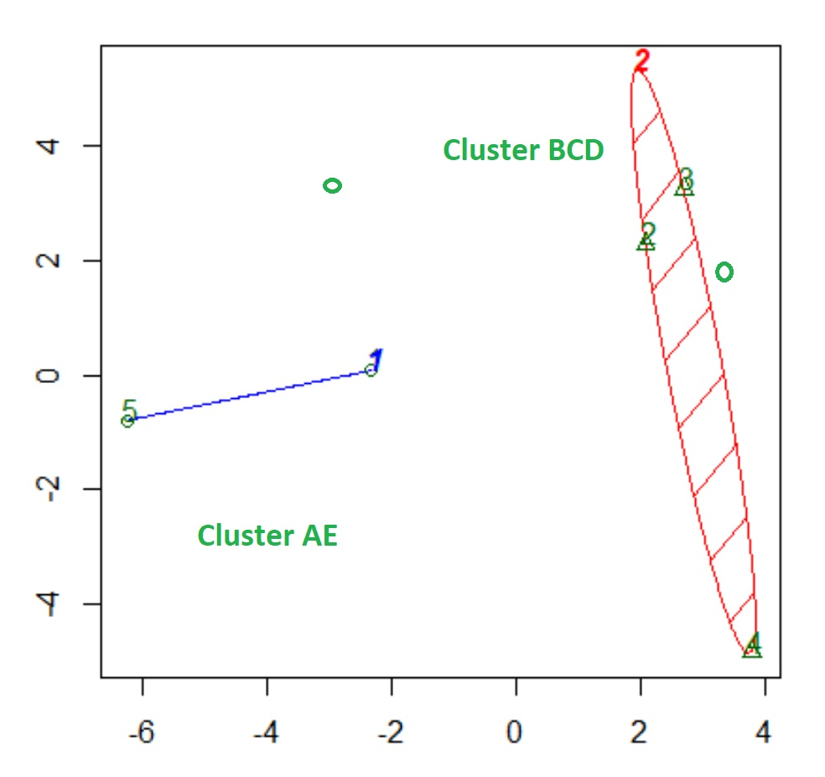
Results from R are the same as by hand

Slide 50
Limitation of k-means

Slide 51
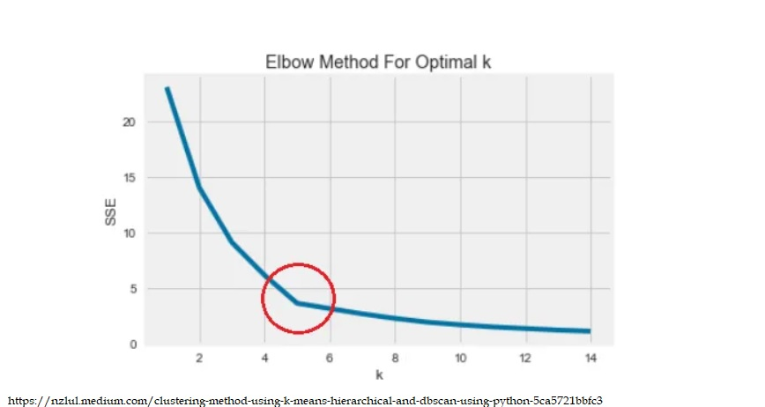
Choosing k: Elbow Method
Elbow Method : There is an “bending” point where the SSE (sum squared error) curve starts to bend known as the elbow point. The x-value of this point is thought to be a reasonable trade-off between error and number of clusters. The elbowpoint is the point where the rate of decrease of mean distance (from points to their centroid) will not change significantly with increase in number of clusters.

Slide 52
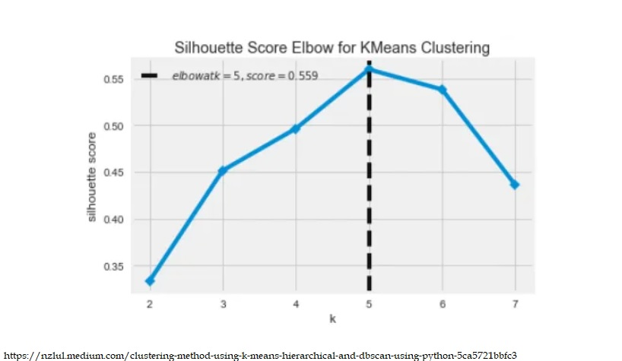
Silhouette Method
Silhouette Coefficient : is a measure of cluster cohesion and separation. It quantifies how well a data point fits into its assigned cluster based on two factors: How close the data point is to other points in the cluster and how far away the data point is from points in other clusters.
Silhouette coefficient values range between -1 and 1. Larger numbers indicate that samples are closer to their clusters than they are to other clusters.

Slide 53
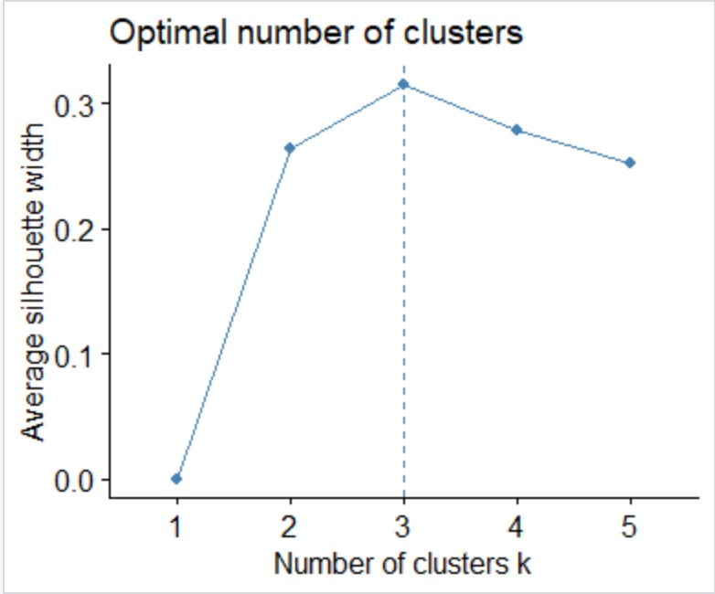
library("factoextra")
(fviz_nbclust(MyDF, kmeans, method='silhouette', k.max=5))

Slide 55
1) It is not necessary to choose or preselect the number of clusters.
2) Hierarchical clusterings may correspond well to taxonomies – such as the animal kingdom.

Slide 56
Hierarchical clustering
Hierarchical clustering is an another method for clustering a dataset into potential groups.
In contrast to k-means, hierarchical clustering will create a hierarchy of clusters.
It is NOT required to pre-specify the number of clusters.
The VIS for hierarchical clustering is a dendrogram.

Slide 57
AGNES and DIANA
Hierarchical clustering can be divided into two main types:
Agglomerative clustering: Commonly referred to as AGNES (AGglomerative NESting) works in a bottom-up manner. Each observation (vector or row) is initially considered as a single-element cluster.
At each step of the algorithm, the two clusters that are the most similar are combined into a new bigger cluster. This procedure is iterated until all points are a member of just one single big cluster
Divisive hierarchical clustering: Commonly referred to as DIANA (DIvise ANAlysis) works in a top-down manner.
Begins with the root - all observations (all rows) are in a single cluster. At each step of the algorithm, the current cluster is split into two clusters that are considered most heterogeneous. The process is iterated until all observations are in their own cluster.

Slide 58
https://bradleyboehmke.github.io/HOML/hierarchical.html

Slide 59
Common Clustering Methods
· Maximum or complete linkage clustering: Computes all pairwise dissimilarities between the elements in cluster 1 and the elements in cluster 2, and considers the largest value of these dissimilarities as the distance between the two clusters. It tends to produce more compact clusters.
· Minimum or single linkage clustering: Computes all pairwise dissimilarities between the elements in cluster 1 and the elements in cluster 2, and considers the smallest of these dissimilarities as a linkage criterion. It tends to produce long, “loose” clusters.
· Mean or average linkage clustering: Computes all pairwise dissimilarities between the elements in cluster 1 and the elements in cluster 2, and considers the average of these dissimilarities as the distance between the two clusters. Can vary in the compactness of the clusters it creates.
· Centroid linkage clustering: Computes the dissimilarity between the centroid for cluster 1 (a mean vector of length p, one element for each variable) and the centroid for cluster 2.
· Ward’s minimum variance method: Minimizes the total within-cluster variance. At each step the pair of clusters with the smallest between-cluster distance are merged. Tends to produce more compact clusters.

Slide 61
Hierarchical Clustering Options in R
Hierarchical clustering in R
stats::hclust() and
cluster::agnes() for agglomerative hierarchical clustering (HC) and
cluster::diana() for divisive HC.
Agglomerative hierarchical clustering
To perform agglomerative HC with hclust(), the dissimilarity (distance) must be calculated. One option in R is dist() and hclust() has options that specify the agglomeration method to be used (i.e. "complete", "average", "single", or "ward.D").

Slide 62
Clustering for Outlier Detection: Row 4 is an outlier….

Slide 63
K means and Hierarchical clustering r code Example of happiness data clustering with clusters and dendrogram views

Slide 64
Cluster results

Slide 65
Dendrogram from r code

Slide 68
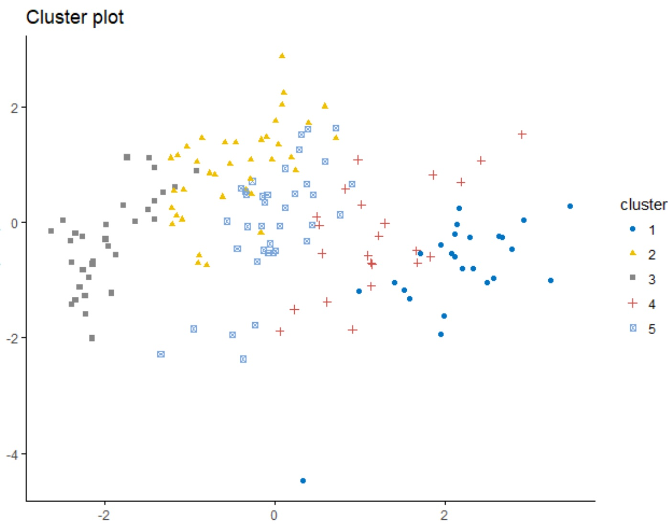
R code for dbSCAN
##library(factoextra) ## for DBSCAN
## install.packages("factoextra")
## DBSCAN Density-based clustering with columns
(HappyData <- read.csv("KaggleHappinessWorldData_raw.csv", header=TRUE))
df <- HappyData[, c(6,8,9,10)]
set.seed(123)
km.res <- kmeans(df, 5, nstart = 25)
fviz_cluster(km.res, df, geom = "point",
ellipse= FALSE, show.clust.cent = FALSE,
palette = "jco", ggtheme = theme_classic())

Slide 69
Comparing documents and r
GATES

Slide 70
libraries
library(wordcloud)
## ONCE: install.packages("tm")
library(tm)
# ONCE: install.packages("Snowball") ## Does not work in R v. 3.5.x as of 5/5/18. check back.
## ONCE: install.packages("slam")
library(slam)
library(quanteda)
## ONCE: install.packages("quanteda") ## Note - this includes SnowballC
library(SnowballC)
library(arules)
##ONCE: install.packages('proxy')
library(proxy)

Slide 71
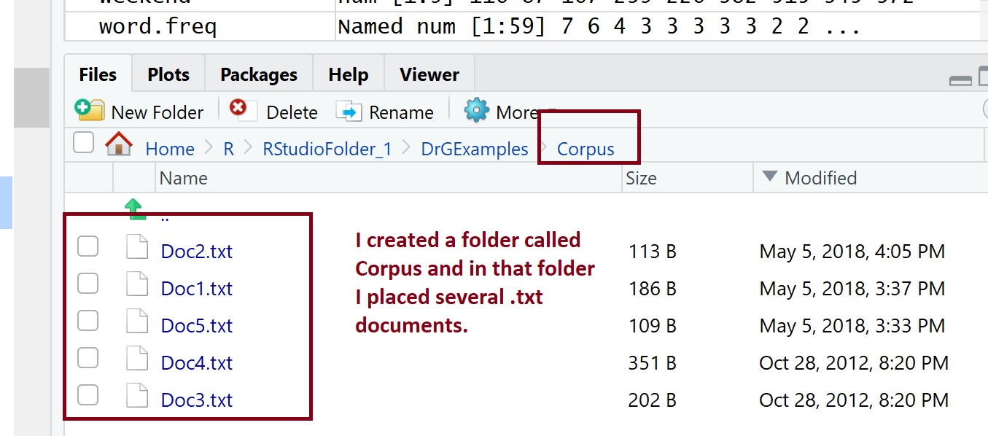
The corpus: a collection of text documents in a folder
TheCorpus <- Corpus(DirSource("Corpus"))
##The following will show you that ##you read in 5 documents
(TheCorpus)

Slide 72
Start to prepare the corpus for evaluation: clean and prep it part 1
## The tm_map function allows you to perform the same
## transformations on all of your texts at once
CleanCorpus <- tm_map(TheCorpus, removePunctuation)
## Remove all Stop Words
CleanCorpus <- tm_map(CleanCorpus, removeWords, stopwords("english"))
## You can also remove words that you do not want
MyStopWords <- c("like", "very", "can", "I", "also", "lot")
CleanCorpus <- tm_map(CleanCorpus, removeWords, MyStopWords)
## NOTE: If you have many words that you do not want to include
## you can create a file/list
## MyList <- unlist(read.table("PATH TO YOUR STOPWORD FILE", stringsAsFactors=FALSE)
## MyStopWords <- c(MyList)
##Make everything lowercase
CleanCorpus <- tm_map(CleanCorpus, content_transformer(tolower))

Slide 73
Start to prepare the corpus for evaluation: clean and prep it part 2
## Let's see where we are so far...
inspect(CleanCorpus)
## Next, I will write all cleaned docs - ##the entire cleaned and prepped corpus
## to a file - in case I want to use it for ##something else.
(Cdataframe <- data.frame(text=sapply(CleanCorpus, identity), stringsAsFactors=F))
write.csv(Cdataframe, "Corpusoutput.csv")

Slide 74
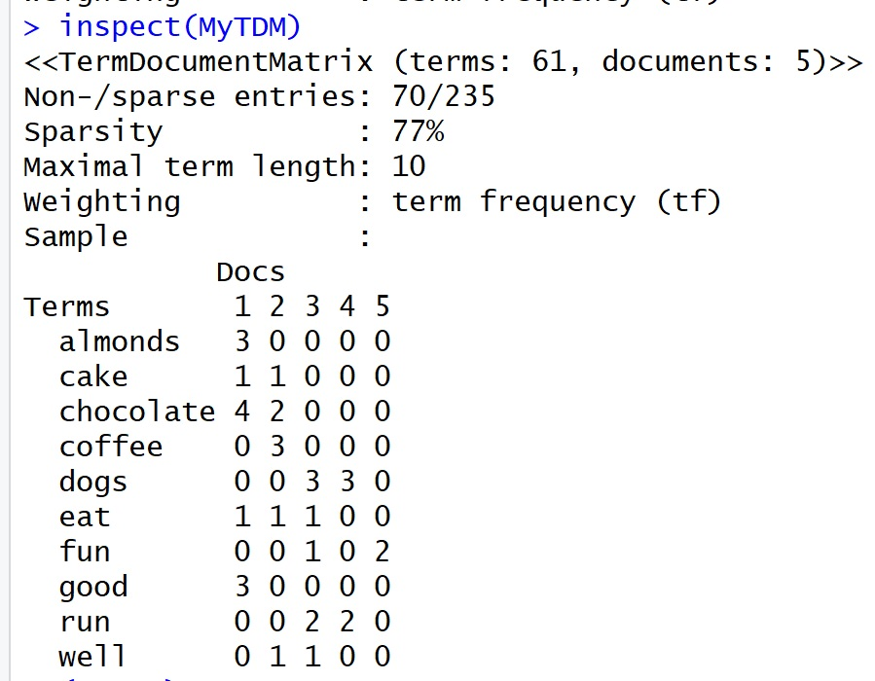
View corpus (all docs) as a matrix
## View corpus as a document matrix
## TMD stands for Term Document Matrix
(MyTDM <- TermDocumentMatrix(CleanCorpus))
inspect(MyTDM)

Slide 75
Look at frequencies and plot
## This will find words that occur more than 3 ##times in the entire corpus
findFreqTerms(MyTDM, 1)
## Find assocations with aselected conf
findAssocs(MyTDM, 'coffee', 0.20)
## VISUALIZE
CleanDF <- as.data.frame(inspect(MyTDM))
(CleanDF)
CleanDFScale <- scale(CleanDF)
d <- dist(CleanDFScale,method="euclidean")
fit <- hclust(d, method="ward.D2")
plot(fit)

Slide 76
Frequency dendrogram

Slide 77
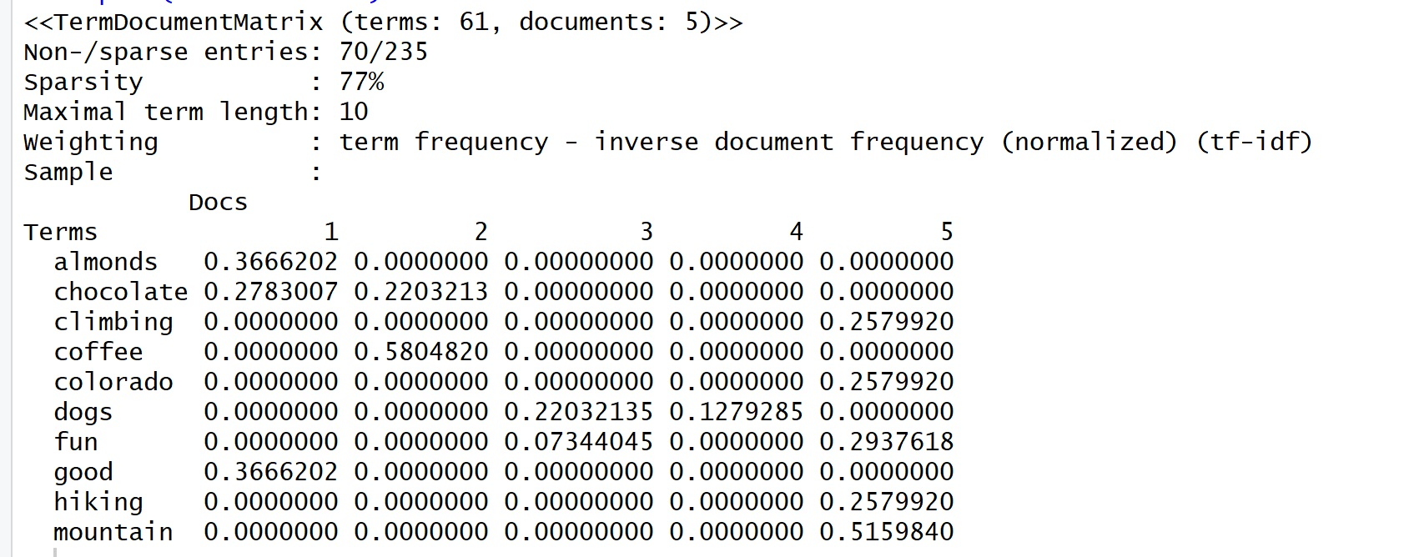
Normalize and re-visualize
(MyDTM <- DocumentTermMatrix(CleanCorpus))
inspect(MyDTM)
## NOrmalize the Term Doc Matrix from above ##and then visualize it again
## Warning!! It is easy to mix up the DTM and ##the TDM- be carefull
NormalizedTDM <- TermDocumentMatrix(CleanCorpus, control = list(weighting = weightTfIdf, stopwords = TRUE))
inspect(NormalizedTDM)

Slide 78
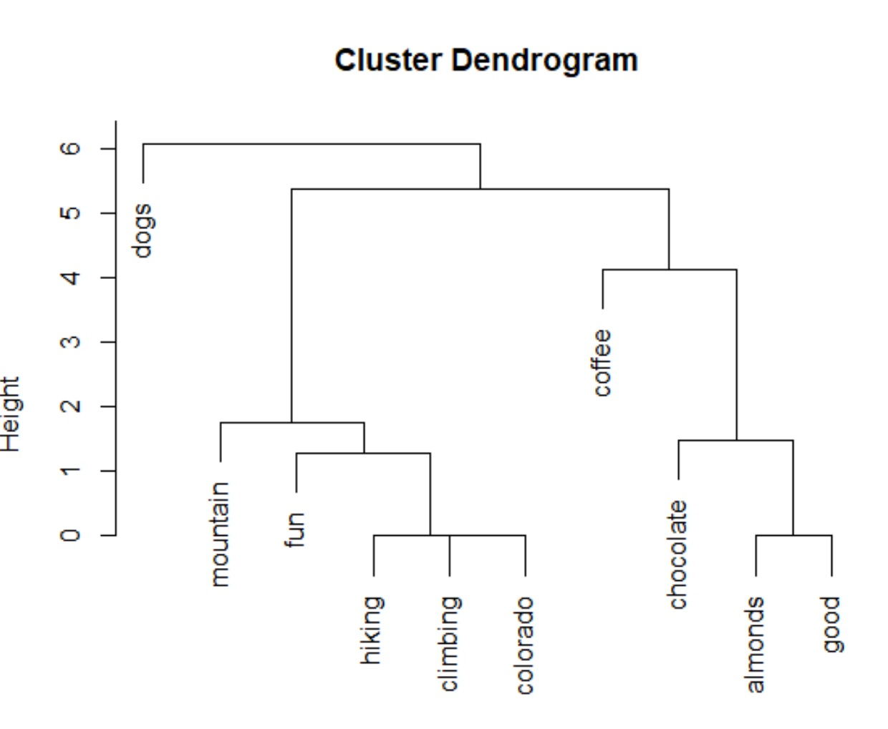
Visualize the normalized corpus
CleanDF_N <- as.data.frame(inspect(NormalizedTDM))
CleanDFScale_N <- scale(CleanDF_N )
d <- dist(CleanDFScale_N,method="euclidean")
fit <- hclust(d, method="ward.D2")
rect.hclust(fit, k = 4) # cut tree into 4 clusters
plot(fit)

Slide 79
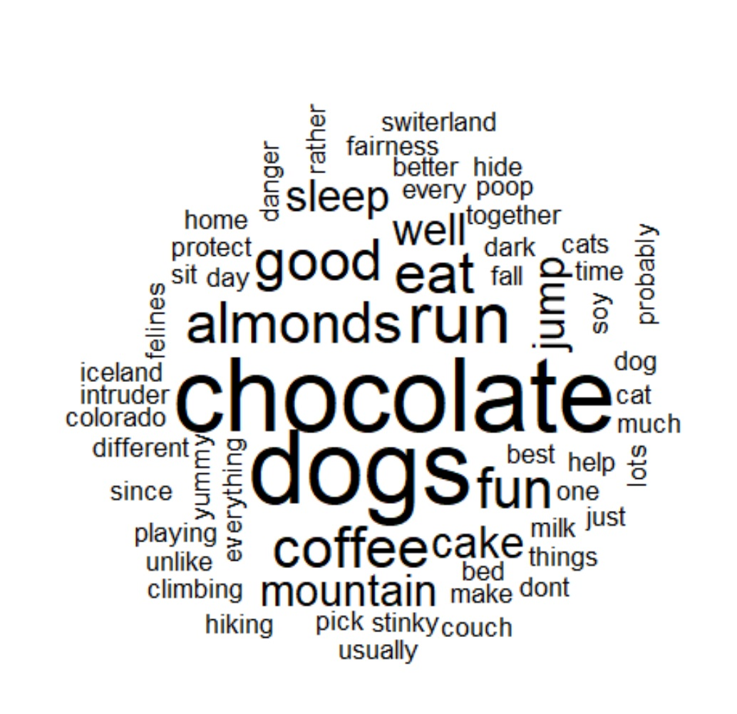
The wordcloud
## Wordcloud
inspect(MyTDM)
m <- as.matrix(MyTDM)
(m)
#m <- as.matrix(CleanDF_N)
# calculate the frequency of words and sort it by frequency
word.freq <- sort(rowSums(m), decreasing = T)
wordcloud(words = names(word.freq), freq = word.freq*2, min.freq = 2, random.order = F)

Slide 80
K means clustering
## Use kmeans to cluster the documents
ClusterM <- t(m)
# transpose the matrix to cluster documents
(ClusterM)
set.seed(100) # set a fixed random seed
k <- 3 # number of clusters
kmeansResult <- kmeans(ClusterM, k)
(kmeansResult$cluster)

Slide 81
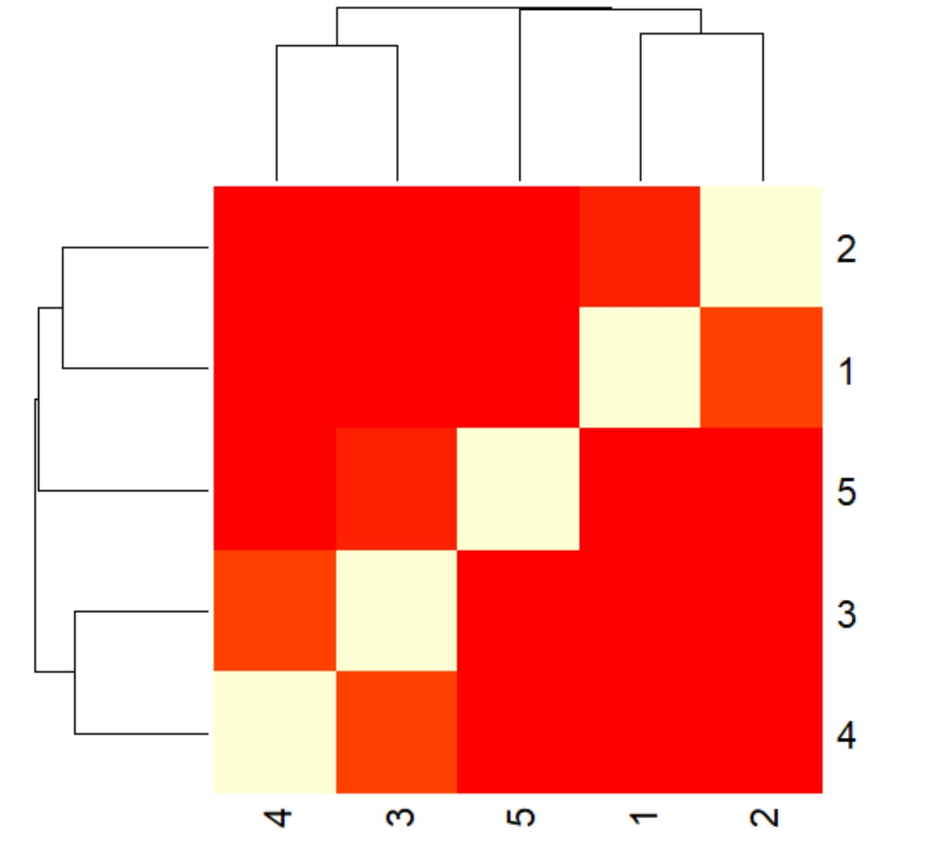
Cosine similarity
m2<-NormalizedTDM
inspect(NormalizedTDM)
str(m2)
cosine_dist_mat <-
1 - crossprod_simple_triplet_matrix(m2)/
(sqrt(col_sums(m2^2) %*% t(col_sums(m2^2))))
(cosine_dist_mat)
(cos_sim_matrix <-(1 - cosine_dist_mat))
heatmap(cos_sim_matrix)
## Most similar: 1 & 2, and 3& 4

Slide 82
Finding Values of k
Elbow (WSS – within sum of squares)
Gap
Silhouette
Etc…
library("factoextra")
# Look at optimal cluster numbers using silh, elbow, gap
WSS <- fviz_nbclust(YourDF, FUN = hcut, method = "wss", k.max = 5) +ggtitle("WSS:Elbow")
SIL <- fviz_nbclust(YourDF, FUN = hcut, method = "silhouette", k.max = 5) +ggtitle("Silhouette")
GAP <- fviz_nbclust(YourDF, FUN = hcut, method = "gap_stat", k.max = 5) + ggtitle("Gap Stat")
# Display plots side by side
gridExtra::grid.arrange(WSS, SIL, GAP, nrow = 1)

Slide 83
Understanding Elbow, Silhouette, and Gap
https://towardsdatascience.com/clustering-metrics-better-than-the-elbow-method-6926e1f723a6

Slide 84
Silhouette
The Silhouette Coefficient is calculated using the mean intra-cluster distance (a) and the mean nearest-cluster distance (b) for each sample. A sample can also be called a row, an observation, a vector, etc.
The Silhouette Coefficient for a sample is (b - a) / max(a, b).
Think about this… “b” is the mean (average of the vectors) for the nearest cluster and “a” is the mean for the current cluster.
b is the distance between a sample (row/vector/point) and the nearest cluster that the sample is not a part of.
We can compute the mean Silhouette Coefficient over all samples (data points / vectors) and use this as a metric to judge the number of clusters.
To really understand this – create a small dataset and do it by hand…

Slide 85
references and resources
1) https://bradleyboehmke.github.io/HOML/hierarchical.html
The above also offers good vis for dendrograms at the end
3) Umich: https://cs.wmich.edu/alfuqaha/summer14/cs6530/lectures/ClusteringAnalysis.pdf
4) Kumar Data Mining Book
5) Stanford Infolab
http://infolab.stanford.edu/~ullman/mining/pdf/cs345-cl.pdf
6) https://stat.ethz.ch/education/semesters/ss2012/ams/slides/v4.2.pdf
7)https://pdfs.semanticscholar.org/954f/ddb0c3d022cda2a7c3324e1391a4a3239d85.pdf
8) https://www.cl.cam.ac.uk/teaching/1314/InfoRtrv/lecture4.pdf
9) https://rstudio-pubs-static.s3.amazonaws.com/33876_1d7794d9a86647ca90c4f182df93f0e8.html
10) http://www.sthda.com/english/articles/30-advanced-clustering/105-dbscan-density-based-clustering-essentials/

