Slide 1
Naïve Bayes
DR. AMI GATES
GOOD REFERENCE: KUMAR ET. AL 2005,2015

Slide 2
Reminder: A Classification Task

Slide 3
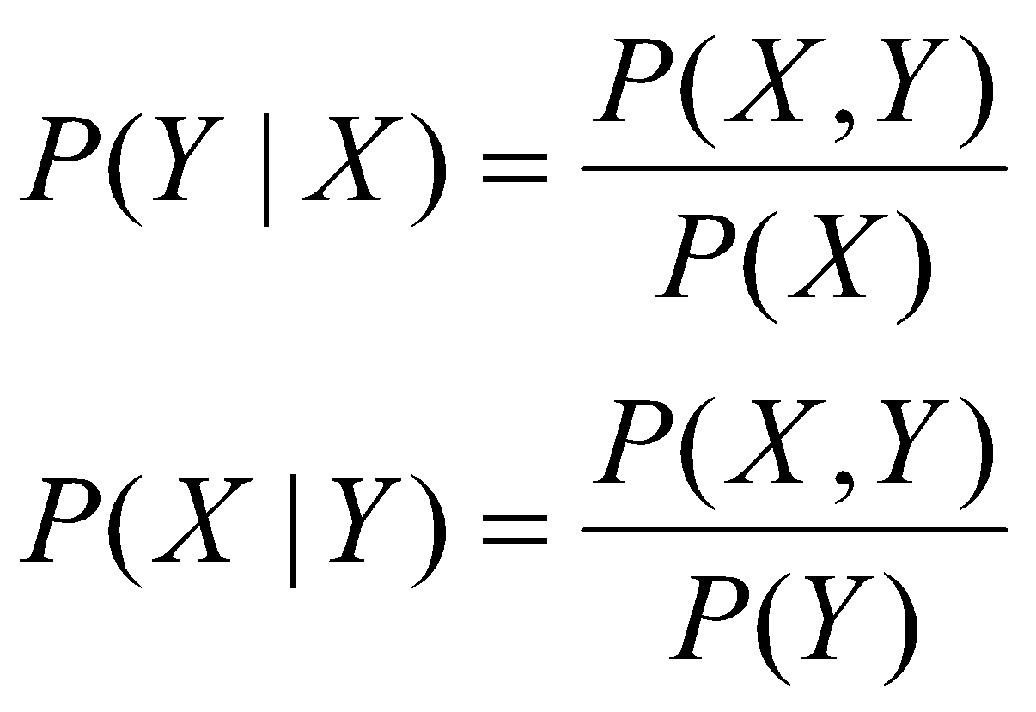
Naïve Bayes:

Slide 4
The Math
1) Notice that the numerator of each formula is the same.
2) Notice also that we can use algebra to rewrite each as:
P(X, Y) = P(Y|X)P(X) and P(X, Y) = P(X|Y)P(Y)
3) Next, because P(Y|X)P(X) and P(X|Y)P(Y)
both equal the same thing, they MUST equal each other 🡪
P(Y|X)P(X) = P(X|Y)P(Y)
Divide both sides by P(X)

Slide 5
Naïve Bayes Theorem
Assume that attributes are independent
Let c be any class or label,
Let x be a data vector
Bayes:
P(c|x) = P(x|c) P(c) / P(x)
= P(x1|c) * P(x2|c) *…*P(xn|c)*P(c) / P(x1) * P(x2) *…*P(xn)
Why? Because we assume independence.
P(c|x) :posterior probability of the class given the predictor attribute vector x
P(x|c) :Likelihood – the prob of the attribute vector given the class.
P(c) :Class Prior Probability – the prob of the class
P(x) :Predictor Prior Probability – the prob of the attribute vector

Slide 6
Example 1: Basic Bayes
Given:
A doctor knows that meningitis (M) causes stiff neck, S, is 50%. P(S|M)=.5
Prior probability of any patient having meningitis is 1/50000. P(M) = 1/50000
Prior probability of any patient having stiff neck is 1/20: P(S) = 1/20
Question: If a patient has stiff neck, what’s the probability he/she has meningitis?

Slide 7
Bayesian Classifiers Overview
1) Consider each attribute and class label as random and independent variables
2) Given a data row (a vector of data) with attributes/values of (A₁, A₂,…,A_{n})
Goal: predict class C
How: Find the value of C that maximizes P(C| A₁, A₂,…,A_{n} )
3) Can we estimate P(C| A₁, A₂,…,A_{n} ) directly from data?
Example:
P(Mammal | [hair=yes, live_birth=yes, legs=2, can_fly=no])
vs.
P(Bird| [hair=yes, live_birth=yes, legs=2, can_fly=no])

Slide 8
Bayesian Classifiers
Approach:
Compute the posterior probability
P(C | A₁, A₂, …, A_{n}) for all values of C using Bayes
Question: Does the denominator change with the class?
Choose value of C that maximizes P(C | A₁, A₂, …, A_{n})

Slide 9
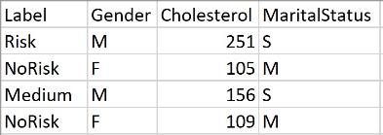
Naïve Bayes Classifier
Why do we need to assume independence among attributes A_{i} ?
P(A₁, A₂, …, A_{n} |C_{j}) We cannot calculate in this form
P(A₁| C_{j}) P(A₂| C_{j})… P(A_{n}| C_{j})
We can in this form and to change to this form, we must assume that all elements in vector A which here are called A₁, A₂, …, A_{n} are independent.
Again, from a dataset standpoint, each A is a variable in the dataset.
Example: In this dataset A1 is Gender, A2 is Cholesterol, and A3 is MaritalStatus and the Label (C) is on the left.
How does assuming independence help?
Why does this assumption make the Bayes estimator“naïve”?

Slide 10
What is “multinomial Bayes?
From Python sklearn:
MultinomialNB implements the naive Bayes algorithm for multinomially distributed data, and is one of the two classic naive Bayes variants used in text classification (where the data are typically represented as word vector counts, although tf-idf vectors are also known to work well in practice).
The multinomial distribution is the type of probability distribution used to calculate the outcomes of experiments involving two or more variables. The more widely known binomial distribution is a special type of multinomial distribution in which there are only two possible outcomes.
In “English” MNB is NB for data that has labels that include two or more groups or classes – such as Mammal or Fish or Bird (3 classes) - or Yes or No (2 classes) – etc.
RE: MNB and Bernoulli in Python
https://scikit-learn.org/stable/modules/naive_bayes.html
Good reference for “behind the scenes”:
https://towardsdatascience.com/multinomial-naive-bayes-classifier-for-text-analysis-python-8dd6825ece67

Slide 11
Example of Naïve Bayes Classifier
Given a Test Record X, classify as Evade Class (C) =Yes or No:
Let record X = {Refund R=No, Married M=Yes, Income I =120K}
So, attribute A1 is Refund, attribute A2 is Married, and Attribute A3 is Income
P(A1,A2,A3|C=No) * P(C=No) = [P(A1|C=No) * P(A2|C=No) * P(A3|C=No)]* P(C=No) =
[P(A1 (refund)=No|C=No) * P(A2 (married)=Yes| C=No) * P(A3 (income)=120|C=No)] * (7/10)
= [4/7 * 4/7 * 0.0072] * (7/10) = .0017 (see slides 12&13)
P(A1,A2,A3|C=Yes) * P(C=Yes) =[P(A1|C=Yes) * P(A2|C=Yes) * P(A3|C=Yes)] *P(C=Yes) =
[P(A1 (refund)=No|C=Yes) * P(A2 (married)=Yes| C=Yes) * P(A3 (income)=120|C=Yes)] *(3/10)
= [3/3 * 0/3 * 0 ] * (3/10) = 0
P(A1,A2,A3|C=No) P(C=No) > P(A1,A2,A3|C=Yes) P(C-Yes) Class = No

Slide 12
If an attribute (such as Taxable Income) is numeric, you can either discretize or you can use a likelihood to estimate the prob.
Normal distribution:
One for each (X_{i},Y_{i}) pair
For (Income, Class=No):
If Class=No
sample mean = 110
sample variance = 2975

Slide 13
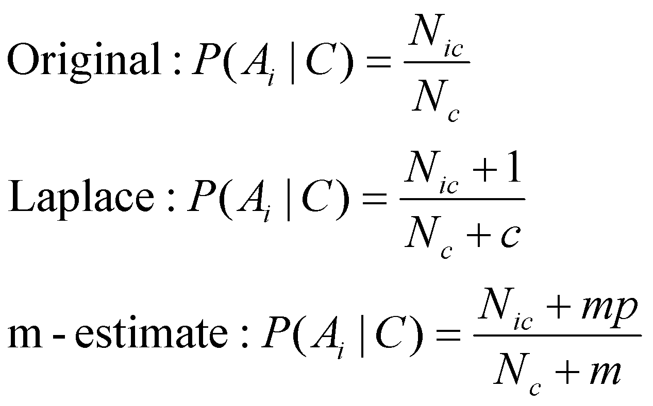
Naïve Bayes Classifier
If one of the conditional probability is zero, then the entire expression becomes zero.
Reference: Page 224 in Intro Data Mining Ed. 2
Probability estimation (and smoothing):
c: number of classes
p: prior probability
m: parameter

Slide 14
Example: Naïve Bayes Classifier
Testing Data
A: attributes (not including “Name” which is not a useful variable. A1 is GB, A2 is CF, A3 is LW, A4 is HL.
M: mammals (7 here)
N: non-mammals (13 here)
Training Data
P(A|M)P(M) =
P(GB=yes|M)*P(CF=no|M)*P(LW=yes|M)*P(HL=no|M)*P(M)=
(6/7)*(6/7)*(2/7)*(2/7)*(7/20) = .021
P(A|N)P(N) =
P(GB=yes|N)*P(CF=no|N)*P(LW=yes|N)*P(HL=no|N)*P(N)=
(1/13)*(10/13)*(3/13)*(4/13)*(13/20) = .0027
Because
P(A|M)P(M) > P(A|N)P(N)
The answer is: mammals for the test data vector(row)

Slide 15
Example: Naïve Bayes Classifier: WITH LAPLACE
Testing Data
A: attributes (not including “Name” which is not a useful variable. A1 is GB, A2 is CF, A3 is LW, A4 is HL.
M: mammals (7 here)
N: non-mammals (13 here)
Because
P(A|M)P(M) > P(A|N)P(N)
The answer is: mammals for the test data vector(row)
Training Data
P(A|M)P(M) =
P(GB=yes|M)*P(CF=no|M)*P(LW=yes|M)*P(HL=no|M)*P(M)=
((6+1)/ 7+2 )*((6+1)/(7+2))*((2+1)/(7+2))*((2+1)/(7+2))*(7/20) = .091
P(A|N)P(N) =
P(GB=yes|N)*P(CF=no|N)*P(LW=yes|N)*P(HL=no|N)*P(N)=
((1+1)/(13+2))*((10+1)/(13+2))*((3+1)/(13+2))*((4+1)/(13+2))*(13/20) = .0056

Slide 16
Naïve Bayes Summary
Robust to isolated noise points
Handle missing values by ignoring the instance during probability estimate calculations
Robust to irrelevant attributes
Independence assumption may not hold for some attributes
Use other techniques such as Bayesian Belief Networks (BBN)

Slide 17
These are good references for text data:
RE: https://sebastianraschka.com/Articles/2014_naive_bayes_1.html
And
https://nlp.stanford.edu/IR-book/html/htmledition/naive-bayes-text-classification-1.html

Slide 18
Naïve Bayes in R and Python (and using Record and Text Data)
GATES

Slide 19
Naïve Bayes in Python for text data
https://drive.google.com/file/d/1do9vfq3fJPF5gGAXdVE8J9cdYEYA-LHG/view?usp=sharing
NOTE: The basic Naïve Bayes in sklearn/Python does not work on mixed data or categorical data. The data must be 100% numeric.
------------------------------------------------------------------------------------------------------------------------------
In Python, you can use:
from sklearn.naive_bayes import GaussianNB
BUT – you must convert ALL data to categorical!
Example: https://www.kaggle.com/jcleivas/naive-bayes-titanic
I also found: (have not tried it yet – it is new – and unstable – you must install the nightly build to use ….)
from sklearn.naive_bayes import CategoricalNB
RE: https://scikit-learn.org/dev/modules/generated/sklearn.naive_bayes.CategoricalNB.html
Learning more about it: https://scikit-learn.org/dev/modules/naive_bayes.html#categorical-naive-bayes
Finally – for advanced users, there is a new mixed version on GIT: (not sure if it works – have not tried it yet)…
https://github.com/remykarem/mixed-naive-bayes

Slide 20
Naïve Bayes (etc) in R for Text Data
Example Here:
https://drive.google.com/file/d/13z9RXHnvLDXkCU5tp7huJ7daasp_n53G/view?usp=sharing

Slide 21
More R Examples….
GATES

Slide 22
Just an example: Bayes in R

Slide 23
Results from the classifier

Slide 24
Quick plot for naïve Bayes

Slide 25
Example 2 in R
The following example is taken directly from:
https://www.r-bloggers.com/understanding-naive-bayes-classifier-using-r/
R supports a package called ‘e1071’ which provides the naive bayes training function. For this demonstration, we will use the classic titanic dataset and find out the cases which naive bayes can identify as survived.
The Titanic dataset in R (not Kaggle) is a table for about 2200 passengers summarised according to four factors – economic status ranging from 1st class, 2nd class, 3rd class and crew; gender which is either male or female; Age category which is either Child or Adult and whether the type of passenger survived. For each combination of Age, Gender, Class and Survived status, the table gives the number of passengers who fall into the combination.

Slide 26
What is Naïve Bayes?
Naive Bayes – a Not so Naive Algorithm
The reason that Naive Bayes algorithm is called Naive … is because the algorithm makes a very strong assumption about the data having features independent of each other while in reality, they may be dependent in some way.
In other words, it assumes that the presence of one feature in a class is completely unrelated to the presence of all other features. If this assumption of independence holds, Naive Bayes performs extremely well and often better than other models.
Naive Bayes can also be used with continuous features but is more suited to categorical variables. If all the input features are categorical, Naive Bayes is recommended. However, in case of numeric features, it makes another strong assumption which is that the numerical variable is normally distributed.
https://www.r-bloggers.com/understanding-naive-bayes-classifier-using-r/

Slide 27
Naïve Bayes Example with R Titanic Data Part 1

Slide 28
Naïve Bayes Example with R Titanic Data Part 2
#Creating data from table
repeating_sequence=rep.int(seq_len(nrow(Titanic_df)), Titanic_df$Freq)
#This will repeat each combination equal to the
#frequency of each combination
#Create the dataset by row repetition created
Titanic_dataset=Titanic_df[repeating_sequence,]
#We no longer need the frequency, drop the feature
Titanic_dataset$Freq=NULL

Slide 29
Naïve Bayes Example with R Titanic Data Part 3
#Fitting the Naive Bayes model
Naive_Bayes_Model=naiveBayes(Survived ~., data=Titanic_dataset)
#What does the model say?
#Print the model summary
Naive_Bayes_Model

Slide 30
results

Slide 31
Results Part 2

Slide 32
Conclusions and Can You DO Better? *Always* ask this question.
We have the results! We are able to classify 1364 out of 1490 “No” cases correctly and 349 out of 711 “Yes” cases correctly. This means the ability of Naive Bayes algorithm to predict “No” cases is about 91.5% but it falls down to only 49% of the “Yes” cases resulting in an overall accuracy of 77.8%
Naive Bayes is a parametric algorithm which implies that you cannot perform differently in different runs as long as the data remains the same.
We will, however, learn another implementation of Naive Bayes algorithm using the ‘mlr’ package. Assuming the same session is going on for the readers, I will install and load the package and start fitting a model

Slide 33
Example 3: Using the mlr package
This full example is taken directly from:
https://www.r-bloggers.com/understanding-naive-bayes-classifier-using-r/
Author info is here too as well as all of the code that they used.

Slide 34
Step 1: using mlr

Slide 36
Table of results

Slide 37
R: Example 4
## libraries
library(naivebayes)
library(psych)
library(dplyr)
library(ggplot2)
## data
data(iris)
str(iris)
# Species is the label
table(iris$Species)
(head(iris))
(summary(iris))
MyIrisDF <- iris
## Create Train and Test Set
(n <- round(nrow(MyIrisDF)/5))
(s <- sample(1:nrow(MyIrisDF), n))
## The test set is the sample
IrisTest<- MyIrisDF[s,]
## The trainng set is the not sample
IrisTrain <- MyIrisDF[-s,]
## Have a look...
(head(IrisTest,n=5))
(head(IrisTrain,n=5))

Slide 38
Visual EDA
pairs.panels(iris)
iris %>%
ggplot(aes(x=Species, y=Sepal.Width, fill=Species)) +
geom_boxplot() +
ggtitle("Box plot")
iris %>%
ggplot(aes(x=Sepal.Width, fill=Species)) +
geom_density(alpha=.6, color="black") +
ggtitle("Density plot")
plot(iris)
plot(iris$Petal.Length,iris$Petal.Width,col=iris$Species)

Slide 39
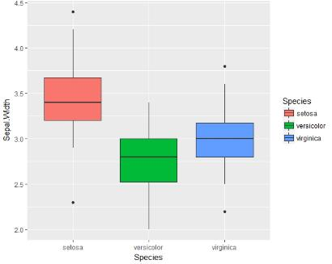
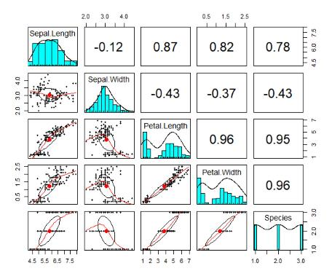
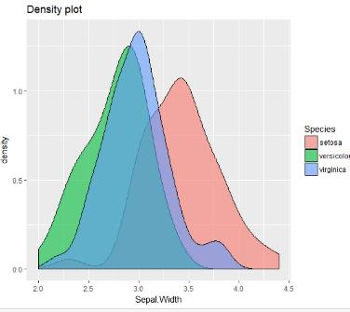

Slide 40
Naïve Bayes
## Naive Bayes
NBModel <- naive_bayes(IrisTrain$Species ~., data=IrisTrain)
print(NBModel)
plot(NBModel)
## predict
NB_p <- predict(NBModel, IrisTest, type="prob")
(head(round(NB_p)))
## classify/predict
NB_p2 <- predict(NBModel, IrisTest, type="class")
(Pred_TABLE <-table(NB_p2, IrisTest$Species))
## accuracy
(sum(diag(Pred_TABLE)/sum(Pred_TABLE)))

Slide 41
Suggestions and references
Kumar 2005, 2015
As with all new things – create a small toy example and do it by hand and with R to see that you get the same results.
https://www.r-bloggers.com/understanding-naive-bayes-classifier-using-r/
There is always more! Each time you use a model or technique, you will always find new ideas, new improvements, new packages, and new methods to visualize.
Ask the question – Can I make this better?

Slide 42
NB in Python for Text
GATES

Slide 43
Base Python Code for NB
from sklearn.naive_bayes import MultinomialNB
MyModelNB= MultinomialNB()
## When you look up this model, you learn that it wants the
## !!! DF separate from the labels !!!
MyModelNB.fit(TrainDF_nolabels, TrainLabels)
Prediction = MyModelNB.predict(TestDF)
## confusion matrix
from sklearn.metrics import confusion_matrix
cnf_matrix = confusion_matrix(TestLabels, Prediction)
print("\nThe confusion matrix is:")
print(cnf_matrix)
print(np.round(MyModelNB.predict_proba(TestDF),2))

