Slide 1
Logistic Regression
Gates

Slide 2
Binary Logistic Regression
Supervised Learning
Classification/Prediction
For two categories: 0 or 1 which can relate to any two-class problem.
Examples:
-Sentiment Analysis such as “positive” or “negative”
-Illness prediction such as “has illness” or “does not have illness”
-Admission such as “Admit” or “Decline”
-Loan Status such as “Approved” or “Not Approved”

Slide 3
Linear Equation
z = w1x1 + w2x2 + ... + wnxn + b
z is the dependent variable (also called the predicted variable or the class)
The “w” values such as w1, w2, ..., wn are the “weights”.
The “b” (which can be any letter) is the “bias”

Slide 4
Other Ways to Write a Linear Equation
z = w₁x₁ + w₂x₂ + ... + w_{n}x_{n} + b
OR
z = ∑_{i} w_{i}x_{i} + b
OR
z = w^{T}x + b where w is the “weight vector (or matrix)”, x is an input vector, and b is the bias.

Slide 5
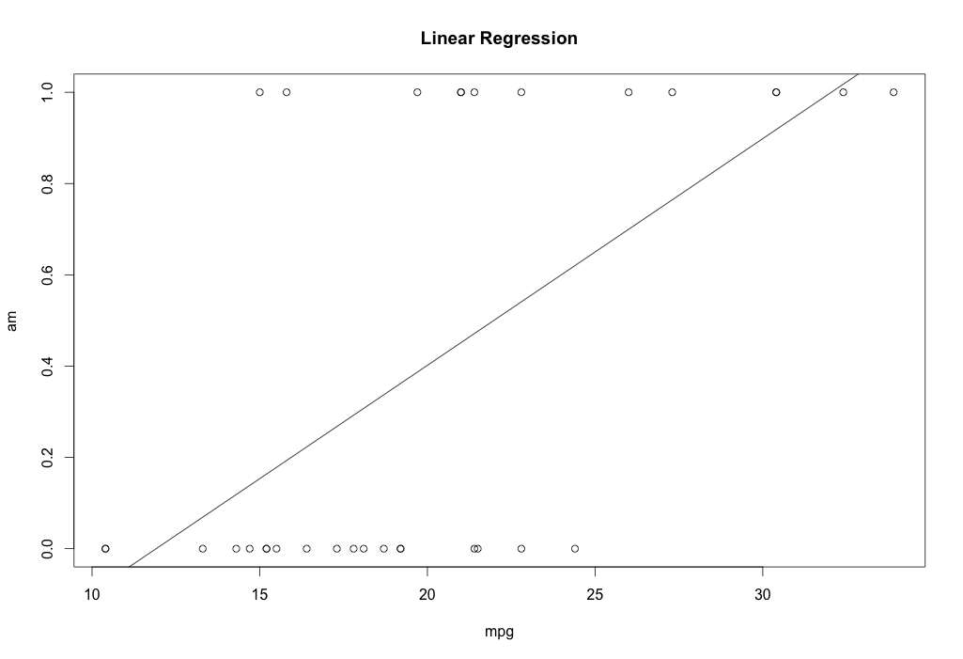
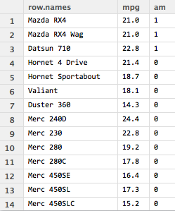
Example
Logistic regression (unlike linear regression) is not “linear” in its output. For example – see the relationship between “am” (0 for auto and 1 for 5-speed) and mpg. Here, a “sigmoid” would be a better fit!
small sample of the dataset

Slide 6
The Sigmoid Function
1/(1 + e^-(-10)) = 0.00004539786
1/(1 + e^-(10)) = 0.99995460213

Slide 7
Sigmoid Properties

Slide 8
Proof that S’(z) = S(z)(1 – S(z))

Slide 9
Linear vs. Logistic Regression Cost Functions
Let z = w^{T}x + b
In Linear Regression, the output is continuous and our goal is to minimize the MSE.
In Logistic Regression, the Cost Function of a Logistic Regression cannot use MSE because our prediction function is non-linear (due to sigmoid transform). Therefore we use a cost function called Cross-Entropy, also known as Log Loss.
Cross-entropy measures the difference between two probability distributions for a given random variable or set of events.
The “log” is base e

Slide 10
The Logistic Transformation The Math for Using the Sigmoid
Suppose we start with a linear equation:
z = w1x1 + w2x2 + ... + wnxn + b
But, because this is logistic regression (a binary classification), we apply the logistic function – also called the Sigmoid:
S(z) = 1 / (1 + e^-z)
But, how do we get there?

Slide 11
The Logistic Transformation - Using the Sigmoid
Starting with: z = w1x1 + w2x2 + ... + wnxn + b (Assume log is base e)
We can consider the log odds of the left hand side – written as:
log(z/(1-z) )= w1x1 + w2x2 + ... + wnxn + b
z/(1-z) = e^(w1x1 + w2x2 + ... + wnxn + b)
z = (1 – z) [e^(w1x1 + w2x2 + ... + wnxn + b)]
z = [e^(w1x1 + w2x2 + ... + wnxn + b)] - z [e^(w1x1 + w2x2 + ... + wnxn + b)]
#divide by z
1 = [e^(w1x1 + w2x2 + ... + wnxn + b)] / z - [e^(w1x1 + w2x2 + ... + wnxn + b)]
1 + [e^(w1x1 + w2x2 + ... + wnxn + b)] = [e^(w1x1 + w2x2 + ... + wnxn + b)]/z
z = [e^(w1x1 + w2x2 + ... + wnxn + b)] / (1 + [e^(w1x1 + w2x2 + ... + wnxn + b)])
Which is the Sigmoid and can also be written as 1 / (1 + e^-z)
where z = w1x1 + w2x2 + ... + wnxn + b

Slide 12
What do the log odds do?
Log is Base e
Let’s check!
Assume that 0 <= z < 1
then →
z/(1 – z) is called the “odds”
Suppose z = .9, then the odds are .9 / .1 = 9. You can read this as 9 to 1 odds.
Suppose z = .2, then the odds are .2/.8 = .25. You can read this as 1/4 to 1 odds.
The “odds” ranges from 0 to +inf.
Next, the log odds are log( z/(1-z)).
log_e(.9 / .1 ) = 2.19
log_e (.2/.8) = -1.39
The log odds ranges from –inf to +inf

Slide 13
More about the sigmoid
S = 1 / (1 + e^-a) = e^a / (1 + e^a)
Proof:
e^a / (1 + e^a)
→ (e^a/ e^a) / (1/ e^a + e^a/e^a)
→ 1 / ( 1+ 1/ e^a)
→ 1 / (1 + e^-a)

Slide 14
Let’s Review What We Have So Far
We have a linear function
z = w^{T}x + b
2) We have the Sigmoid function (also called the logistic function). We apply this function to the result of the linear function to produce a value between 0 and 1.
S(z) = 1 / 1 + e^-z
** This is also called an activation function - which we will see and use in Neural Networks.

Slide 15
What Do We Need Next?
Our goal is to create a model that can predict the binary class (0 or 1) given our parameters which are w and b.
To train the model, we need a way to determine how close the prediction is to the known training value. For example, if our model predicts a 1, but the label should be 0, this is wrong (far) and we need a method to measure and improve this.
To Train - we need a Loss Function (also called a cost function)
For example, the MSE is type of Loss Function.
For Logistic Regression, we will use the following Loss Function...

Slide 16
The Architecture Our “parameters” are w₁, w₂, ..., w_{m}, and b
Log is base e
x1
w₁
(y is 0 or 1 in this example)
x2
z = $\sum_{i=1}^{m}{w_{i}}$ $x_{i}$+ b
→ X dot W^{T} + b
w₂
_{Sigmoid Activation}
y^ = 1/(1 + e^{-z})
w_{m}
xm
What affects the Loss, L_{CE}?
What affects y^?
What affects z?
What is dL/dW?
What is dL/db?

Slide 17
The Architecture Our “parameters” are w₁, w₂, ..., w_{m}, and b
x1
w₁
(y is 0 or 1 in this example)
x2
z = $\sum_{i=1}^{m}{w_{i}}$ $x_{i}$+ b
→ X dot W^{T} + b
w₂
_{Sigmoid Activation}
y^ = 1/(1 + e^{-z})
w_{m}
dL_{CE} / dW = dL_{CE} /dy^ * dy^/dz * dz/dW
= -1/y^ * (y^)(1- y^) dot X^{T}
= (y^ - 1)/m dot X^{T}
(shapes will need to match)
xm
What affects the Loss, L_{CE}?
What affects y^?
What affects z?
What is dL/dW?
What is dL/db?

Slide 18
Binary Classification – Logistic Regression – Loss Function
Here, the y_hat is what the model predicts and the y is the known training value.
Let’s take a look at this equation:
Suppose y and y_hat are both predicted as 0. Then, this equation becomes:
-1/m [ SUM_m 0 log(0) + (1)log(1)] ➔ -1/m [SUM_m 0 + 0] ➔ 0
Now, we are only considering one example here, so m = 1
Note that we get that LCE = 0. This is good because the difference between the prediction and the true value is 0.
Let’s keep m = 1 and try a prediction of .9 (which is possible with a Sigmoid) and a true value of 1. (y_hat=.9 and y=1)
→-1 ( 1 log(.9) + (0)log(.1) ) → -( -.105 + 0) = .105
Suppose m = 1 and our model predicts .1 but the true label is 1. Then →
-1 ( 1 log(.1) + (0)log(.9) ) → - ( - 2.3 + 0 ) → 2.3 which shows that the prediction and the true value are farther apart.
Log is base 2

Slide 19
LCE (Loss: Cross Entropy)
You can also observe that:
“Entropy” can be defined as -p(x) log p(x) where the log is base e.
Note also that log base 2 is used – especially if the goal is “bits”.
RE: https://towardsdatascience.com/cross-entropy-loss-function-f38c4ec8643e
2) The greater the value of entropy, the greater the uncertainty.
3) The Cross-Entropy Loss Function is also called the logarithmic loss, log loss or logistic loss.
Cross-entropy loss is used to adjust model parameters – such as weights - during training.
The aim is to minimize the loss.
The smaller the loss the better the model.
A perfect model has a cross-entropy loss of 0.

Slide 20
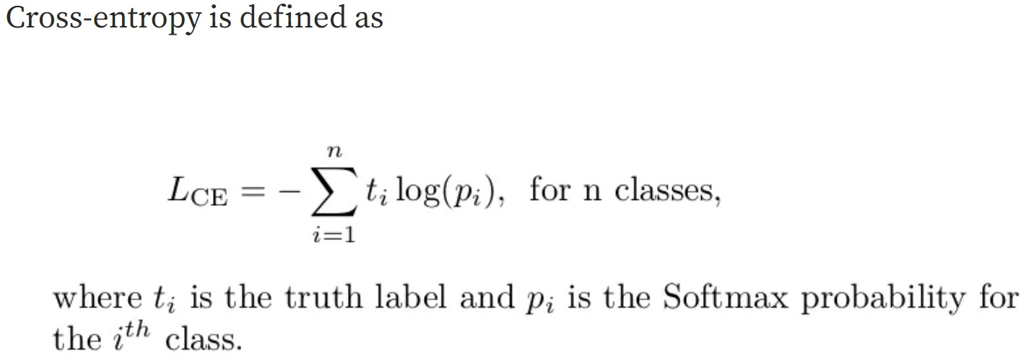
Binary Cross Entropy vs. Categorical Cross Entropy Loss Functions (log is base e)

Slide 21
NOTE: Binary cross-entropy is often calculated as the average cross-entropy across all data examples. Therefore, the BCE formula contains a 1/m where m is the number of data examples.

Slide 22
Softmax and CCE (Categorical Cross Entropy)
We will soon see that our example here with Logistic Regression will expand into multinomial (not binary) categories where we will use categorical cross entropy and softmax.
More on this later ☺

Slide 23
Back to Logistic Regression – So Far We Have:
Now, we have a Loss Function.
2) We also want to minimize the difference between what is predicted and what is correct.
3) Therefore, we have an optimization problem.
4) We will use gradient descent and a learning rate to optimize.

Slide 24
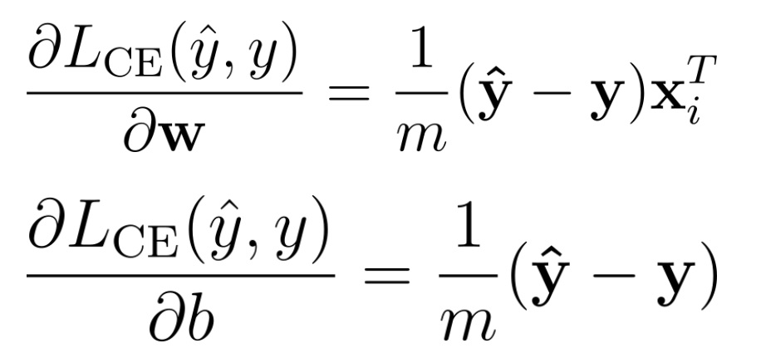
Parameter Update and Gradient Descent
How do we get these two partial derivatives?
Let’s see....

Slide 25
The Math: Our Goal is to calculate the gradient of LCE
Notes: First, recall the following:
All “log” here are log base e. The derivative of log_e( x ) is 1/x * the derivative of x.
Example: Let y = log_e(2x^2 + 4x) and let “d” represent “partial derivative”
dy/dx = [1 / (2x^2 + 4x) ] * (4x + 4)
2) The Jacobian is the same as the gradient – all the partial derivatives of a function wrt all parameters
3) y_hat = 1 / (1 + e^-(w^{T}x +b))
Note also that d(w^{T}x +b) / dw = xi and d(w^{T}x +b) / db = 1
Note that d(e^- w^{T}x)/dw = e^- w^{T}x * x
4) The derivative of the Sigmoid, say S(z) is S(z)(1 – S(z))(dz)

Slide 26
The Math For the Partial Derivatives
y^= S(z) where z = w1x1 + w2x2 + ... + wnxn + b
y is 0 or 1
Let d represent “partial derivative” for ease of typing.
Let y^ be “y_hat”
We will use the Chain Rule:
To update w:
dL/dw = dL/dy^ * dy^/dz * dz/dw
To update b:
dL/db = dL/dy^ * dy^/dz * dz/db

Slide 27
The Math For the Partial Derivatives
y^ = S(z) where z = w1x1 + w2x2 + ... + wnxn + b
y is 0 or 1
dL/dw = dL/dy^ * dy^/dz * dz/dw
-1/m ( [SUM_m y/y^ + (1- y)/-(1-y^) * S(z)(1 – S(z)) * x ] )
-1/m ( [sum_m y/y^ * S(z)(1 – S(z)) * x ]
+ [sum_m (1- y)/(1-y^) * -S(z)(1 – S(z)) * x ] )

Slide 28
So Far we are here: -1/m ( [sum_m y/y^ * S(z)(1 – S(z)) * x ] + [sum_m (1- y)/(1-y^) * -S(z)(1 – S(z)) * x ] )
-1/m ( [sum_m [
y * 1/y^ * S(z)(1 – S(z)) * x + (1 – y) * 1/(1-y^) * -S(z)(1 – S(z)) * x ])
-->
Recall that y^ = S(z) so replace all S(z) with y^
→ -1/m ( [sum_m [
y * 1/y^ * y^(1 – y^) * x + (1 – y) * 1/(1-y^) * -y^(1 – y^) * x ])
→ -1/m ( [sum_m [y(1 – y^) * x + (1 – y) * -y^ * x ])

Slide 29
From here: → -1/m ( [sum_m [y(1 – y^) * x + (1 – y) * -y^ * x ])
-1/m ( [sum_m [ (y – yy^) * x + (-y^ + yy^) * x ] )
-1/m ( [sum_m [x [(y – yy^) + (-y^ + yy^) ] ] )
-1/m ( [sum_m [x [y – yy^ -y^ + yy^ ] ] )
-1/m ( [sum_m [x (y - y^ ) ] )
This can be written without the SUM using a matrix form of x.
→
1/m x^{T}(y^ - y)

Slide 30
You Prove the one for b:

Slide 31
Example By Hand: Feed Forward and Back Propagation
Weight | Height | BB_Player
200 | 84 | 1
150 | 80 | 1
107 | 60 | 0
110 | 62 | 0
165 | 75 | 1
Predict whether a person is on the BB Team based on GPA and Height.
y^ = S(z) where z = w1x1 + w2x2 + b
To update w we will use 1/m(y^ - y)x
To update b we will use 1/m(y^-y)
m = 5 because we have 5 examples (rows) of data.
Our LABEL is called “BB_Player” and it can be either 0 or 1, so y is 0 or 1.

Slide 32
Normalize We will use min/max →(x – min) / (max – min)
Weight | Height | BB_Player
200 | 80 | 1
150 | 75 | 1
100 | 60 | 0
110 | 62 | 0
160 | 75 | 1
Weight | Height | BB_Player
(200 – 100)/(200 – 100) = 1 | (80 – 60) / (80 – 60) = 1 | 1
(150 – 100)/(200 – 100) = .5 | (75 – 60) / (80 – 60) = .75 | 1
(100 – 100) / (200 – 100) = 0 | (60 – 60) / (80 – 60) = 0 | 0
(110 – 100) / (200 – 100) = .1 | (62 – 60) / (80 – 60) = .1 | 0
(160 – 100) / (200 – 100) = .6 | (75 – 60) / (80 – 60) = .75 | 1

Slide 33
Weight | Height | BB_Player
1 | 1 | 1
.5 | .75 | 1
0 | 0 | 0
.1 | .1 | 0
.6 | .75 | 1
1) We know that z = w1x1 + w2x2 + b which is w^{T}X + b in matrix form
2) We know that y^ = S(z), where S(z) = 1 / (1 + e^-z)
3) We know that we want to find the parameters that create the best model.
The “best” model is the model that offers the most accurate predictions for BB_Player. Our parameters are w and b, where w is [w1 w2].
4) Here (because our dataset is 2D), our x is [x1 x2] for each row.

Slide 34
Feed Forward Step 1: Using Matrix Form for w^{T}X + b Also note that this can be written as X^{T}w + b The key is that we need: w1x1 + w2x2 + b for all x values.
Weight | Height | BB_Player
1 | 1 | 1
.5 | .75 | 1
0 | 0 | 0
.1 | .1 | 0
.6 | .75 | 1

Slide 35
Recall:
But – how do we get w and b to start with??
In many cases (especially in NN) we start with a random set of parameters and then we optimize them.
Let w be [1 1] and let b = 0

Slide 36
FF: Getting z
Using w as [1 1] and b as 0 then z is:
(1)(1) + (1)(1) + 0 = 2
.5(1) + .75(1) + 0 = 1.25
0(1) + 0(1) + 0 = 0
.1(1) + .1(1) + 0 = .2
.6(1) + .75(1) + 0 = 1.35

Slide 37
FF: Getting y^ - we need S(z)
y^ = S(z) = 1 / 1 + e^-z
S(z)
1 / 1 + e^-2
1 / 1 + e^-1.25
1 / 1 + e^-0
1 / 1 + e^-.2
1 / 1 + e^-1.35
y^ = S(z)
.88
.78
.5
.55
.79

Slide 38
Calculate the Loss Look at y vs. y^
Weight | Height | BB_Player
1 | 1 | 1
.5 | .75 | 1
0 | 0 | 0
.1 | .1 | 0
.6 | .75 | 1
y^
.88
.78
.5
.55
.79
y
1
1
0
0
1
Using our Loss function (Binary Cross Entropy), let’s calculate the losses:
First, let’s get y log (y^) + (1 – y) log (1 – y^) for all 5 data values
(1)log(.88) + (0)log(.12) = (1)(-.18) + (0)(-3.059) = -.18
(1)log(.78) + (0)log(.22) = (1)(-.36) + (0)(-2.1844) = -.36
(0)log(.50) + (1)log(.50) = (0)(-1) + (1)(-1) = -1
(0)log(.55) + (1)log(.45) = (0)(-.8625) + (1)(-1.15) = -1.15
(1)log(.79) + (0)log(.21) = (1)(-.34) + (0)(-2.2515) = -.34

Slide 39
Calculating the Loss (cont.): Take the negative mean using the sum and then multiplying by -1/m
Using our Loss function (Binary Cross Entropy), let’s calculate the loss:
First, let’s get y log (y^) + (1 – y) log (1 – y^) for all 5 data values
-.18
-.36
-1
-1.15
-.34
The sum is: -3.03 (rounded)
Then, multiply by -1/5: (-1/5)(-3.03) = .606
Next, we see that this is not 0 (our goal) and so we can adjust w and b to reduce the loss.
In other words, we can try to better optimize the parameters.
To do this, we will use the derivatives we calculated AND a learning rate.

Slide 40
BP Step 1: Update for w (without the LR yet – so LR=1)
To get the update for w:
y^ is
.88
.78
.5
.55
.79
y is
1
1
0
0
1
= 1/5 [ (-.12*1 + -.22*.5 + .5*0 + .55* .1 + -.21* .6)
(-.12*1 + -.22*.75 + .5*0 + .55* .1 + -.21* .75) ]
→
1/5 [ -.3 -.39 ]→
[ -.06 -.08] is the update for w

Slide 41
BP Step 2: Update for b (LR =1)
To get the update for b:
y^ is
.88
.78
.5
.55
.79
y is
1
1
0
0
1
(1/m)(y^ - y) is
-.02
-.044
0.1
0.11
-.04
Options here for b are to take the mean of these values or to sum the values.
We will take the mean:
.02

Slide 42
The Learning Rate
So far, we have a new set of values for w and a new value for b.
Our original w was [ 1 1] and our update that we will subtract from w is
[-.06 -.08].
Our original b was 0 and our update to subtract from b is .02.
The Learning Rate is the fraction of these updates that we want to apply (how fast we want to change w and b). For simplicity, let’s use an LR of 1. However, normally, learning rates are very small. We will talk about this later.

Slide 43
New w and new b
w_new = w_last – LR(w update)
→
w_new= [1 1] – (1) [-.06 -.08].= [ 1.06 1.08 ]
b_new = b_last – LR(b update)
b_new = 0 - .02 = -.02

Slide 44
Let’s recalculate the Loss function using the new w and the new b to see if we get improvement.
...

Slide 45
Now - Using w as [1.06 1.08] and b as -.02 then z is:
(1)(1.06) + (1)(1.08) + -.02 = 2.11
.5(1.06) + .75(1.08) + -.02 = 1.31
0(1.06) + 0(1.08) + -.02 = -.02
.1(1.06) + .1(1.08) + -.02 = .19
.6(1.06) + .75(1.08) + -.02 = 1.42

Slide 46
Now, to get y^ we need S(z)
y^ = S(z) = 1 / 1 + e^-z
S(z)
1 / 1 + e^-2.11
1 / 1 + e^-1.31
1 / 1 + e^.02
1 / 1 + e^-.19
1 / 1 + e^-1.42
y^ = S(z)
.89
.79
.50
.55
.81

Slide 47
Recalculate the Loss
Weight | Height | BB_Player
1 | 1 | 1
.5 | .75 | 1
0 | 0 | 0
.1 | .1 | 0
.6 | .75 | 1
y
1
1
0
0
1
y^
.89
.79
.49
.55
.81
Using our Loss function (Binary Cross Entropy), let’s calculate the losses:
First, let’s get y log (y^) + (1 – y) log (1 – y^) for all 5 data values
(1)log(.89) + (0)log(.11) = -.17 The sum is 2.93
(1)log(.79) + (0)log(.21) = -.34 The neg. mean is -2.93/5 = .59
(0)log(.49) + (1)log(.51) = -.97
(0)log(.55) + (1)log(.45) = -1.15
(1)log(.81) + (0)log(.19) = -.30

Slide 48
So – What Happened?
Our first Loss was .606 and now our new Loss is down to .59.
If we continue to repeat this process of updating the parameters w and b, we expect the Loss to continue to reduce and the predictions to continue to improve.
What are the predictions right now with w as [1.06 1.08] and with b as -.02?
Let’s see....

Slide 49
Let’s try to predict the second row [.5 .75]
Weight | Height | BB_Player
1 | 1 | 1
.5 | .75 | 1
0 | 0 | 0
.1 | .1 | 0
.6 | .75 | 1
z = wTx + b Recall that w=[1.06 1.08] and
b as -.02
S(z) = y^ where S(z) = 1/(1 + e^-z)
z = w1x1 + w2x2 + b = 1.06(.5) + 1.08(.75) - .02 = 1.3
S(z1) = 1 / (1 + e^-z1) = 1/ (1 + e^-1.3) = .79 which is > .5 → 1 (correct)
Let’s try predicting the 4th input which is [.1 .1]
z = w1x1 + w2x2 + b = 1.06(.1) + 1.08(.1) - .02 = .18
S(z) = 1 / (1 + e^-z) = 1/ (1 + e^-.18) = .55 which is > .5 → 1 (not yet correct – but closer!)
As we adjust w and b, we expect our predicts to improve.
Let’s use Python to see how this might work is we do it 200 times – which is called 200 epochs.

Slide 50
Coding this in Python
“Coding” is when you think about a goal and then build up the code ☺
“Borrowing” is when you search for code and use it.
Because it is critical to learn to “code”, let’s take all of the steps here.
Our steps start with thinking about the problem – they do not start with searching the web ☺

Slide 51
Part 1: Thinking about the Problem What “input” do we need and what “type” should it be?
We need to be able to read in a dataset that has binary labels.
We need to separate the dataset and labels.
We need to convert the dataset to a matrix (because later for NN we will use matrix types)
We need to assure that the labels are 0 or 1 and to convert the label to a matrix or vector (a numpy array to be specific)
We will need other things too – like the number of epoch, the LR, the parameters, etc. but not yet. Let’s just start with bringing in the data.
To do this, let’s CREATE a small easy dataset first. Avoid using complex data first – you can always extend to that once your easy data works. Do this in Excel, save as .csv.

Slide 52
Small Dataset

Slide 53
Reading in and formatting the dataset
import numpy as np
import pandas as pd
import matplotlib.pyplot as plt
import time
from mpl_toolkits import mplot3d
plt.rcParams["figure.figsize"] = (12, 9)
datafile="C:/Users/profa/Documents/Python Scripts/NeuralNetworks/SimpleLogRegDataSetBB_Players.csv"
## !! Update this to YOUR path
DF = pd.read_csv(datafile)
print(DF)

Slide 54
Normalization
Our dataset is tiny and already normalized.
However, you must otherwise normalize your dataset.
## NOTE: -------------------------------
## Normalize the data (and not the label!)
## Min-Max
## DF=(df-df.min())/(df.max()-df.min())
## Or z norm....
## DF=(DF-DF.mean())/DF.std() ## z stardard method
## If your dataset is already normal, skip the above.
## --------------------------------------------

Slide 55
Shapes, Sizes, and Types
When reading in and using data, you must make sure that you know the type (like dataframe, matrix, vector, numpy array, etc.)
It is also important to be aware of shapes and sizes.
For example:
If you want to multiple a matrix that is (5,2) times a matrix that is (5, 3), one option is to transpose (5,2) into (2,5), the multiply (2,5) @ (5,3) which will result in (2,3).
This matters!
Let’s see more code...

Slide 56
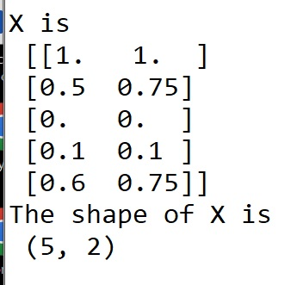
X and y
Set “y” to be the label.
Set X to be the 2D dataset.
DF = pd.read_csv(datafile)
print(DF)
## Set y to the label. Check the shape!
y = np.array(DF.iloc[:,2]).T
#y = np.array([y]).T
print("y is\n", y)
print(y.shape)
y is
[1 1 0 0 1]
The shape of y is
(5,)
##Place the data (and not the labels) in DF
DF=DF.iloc[:, [0, 1]]
print(DF)
X = np.array(DF)
print("X is\n", X)
print(X.shape)

Slide 57
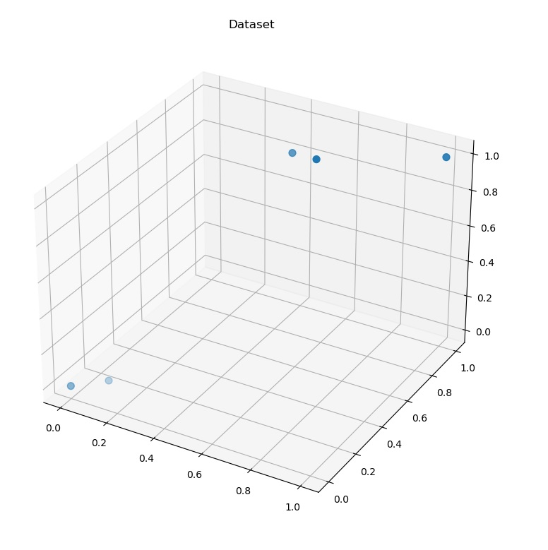
Set LR and n, Create a Plot

Slide 58
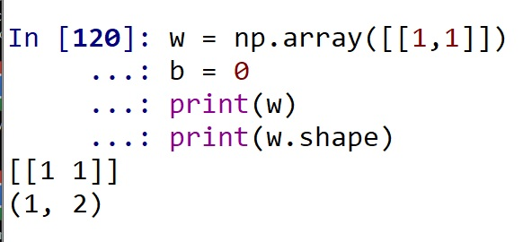
Set Up Initial weights w and parameter b
w = np.array([[1,1]])
b = 0
print(w)

Slide 59
Creating z = wTx + b
print("X is\n",X)
print("The shape of X is\n", X.shape)
print("w is\n",w)
print("w tranpose is\n", w.T)
print("The shape of w transpose is\n", w.T.shape)
z = (X @ w.T) + b #The “@” is matrix mult
print("z = (X @ w.T) + b\n", z)
print("The shape of z is\n", z.shape)
Now – go back in these slides to see if this matches the z we got by hand....

Slide 60
Using w as [1 1] and b as 0 then z is:
(1)(1) + (1)(1) + 0 = 2
.5(1) + .75(1) + 0 = 1.25
0(1) + 0(1) + 0 = 0
.1(1) + .1(1) + 0 = .2
.6(1) + .75(1) + 0 = 1.35

Slide 61
Taking the Sigmoid of z S(z) = 1/(1 + e^-z)
## Next, apply the sigmoid function to all the z value results.
## Let's create a function for sig
def Sigmoid(s, deriv=False):
if (deriv == True):
return s * (1 - s)
return 1/(1 + np.exp(-s))
## TEST YOUR FUNCTION!
print(Sigmoid(2)) ## answer should be .88079
## OK - it works and so now we can create S_z by applying
## the sigmoid to all the values in z
S_z = Sigmoid(z)
print("S(z) is\n", S_z)
The next slide shows the S(z) we got by hand...

Slide 62
Now, to get y^ we need S(z)
y^ = S(z) = 1 / 1 + e^-z
S(z)
1 / 1 + e^-2
1 / 1 + e^-1.25
1 / 1 + e^-0
1 / 1 + e^-.2
1 / 1 + e^-1.35
y^ = S(z)
.88
.78
.5
.55
.79

Slide 63
OK – now what?
So far we have read in the data. Even if the data is larger or more complicated, we can update our code to deal with that.
We made sure to separate X from y and to note shapes, sizes, and types.
Next, we set many initial parameters like w, b, LR, and n.
We created and a Sigmoid function which we can use and/or update once we start to use NN and different activations (more on this soon).
We created z = XwT + b and we confirmed it was correct. We also calculated S(z) using our Sigmoid function.
NEXT – we need to create the Loss function and we need to calculate the loss.
THEN – we need to UPDATE w and b and repeat.

Slide 64
## What is our Loss function?
## How do we calculate the error
##
## Recall that our Loss function is
## the LCE - Loss Categorical Entropy function
## for binary (0 and 1) labels.
## LCE = -1/n SUM ylog(y^) + (1 - y)log(1 - y^)
## where y^ is the predicted value
## and the log is log base 2. The "y" is the label, which here is 0 or 1.
## The "n" is the number of rows in the dataset.
##---------------------------------------------------
## Now - think about what we are doing
## We want to minimize the LCE by updating w and b using gradient descent
##--------------------------------------------------------------------------
## Our LR (learning rate) was set above and can be tuned.
## The epochs are the number of iterations we want to go through
## to recalculate w and b with the goal of optimization (minimization of LCE)

Slide 65
Epochs and Shapes
The epochs are the number of iterations where an iteration can be single, batch, or the entire dataset. (More on that later).
We also want to make sure that we double check the shape of y.
Recall the LCE:
LCE = -1/n SUM ylog(y^) + (1 - y)log(1 - y^)
For this to work, y and y_hat will need to be the same shape!

Slide 66
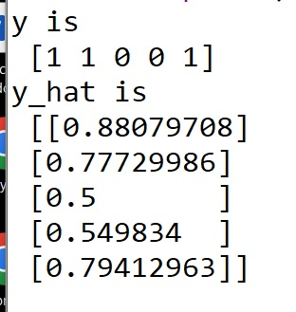
Checking y and y_hat
##Note that S_z here is the same as y^
## It is the output of the logistic regression
y_hat = S_z
print("y is\n",y)
print("y_hat is\n", y_hat)
## !! Shapes Not RIght Yet!

Slide 67
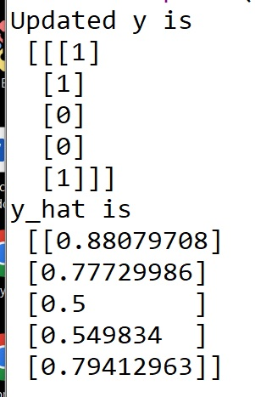
Change the shape of y
y = np.transpose([y])
print("Updated y is\n",y)
print("y_hat is\n",y_hat)
Now y and y_hat are the same shape and we can calculate the LCE.

Slide 68
Creating the for loop – step 1
Now we need to do several things.
1) Create an empty list where we can store the Loss values (the error) as we calculate the LCE, update w and b, and recalculate.
AllError_LCE=[]
2) Set the epochs
epochs = 200 # or whatever you like

Slide 69
Creating the for loop – step 2

Slide 70
Creating the for loop – step 3

Slide 71
Creating the for loop – step 4
The next two slides will show that by-hand is the same as the Python results

Slide 72
Update for w (without the LR yet – so LR=1)
To get the update for w:
y^ is
.88
.78
.5
.55
.79
y is
1
1
0
0
1
= 1/5 [ (-.12*1 + -.22*.5 + .5*0 + .55* .1 + -.21* .6)
(-.12*1 + -.22*.75 + .5*0 + .55* .1 + -.21* .75) ]
→
1/5 [ -.3 -.39 ]→
[ -.06 -.08] is the update for w

Slide 73
Update for b (without the LR yet)
To get the update for b:
y^ is
.88
.78
.5
.55
.79
y is
1
1
0
0
1
(1/m)(y^ - y) is
-.02
-.044
0.1
0.11
-.04
Options here for b are to take the mean of these values or to sum the values.
We will take the mean:
.02

Slide 74
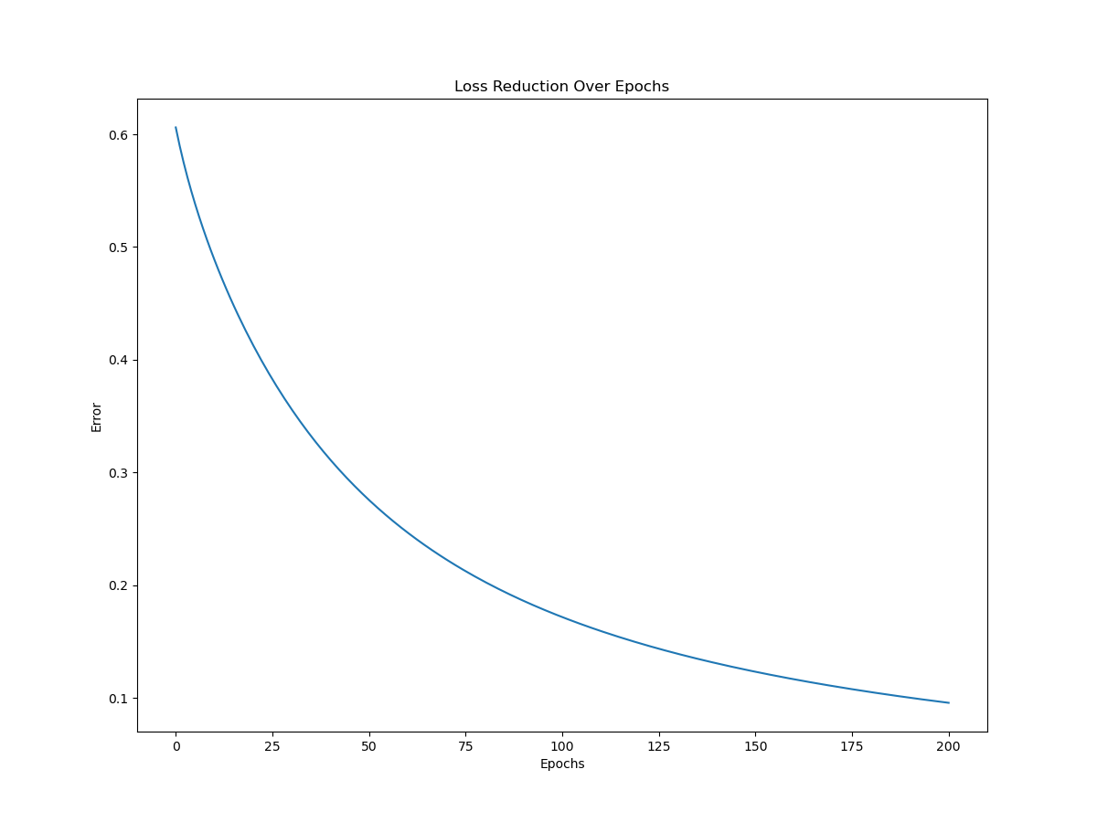
Plot the change in LCE as you update w and b
##Plot the change in Loss over 200 epochs
fig1 = plt.figure()
plt.title("Loss Reduction Over Epochs")
plt.xlabel("Epochs")
plt.ylabel("Error")
ax = plt.axes()
x = np.linspace(0, epochs, epochs)
#start, stop, how many
#print(x.shape)
ax.plot(x, AllError_LCE)
print("The predicted w is \n", w)
print("The predicted b is\n",b)

Slide 75
w and b after 200 epochs
print("The predicted w is \n", w)
print("The predicted b is\n",b)
----------------------------------
The predicted w is
[[3.70889215 4.94388297]]
The predicted b is
-2.5408498883681756
Let’s check (.5, .75)
z = 3.71x1 + 4.94x2 - 2.54
For x1 as .5 and x2 as .75, we have:
z = 3.71(.5) + 4.94(.75) - 2.54
z = 3.02
S(z) = S(3.02) = 1 / (1 + e^-3.02) = .95 → 1
Let’s check (.1, .1)
z = 3.71x1 + 4.94x2 - 2.54
For x1 as .1 and x2 as .1, we have:
z = 3.71(.1) + 4.94(.1) - 2.54
z = -1.675
S(z) = S(-1.675) = 1 / (1 + e^1.675) = .15→ 0

Slide 76
Next, we can test our “model” on another dataset.
What is our model?

Slide 77
Next, we can test our “model” on another dataset.
What is our model?
Our model is defined by two parameters and a threshold.
w Using 200 epochs, our w (rounded) is [3.7 4.9]
b Using 200 epochs, our b (rounded) is -2.5
The equation of our model is z = 3.7x1 + 4.9x2 – 2.5, where
if S(z) >= .5 → 1, else 0. S(z) = 1 / (1 + e^-z)

Slide 78
The Code
The code can be found here:
https://gatesboltonanalytics.com/?page_id=873

Slide 79
Want More Math?
https://rpubs.com/dnuttle/ml-logistic-cost-func_derivative
https://developer.ibm.com/articles/implementing-logistic-regression-from-scratch-in-python/

Slide 80
FYI: Convex vs. Non-Convex Optimization

