Slide 1
K Means Clustering and Intro to EM -Alternating Optimization, -Distance Metrics
Gates

Slide 2
Clustering: Grouping - Categorizing
1) Clustering is “unsupervised”. This means that the data is not labeled or categorized.
2) Clustering is used to “discover” if groups/categories exist and if so – what they are.
3) Clustering can be used to determine if the data in a dataset fits into any type of groups/categories/classes.
4) If categories can be identified, this information then be used to classify or predict other vectors.
5) Clustering reduces dimensionality.
6) Clustering can be used to create labels.
7) Clustering is a special case of alternating optimization/EM via Lloyd’s Algorithm

Slide 3
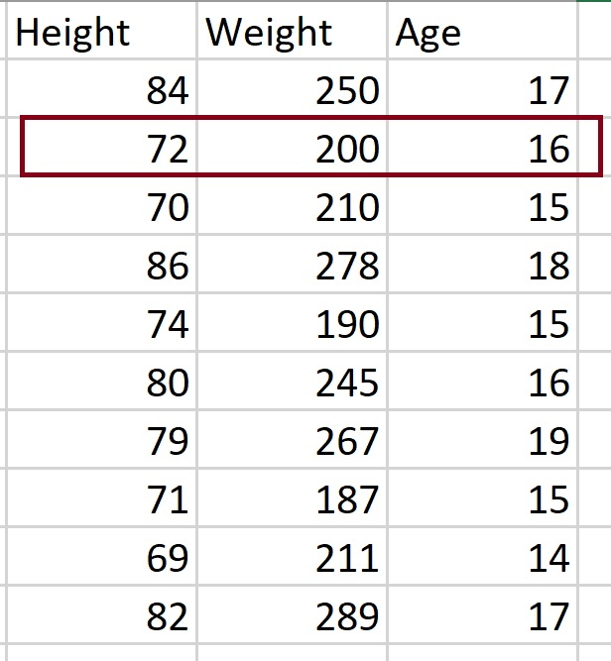
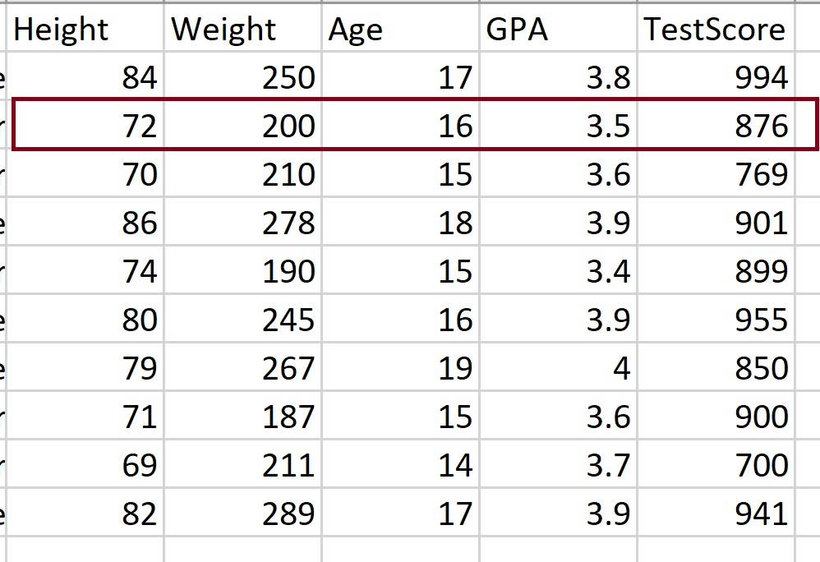
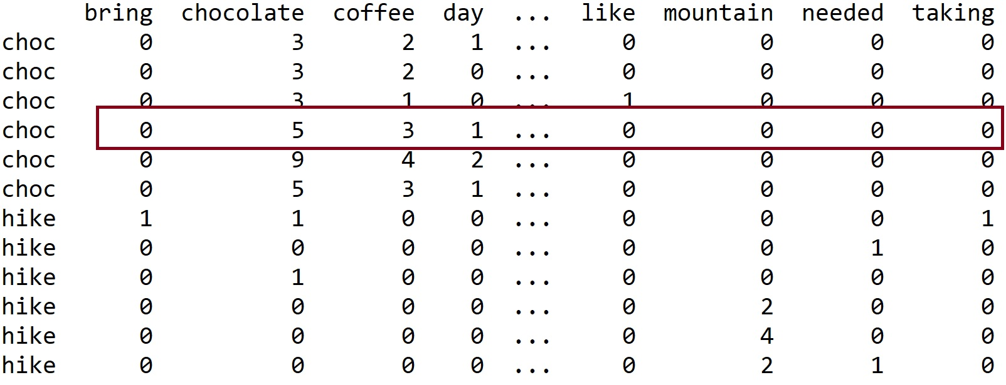
What is a VECTOR (in a dataset)?

Slide 4
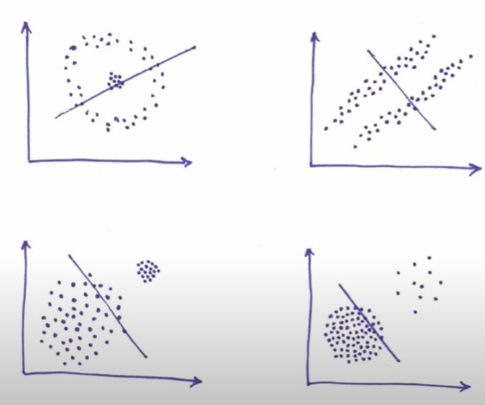
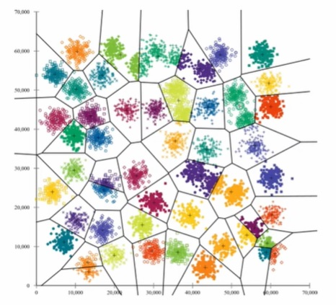
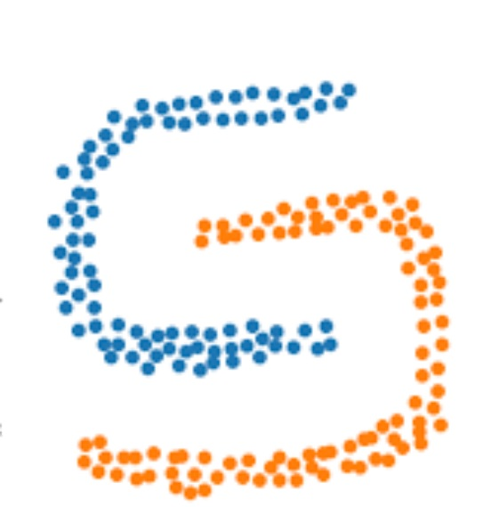
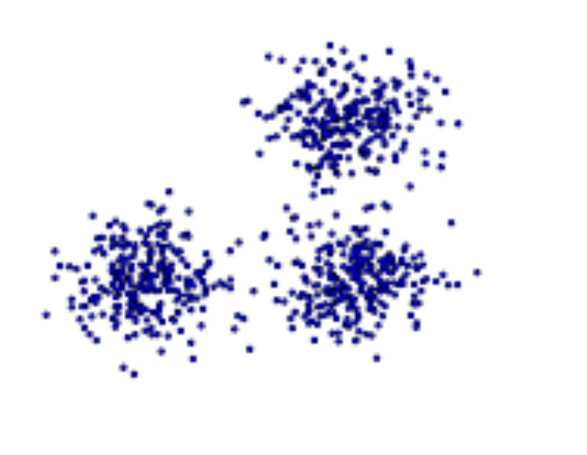

Slide 5
Common Clustering Categories
Partitional Clustering (such as k – means): divides data objects into nonoverlapping groups. No object can be a member of more than one cluster, and every cluster must have at least one object.
Hierarchical Clustering : determines cluster assignments by building a hierarchy. This is implemented by either a bottom-up or a top-down approach. These methods produce a tree-based hierarchy of points called a dendrogram. - Agglomerative or divisive
Density Based Clustering : determines cluster assignments based on the density of data points in a region. This approach doesn’t require the user to specify the number of clusters. Instead, there is a distance-based parameter that acts as a tunable threshold. Example : DBSCAN (Density-Based Spatial Clustering of Applications with Noise)

Slide 6
Applications of clustering
1) There are an enormous number of applications for clustering, as clustering is a method for discovering similarity (and differences) between data vectors/rows.
2) One can cluster books, articles, or documents by topics.
3) Once can cluster customers by common attributes – such as purchase similarities, location similarities, expenditure similarities, etc.
4) One can cluster social data by attributes such as common interests, common career areas, etc.
5) One can cluster radiation data collected from objects is space to determine if they are star, planets, galaxies, etc.
6) One can cluster music into categories – think about this for a second – how do you think Pandora does this?
Clustering can also be used for outlier detection. This is especially true for visual EDA (exploratory data analysis).

Slide 7
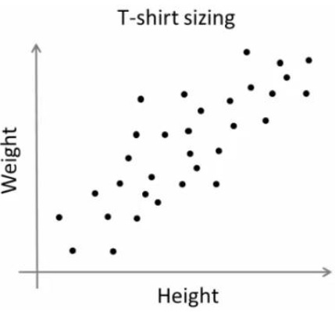
Example: Market Segmentation
Suppose your company makes t-shirts.
T-shirts cannot come in an infinite number of sizes ☺
You, as the owner or manager, will determine how many sizes you want to manufacture (this is your k).
Then, you can collect data (a sample from your buyer population) that includes weight and height. [You will do this likely by gender as well.]
You will then cluster this data using a method like k means to determine the centroid (average height and weight in this case) of each of your clusters.

Slide 8
Example 2: College Admissions
Suppose it is your job to analyze and then suggest methods to improve college admissions.
You have all the admissions data from the past 10 years. Your data is labeled as Admit, Decline, and Waitlist.
You can apply clustering to the data (after you remove the labels) to answer many questions. Here, your first k is 3, but you can also experiment with other k values. Why?
Before performing k means clustering, assume that you assure only quantitate data and you remove and save the labels.
Questions you can explore:
Do your labels match the cluster centroids (using k = 3)?
Which features appear significant?
What is the average GPA of students in each cluster? What are other average scores in each cluster?
etc.

Slide 9
Common Clustering Categories
Partitional Clustering (such as k – means): divides data objects into nonoverlapping groups. No object can be a member of more than one cluster, and every cluster must have at least one object.
Hierarchical Clustering : determines cluster assignments by building a hierarchy. This is implemented by either a bottom-up or a top-down approach. These methods produce a tree-based hierarchy of points called a dendrogram. - Agglomerative or divisive
Density Based Clustering : determines cluster assignments based on the density of data points in a region. This approach doesn’t require the user to specify the number of clusters. Instead, there is a distance-based parameter that acts as a tunable threshold. Example : DBSCAN (Density-Based Spatial Clustering of Applications with Noise)

Slide 10
Clustering Uses a Measure of Distance or Similarity Distance by Hand…Which is “closer” – rows 1 and 2 OR 1 and 3?
Using Manhattan:
Dist(1, 2):
[251 267 70]
[105 103 62]
|(251-105)| + |(267-103)| + |(70-62)| = 318
Dist(1, 3)
[251 267 70]
[156 193 72]
abs(251-156) + abs(267-193) + abs(70-72) = 171

Slide 11
Note: The L3 norm, cubes the differences and so no.
The L1 norm is often called the Manhattan distance as it is based on the idea of “block distance” rather than point to point direct distance.

Slide 13
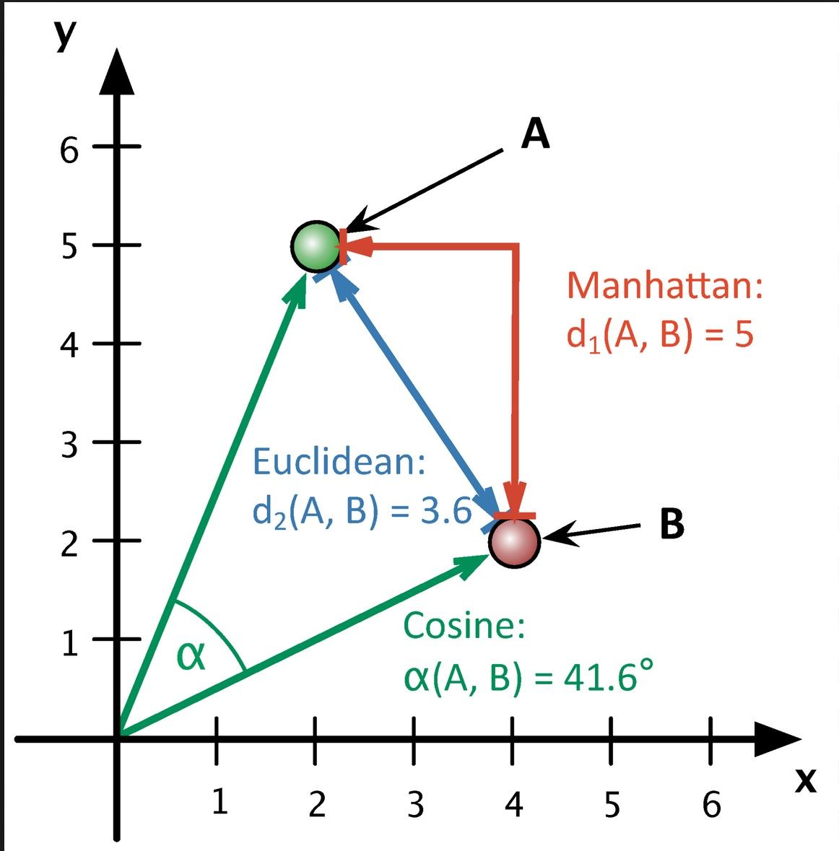
Cosine Similarity is non-Euclidean.

Slide 14
import numpy as np
def cosine_sim(x, y):
x = np.array(x)
y = np.array(y)
if len(x) != len(y) :
return None
dot_product = np.dot(x, y.T)
# Magnitudes of x and y
magnitude_x = np.sqrt(np.sum(x**2))
magnitude_y = np.sqrt(np.sum(y**2))
# Cosine Sim and angle as degrees
cos_sim = dot_product / (magnitude_x * magnitude_y)
angle=np.arccos(cos_sim)
angle=np.degrees(angle)
return cos_sim, angle
CS, Cos_angle=cosine_sim([[251,267,70]], [[105,103,62]])
print(CS)
print(Cos_angle)
Cosine Similarity – by hand – in Python
from sklearn.metrics.pairwise import cosine_similarity
import pandas as pd
DF = pd.read_csv("C:/Users/profa/Desktop/UCB/ML CSCI 5622/Data/HeartRisk_JustNums.csv")
print(cosine_similarity(DF, DF))

Slide 15
Cosine similarity
Good for high D data.
1) Imagine that each row or data vector is a numerical vector.
2) Next, no matter what dimension you are using, the origin is (0, 0, …0)
So in 2D the origin is (0,0) in 3D its (0,0,0) and so on.
3) Next, Any two vector points in any D space create an angle between them.
4) The COS of any angle is defined as the normalized dot product:
(V1 . V2) / |V1| |V2|
Example: Suppose vector 1 (V1) is [1, 3] and suppose vector 2 (V2) is [2,2]
Then, the dot product V1 . V2 = (1*2) + (3*2) = 8
Next, |V1| = sqrt(1^2 + 3^2) = sqrt(10)
|V2| = sqrt(2^2 + 2^2) = sqrt(8)
So COS() = 8 / (sqrt(8)*sqrt(10)) = .894
To solve for the angle, find the arccos (.894) = 26.6 degrees

Slide 16
Non-Euclidean distances
http://infolab.stanford.edu/~ullman/mining/pdf/cs345-cl.pdf

Slide 17
Some fun math: the axioms of a distance measure
1) For any measure D to be a “distance measure” it must meet the following properties:
(a) Given any two vectors x and y, D(x,y) >= 0. In other words, distance cannot be negative.
(b) D(x, y) = 0 iff x = y. In other words, the only way the distance between two vectors is 0 is if they are the same vector.
(c) D(x,y) = D(y,x). Direction does not matter.
(d) D(x, y) <= D(x,z) + D(z,y). This is called the Triangle Inequality.

Slide 18
Partition vs. Hierarchical

Slide 20
1) It is not necessary to choose or preselect the number of clusters.
2) Hierarchical clusterings may correspond well to taxonomies – such as the animal kingdom.

Slide 21
AGNES and DIANA
Hierarchical clustering can be divided into two main types:
Agglomerative clustering: Commonly referred to as AGNES (AGglomerative NESting) works in a bottom-up manner. Each observation (vector or row) is initially considered as a single-element cluster.
At each step of the algorithm, the two clusters that are the most similar are combined into a new bigger cluster. This procedure is iterated until all points are a member of just one single big cluster
Divisive hierarchical clustering: Commonly referred to as DIANA (DIvise ANAlysis) works in a top-down manner.
Begins with the root - all observations (all rows) are in a single cluster. At each step of the algorithm, the current cluster is split into two clusters that are considered most heterogeneous. The process is iterated until all observations are in their own cluster.

Slide 22
Common Clustering Methods (FYI only)
· Maximum or complete linkage clustering: Computes all pairwise dissimilarities between the elements in cluster 1 and the elements in cluster 2, and considers the largest value of these dissimilarities as the distance between the two clusters. It tends to produce more compact clusters.
· Minimum or single linkage clustering: Computes all pairwise dissimilarities between the elements in cluster 1 and the elements in cluster 2, and considers the smallest of these dissimilarities as a linkage criterion. It tends to produce long, “loose” clusters.
· Mean or average linkage clustering: Computes all pairwise dissimilarities between the elements in cluster 1 and the elements in cluster 2, and considers the average of these dissimilarities as the distance between the two clusters. Can vary in the compactness of the clusters it creates.
· Centroid linkage clustering: Computes the dissimilarity between the centroid for cluster 1 (a mean vector of length p, one element for each variable) and the centroid for cluster 2.
· Ward’s minimum variance method: Minimizes the total within-cluster variance. At each step the pair of clusters with the smallest between-cluster distance are merged. Tends to produce more compact clusters.

Slide 23
https://bradleyboehmke.github.io/HOML/hierarchical.html

Slide 25
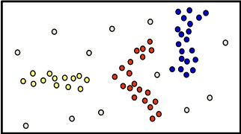
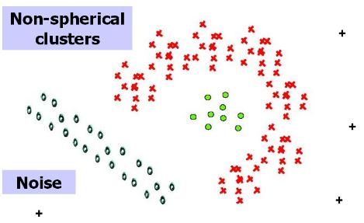
Types of Clusters: Density-Based
Density-based
A cluster is a dense region of points, which is separated by low-density regions, from other regions of high density.
Used when the clusters are irregular or intertwined, and when noise and outliers are present. DBSCAN

Slide 26
Limitation of k-means

Slide 28
Visual Example of k - means
1) Choose k
2) Randomly choose k centroids
3) Place all points into one of the k clusters based on distance.
4) Update the centroids
5) Re-assign points to closest cluster
Repeat steps 4 and 5 for N iterations

Slide 29
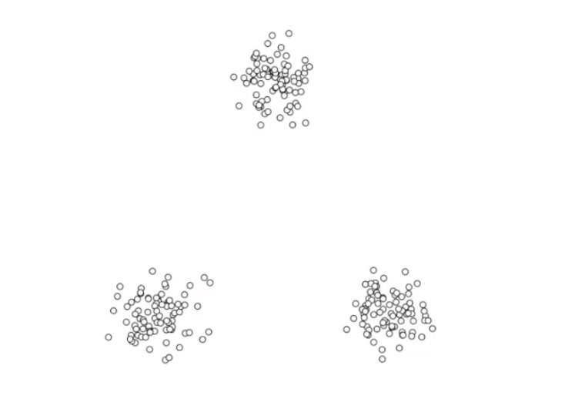
Choose k = 3

Slide 30
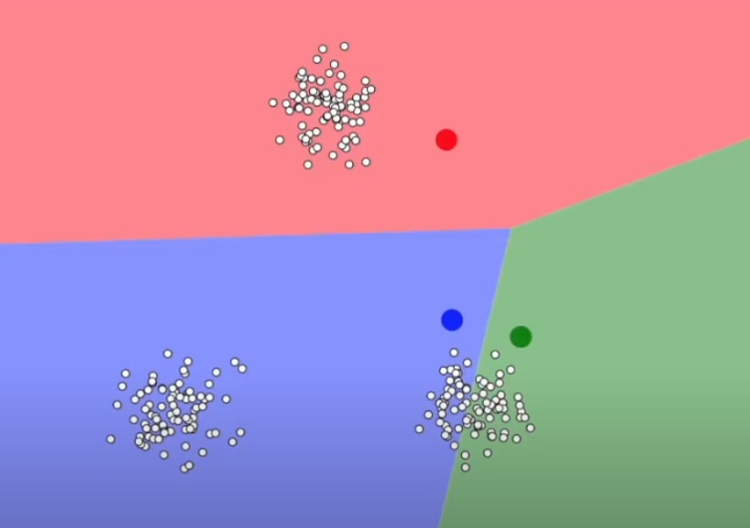
Randomly Choose Initial Centroids

Slide 31
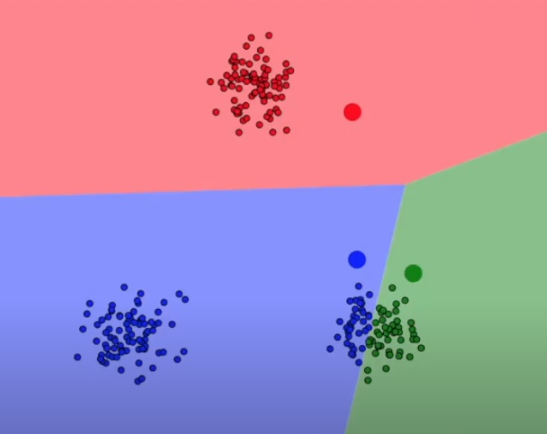
Place Points into Closest Cluster

Slide 32
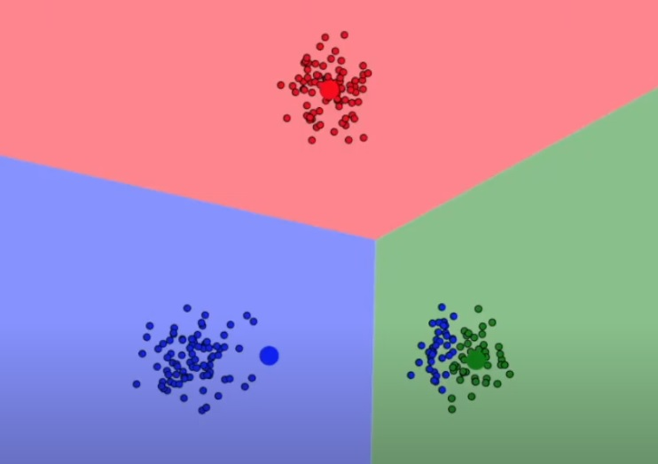
Update Centroids

Slide 33
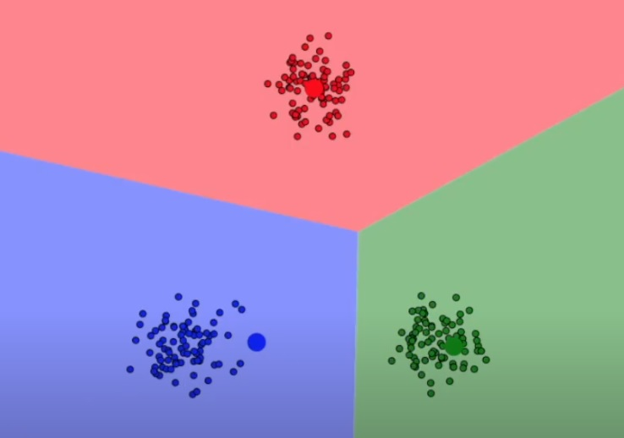
Re- calculate ALL distances from points to centroids and re-assign points to centroids as needed.

Slide 34
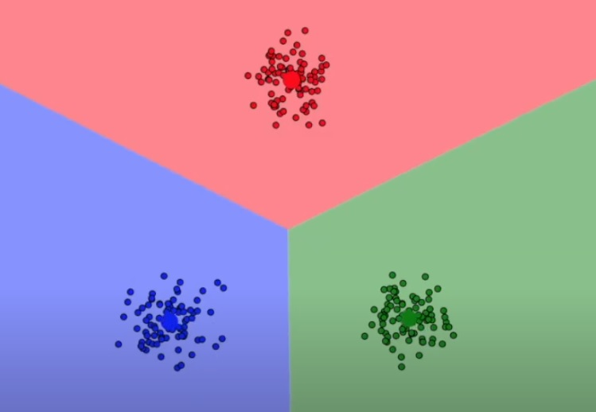
Recalculate Centroids

Slide 36
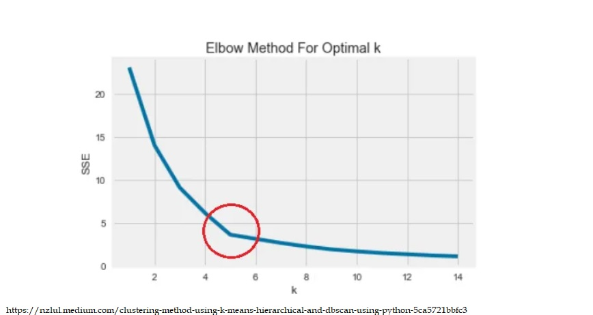
Choosing k: Elbow Method
Elbow Method : There is an “bending” point where the SSE (sum squared error) curve starts to bend known as the elbow point. The x-value of this point is thought to be a reasonable trade-off between error and number of clusters. The elbowpoint is the point where the rate of decrease of mean distance (from points to their centroid) will not change significantly with increase in number of clusters.

Slide 37
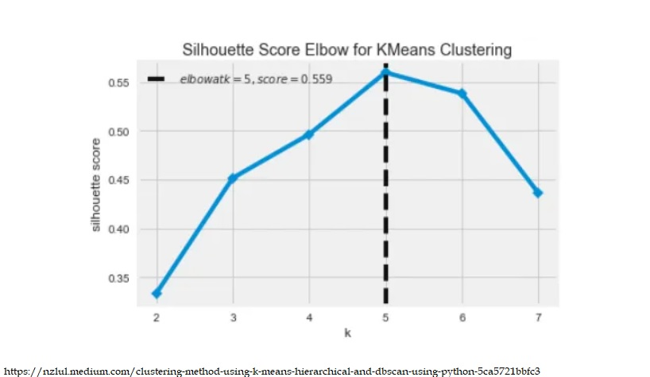
Silhouette Method
Silhouette Coefficient : is a measure of cluster cohesion and separation. It quantifies how well a data point fits into its assigned cluster based on two factors: How close the data point is to other points in the cluster and how far away the data point is from points in other clusters.
Silhouette coefficient values range between -1 and 1. Larger numbers indicate that samples are closer to their clusters than they are to other clusters.

Slide 38
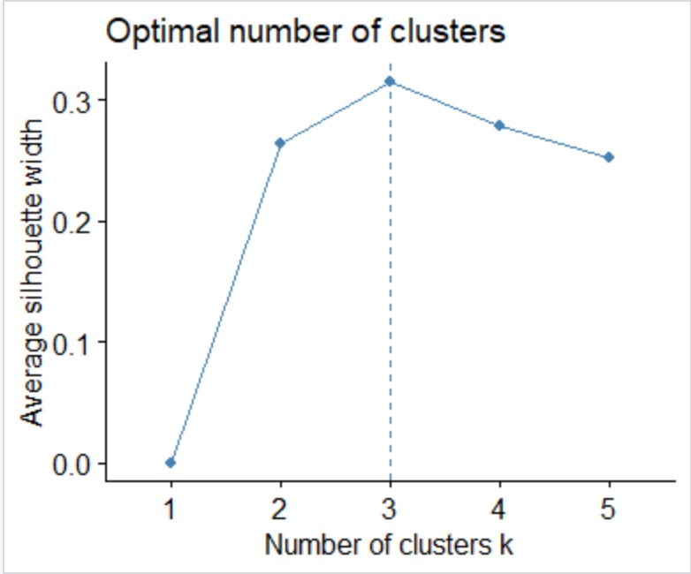
library("factoextra")
(fviz_nbclust(MyDF, kmeans, method='silhouette', k.max=5))

Slide 39
Part 2
The Math and Code Behind K Means

Slide 40
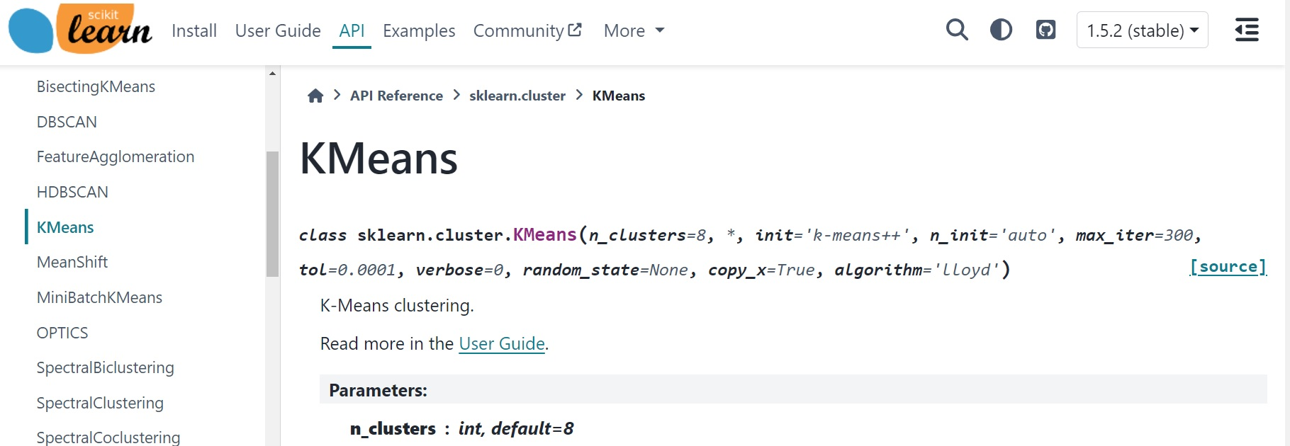
The Code
By Hand – In Python
https://gatesboltonanalytics.com/?page_id=924
Using Sklearn in Python
https://gatesboltonanalytics.com/?page_id=262
and
https://scikit-learn.org/stable/modules/generated/sklearn.cluster.KMeans.html

Slide 41
K Means – the Math and EM
Suppose we have a dataset {x₁, x₂, ...,x_{n}}
We choose k, the number of clusters.
Let µ_{k} be the centroid (mean) of cluster k.
Goal: Assign points to clusters so that the sum of the square distances between points and their closest cluster is minimized.
For each datapoint x_{n}, let r_{nk} in {0,1} be a binary indicator function such that if x_{n} is assigned to µ_{k} then r_{nk} = 1.

Slide 42
What is our Loss (or Objective) Function that we want to Optimize?
Our goal is to find values of µ_{k} and r_{ik} that minimize L.

Slide 43
Steps:
Initialization: Choose µ_{k}
1) E Step: Update r_{ik}
Minimize L wrt r_{ik} while keeping µ_{k} fixed.
To do this, we place points into their closest clusters.
2) M Step: Update µ_{k}
Update L wrt µ_{k} while keeping fixed r_{ik} .
To do this, we recalculate each cluster mean, µ_{k,} based on the points in those clusters.
3) Repeat until convergence. Note that convergence may not be to a global min.

Slide 44
Make sure it makes sense loss-wise

Slide 45
The Math: The best r_{ik}
The E Step:
All data points are considered to be independent.
Therefore, we can choose r_{ik} to be 1 for whichever k gives the minimum value of ||x_{i} - µ_{k} ||². This just means that we can place all the points in their “closest” clusters.

Slide 46
The Math: The best mean
The M Step: Updating µ_{k} with r_{ik} fixed.
Take dL/dr_{ik} = 2 ∑_{n} r_{ik}(x_{i}- µ_{k} )
Set this to 0 and solve.
We get:
Here, the denominator is the number of points assigned to cluster k (because otherwise it is 0).
So in short, this is just the mean (average) of the points in each cluster for all k clusters.
µ_{k} = ∑_{n} r_{ik} x_{i}/ ∑_{n} r_{ik}

Slide 47
In Summary 1) First, choose k. 2) Next, randomly choose points to represent each cluster center.

Slide 48
Repeat Until Convergence
Here, we repeat the EM steps until we converge.
Convergence may not result in a global min.
In words, the two phases are:
E: Reassign points (this updates r_{ik} )
M: Calculate the mean (this updates µ_{k} )

Slide 49
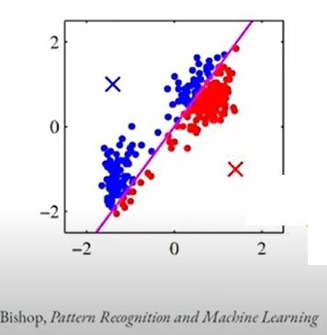
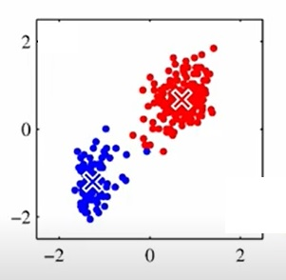
For K-means, The Expectation(E) step is where each data point is assigned to the “nearest” cluster and the Maximization(M) step is where the centroids are recomputed using the mean of the points in that centroid.

Slide 50
Notes
The K means algorithm is generally based on the use of the Euclidean distance and the measure of similarity.
This limits the type of data that can be considered as “it would be inappropriate for cases where some or all of the variables represented categorical labels” (Bishop, 2006)

Slide 51
Part 3:
Mild Introduction to Expectation Maximization for Gaussian Mixture Models

Slide 52
Expectation Maximization (EM)
The Expectation-Maximization algorithm is a very influential and widely used machine learning algorithm.
K-means is special variant of the EM algorithm with the assumption that the clusters are spherical and we use only the mean to determine a cluster centroid (not a standard deviation as well).
EM is a method to find the maximum likelihood estimate of parameters, θ, in a latent variable model.
EM is made up of an “E” step and an “M” step. It starts with random values for the parameters, θ, and then alternates between:
In the E step, the algorithm computes the latent variables - expectation of the log-likelihood using the current parameter estimates.
In the M step, the algorithm determines the parameters that maximize the expected log-likelihood obtained in the E step, and corresponding model parameters are updated based on the estimated latent variables.

Slide 53
Example:
Suppose you are a hiker and are interested in the temperature and humidity distribution during both summer and winter in Colorado.
You ask a friend who lives in CO to gather N temperature and humidity datapoints so you can calculate the mean and variance. You are assuming a gaussian distribution.
BUT, (pretend with me here), your friend gives you the N datapoints *without* telling you whether they were gathered them during summer or winter.
In this case, the season (summer or winter) is now a latent variable.
Next, at this moment, we are missing two bits of information. For any given datapoint, we do not know the season it was gathered in. In addition, we also do not know the mean and variance for each season.
One more note: If we knew which season (summer or winter) each datapoint came from, we could solve this fast. Just take the mean and variance for the points gathered in that season. But we don’t!
Also, if we knew the mean and variance for each season, then we could place all datapoints into the correct gaussian (season) based on which it is closer to. But we don’t.
In cases like these, we use EM.

Slide 54
EM Assumptions and a Random Start
In EM (and in kmeans) - we must know “k”.
In k means, k is the number of clusters (latent variables) we have. In EM, it is the number of distributions (latent) that we have.
In our example, we have k = 2, Summer and Winter.
Next, in EM, we start the algorithm by randomly choosing our parameters and then assigning all points to whichever they are “closest to”. Technically, we need to ML here – but we will come back to that.
In k-means, this was easy because our “parameters” are just the means of our centroids. We can initialize kmeans by randomly choosing our initial centroids (means).
However, suppose we have a Gaussian Mixture instead. This means we have two parameters: mean and variance for each Gaussian. We will still choose them randomly and we will still “assign” all the points to them based on a measure of similarity. However, assigning points in k means only requires a distance metric (like Euclidean distance). Assigning points to gaussians is a little bit more complicated (but not much!)
NOTE: Mahalanobis Distance is used to measure the “distance” between a datapoint and a gaussian distribution.

Slide 55
EM for Gaussian Mixture Models (GMMs)
Note that EM can be applied broadly. GMMs is one example that is useful in explaining how EM works.
To explain EM as applied to GMM, we will need to gain some understanding of GMM, of Maximum Likelihood (ML), and then of EM.

Slide 56
Gaussian Mixture Models
This is a Gaussian mixture distribution. It is a true probability and it sums to 1.
Here, we are looking at GMs in terms of discrete latent variables.
p(z_{k}=1) = π_{k} where z defines a “cluster” – in this case – a Gaussian.
For example, if we have a mixture of 3 Gaussians, then a point x can be a member of a gaussian with probability such that the sum of the probabilities is 1.
_{If zk = 1,}

Slide 57
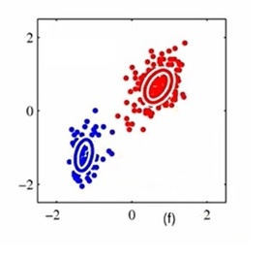
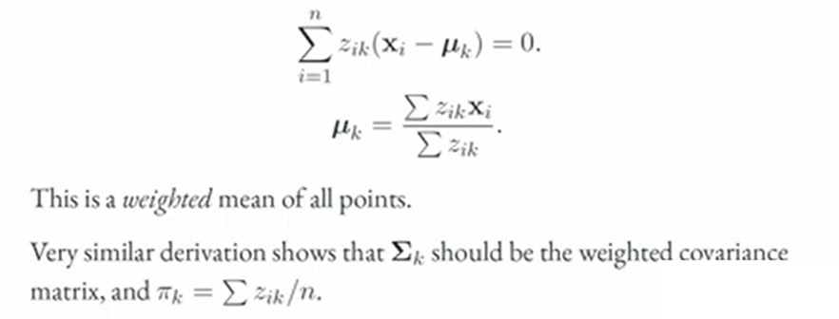

Slide 58
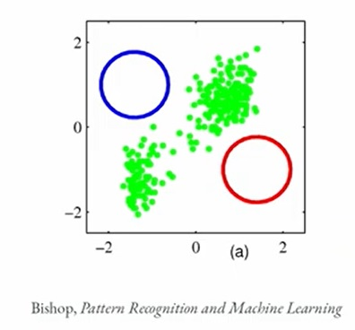
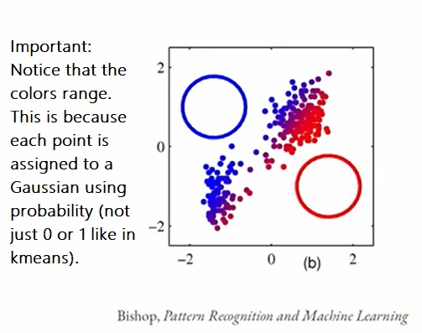
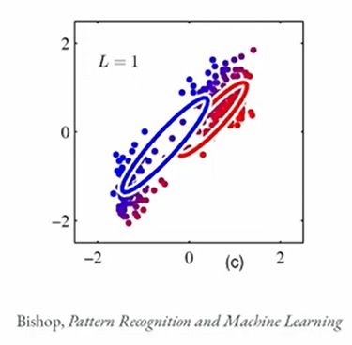
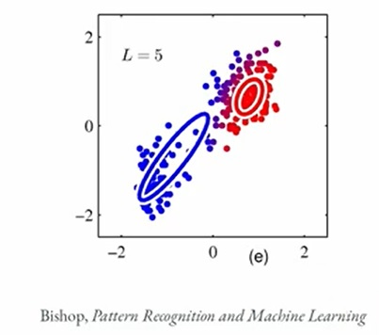
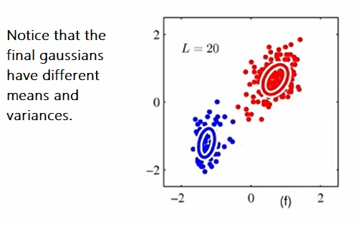

Slide 59
References
Bishop’s Book
https://www.microsoft.com/en-us/research/uploads/prod/2006/01/Bishop-Pattern-Recognition-and-Machine-Learning-2006.pdf

